Slide 1
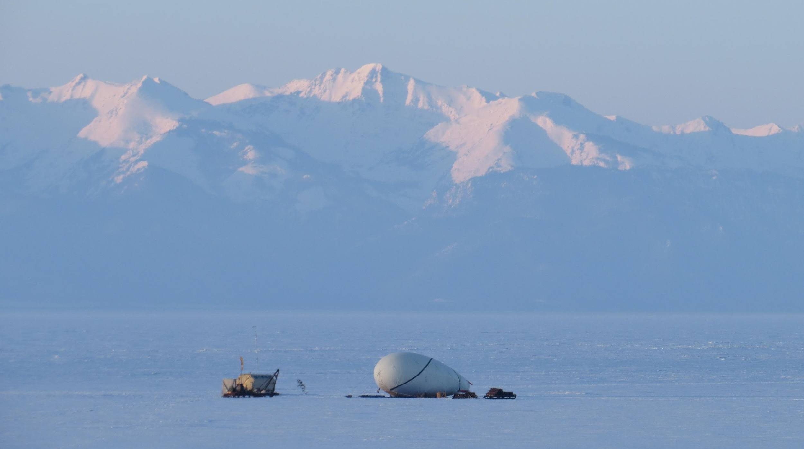
Elaboration of a Model of SPHERE-3 Telescope for the Studies of the PCR in 10¹⁵ - 10¹⁸ eV Energy Range Using Reflected from Snowed Surface And Direct Cherenkov Light from EAS.
Elena Bonvech, Skobeltsyn Institute of Nuclear Physics, Moscow State University, Russia
Dmitry Chernov, Tatiana Roganova, Vladimir Galkin, Maxim Ziva, Vasilisa Latypova, Vladimir Ivanov, Clemance Azra, Elena Entina, Dmitry Podgrudkov. Moscow State University, Russia
ISCRA-2023, 27-29 June 2023

Slide 2
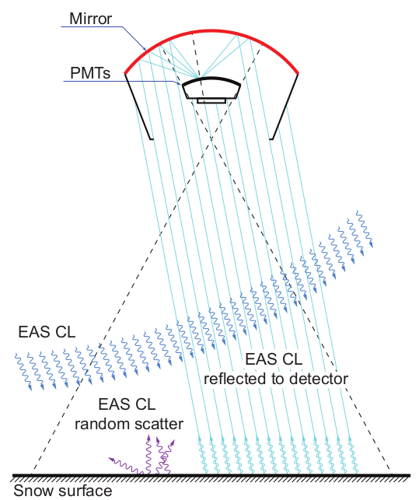
SPHERE Project
Cosmic rays E > 3 PeV.
Detection of reflected Cherenkov light of EAS.
Balloon telescope SPHERE-2: Baikal Lake, 2008-2013. Detector altitude: 300-900 m
Mirror diameter - 1.5 m Retina 109 FEU-84-3 Time digitation 12.5 ns
2011-2013: EAS events: 1040

Slide 3
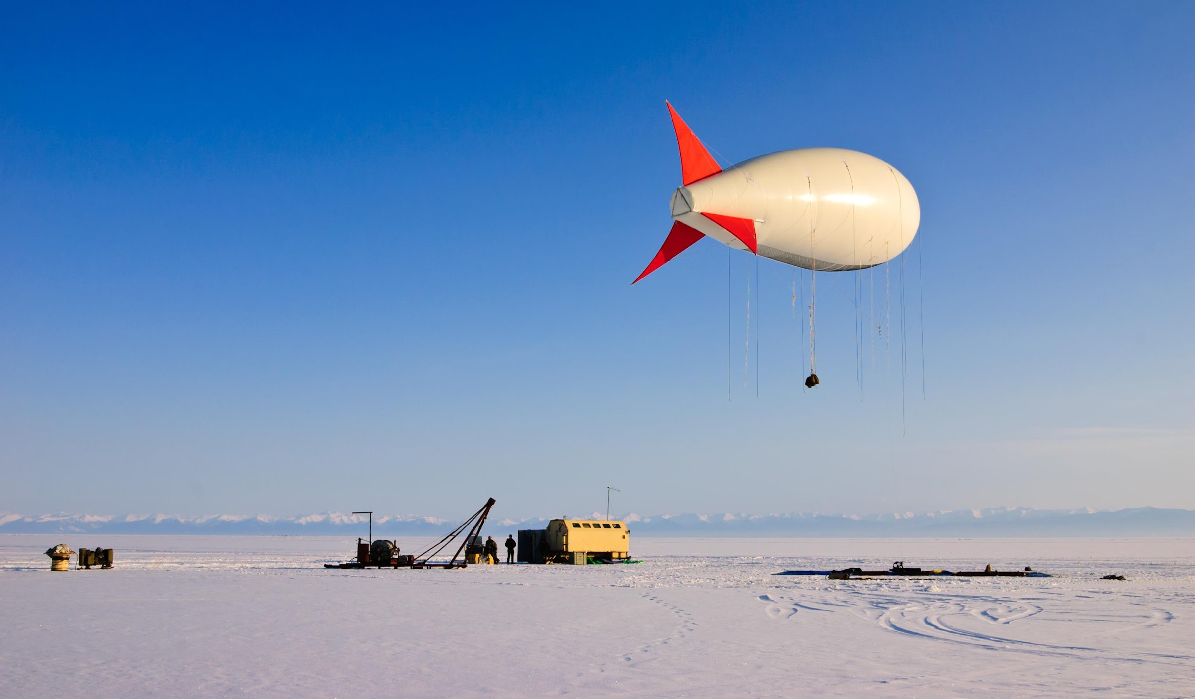
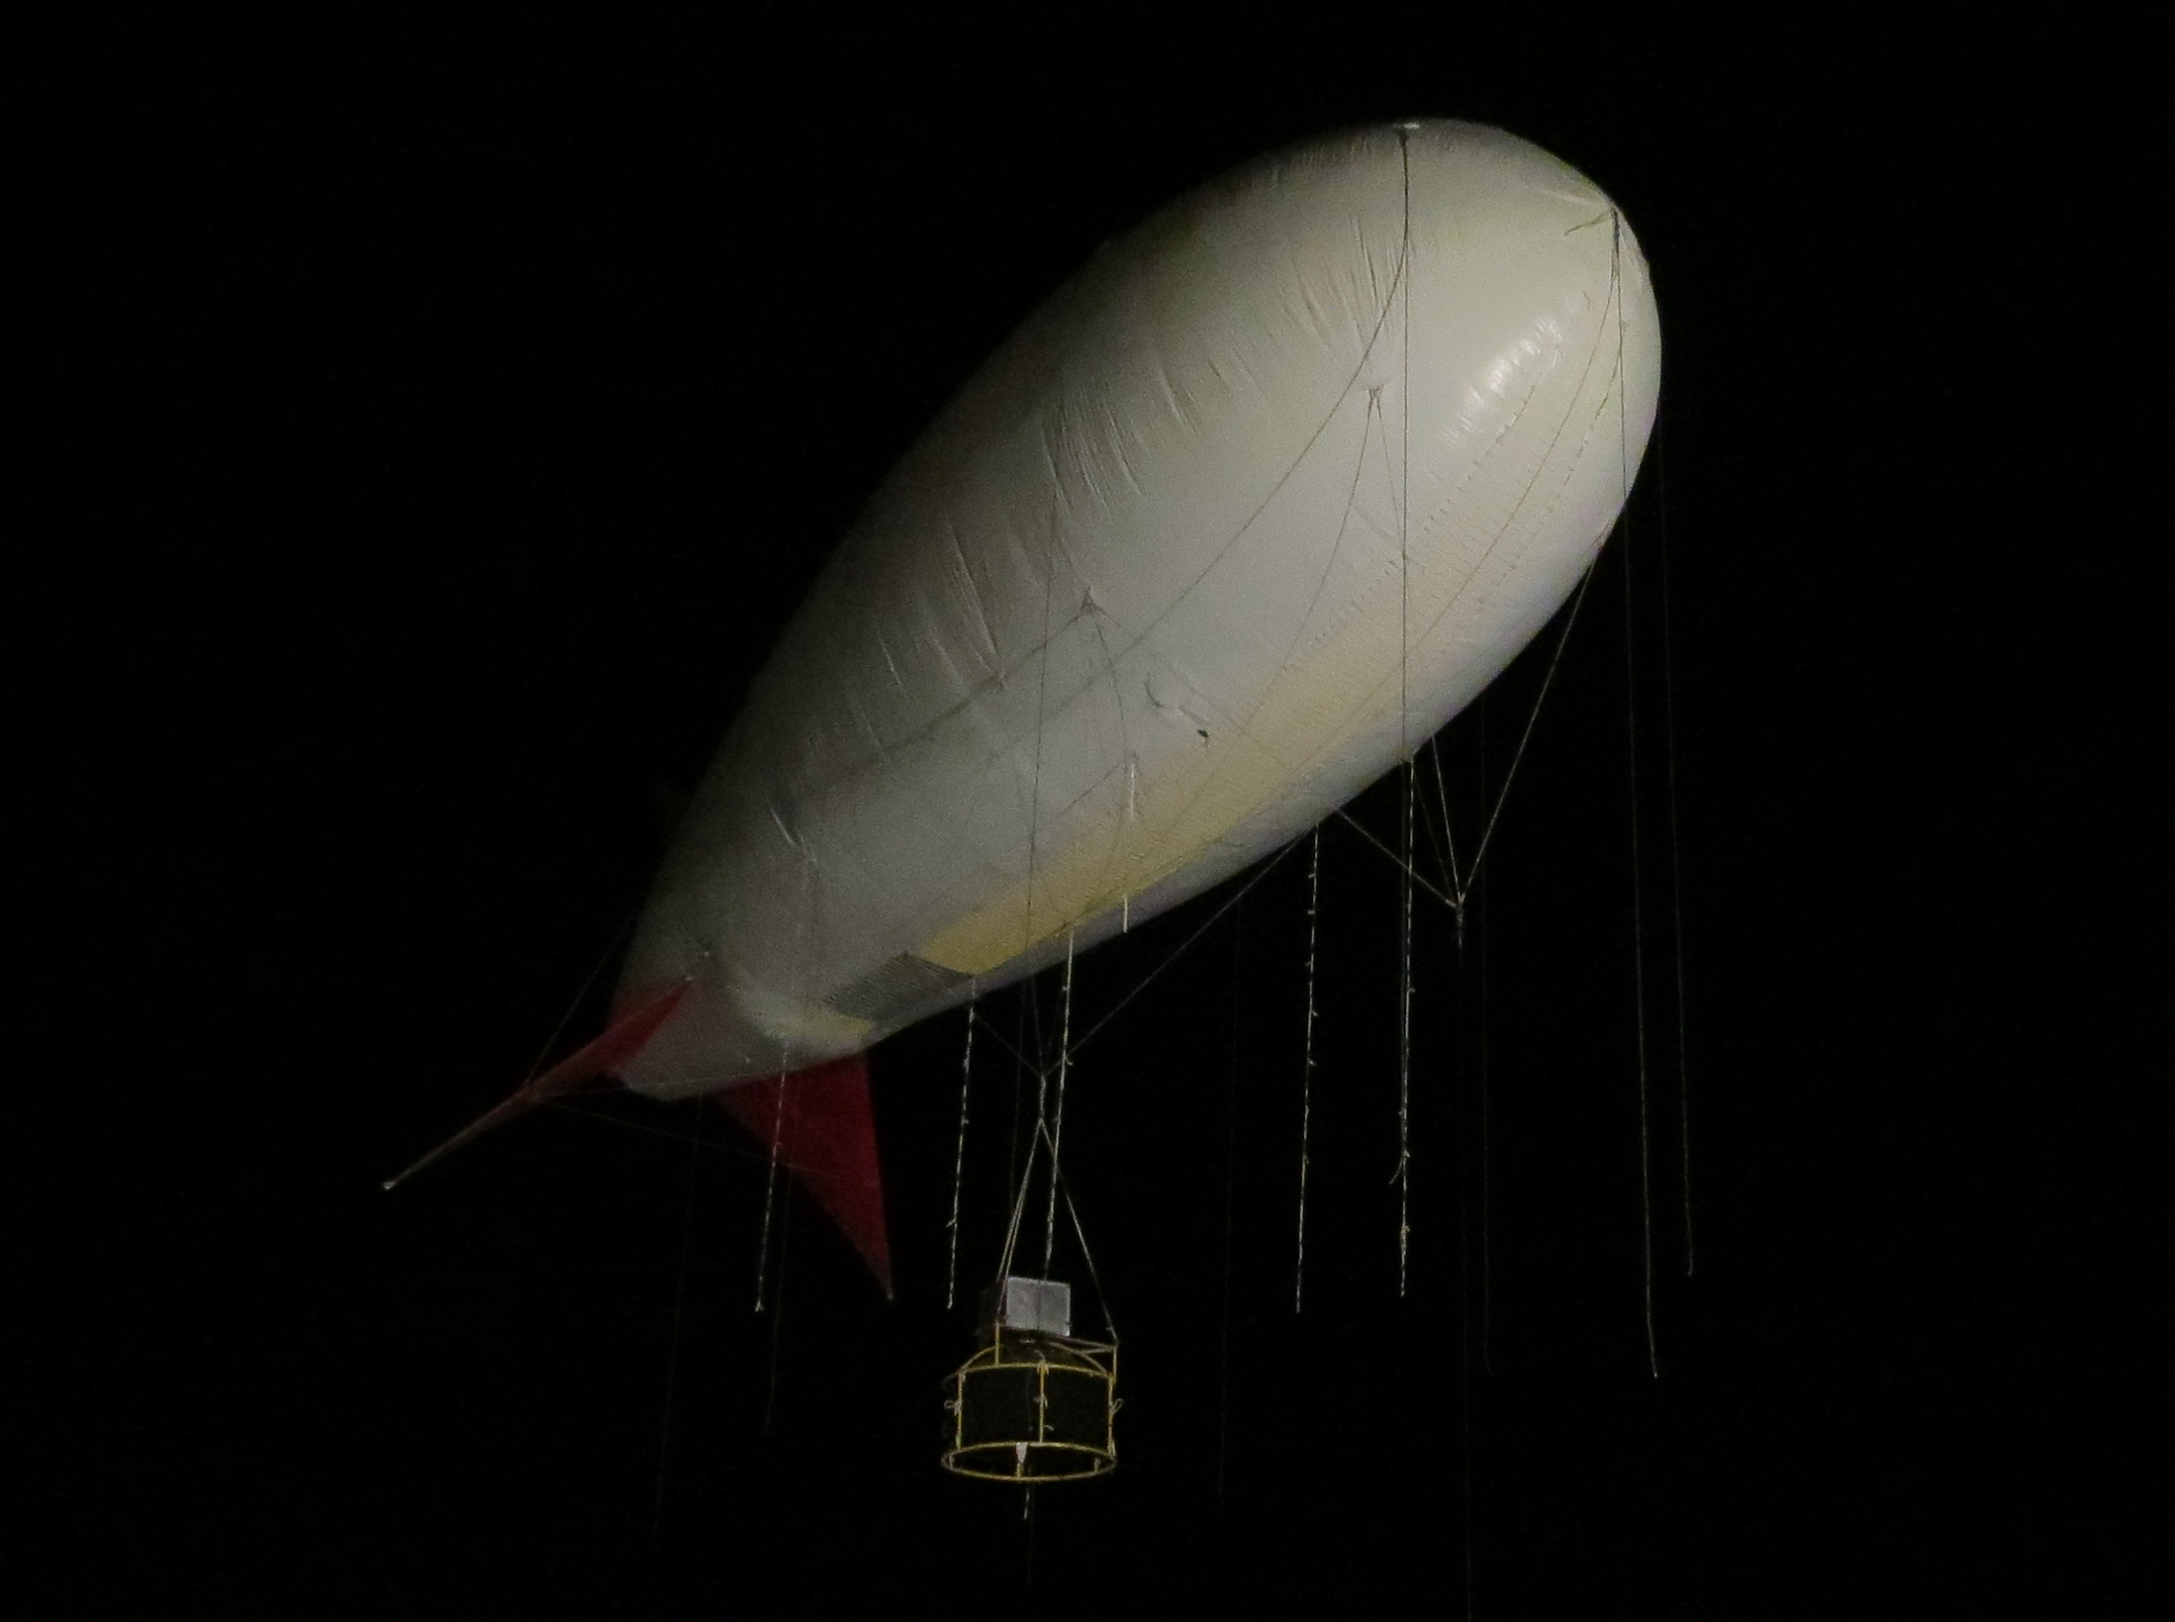
SPHERE-2 launch pad
Night flight
Balloon BAPA
250 m³
SPHERE-2 home box
Internet antenna
Lifting crane
Cargo block
Mission Control Center

Slide 4
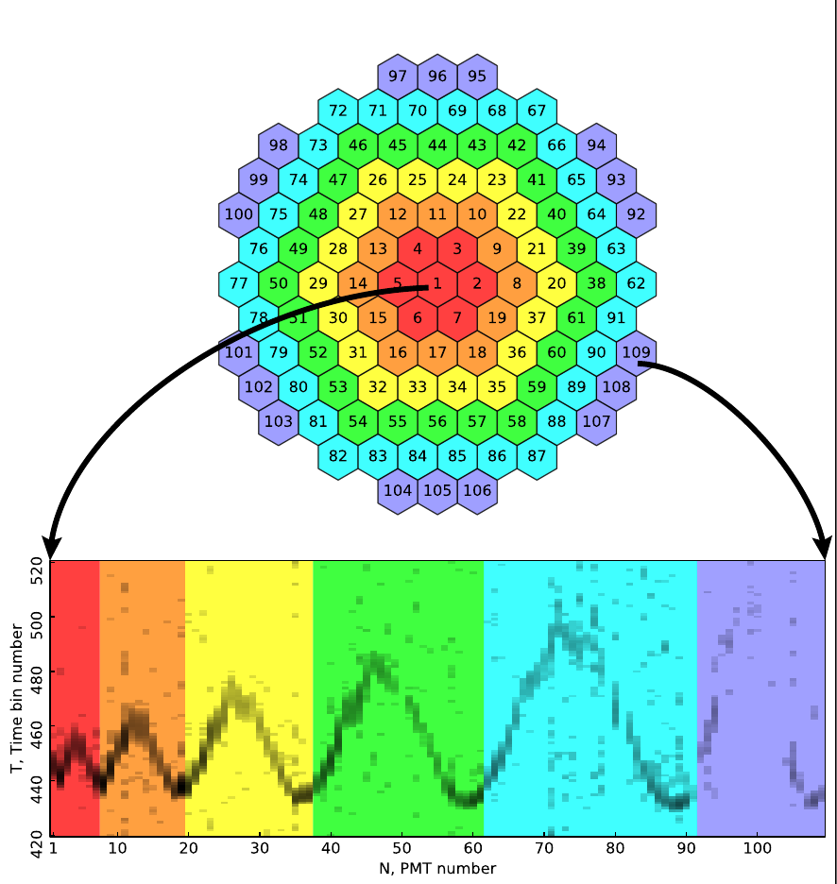
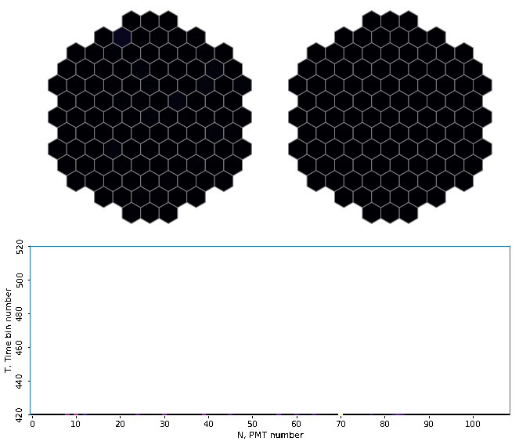
Reflected Cherenkov Light on the retina.
Time step 12.5 ns
Sum image

Slide 5
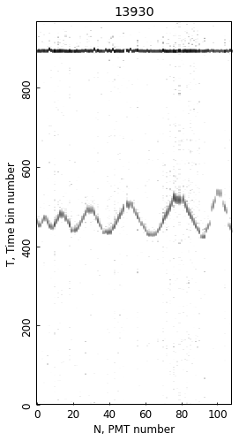
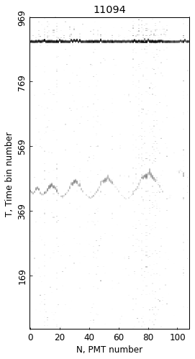
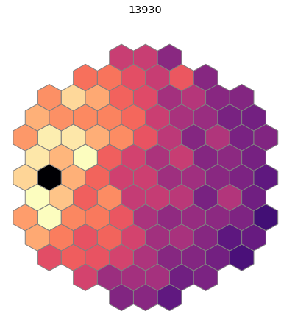
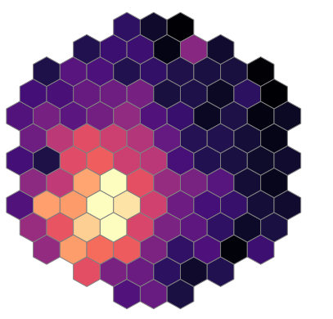
EAS events
H = 607 м
r = 140 м
Ө = 35°
H = 380 м

Slide 6
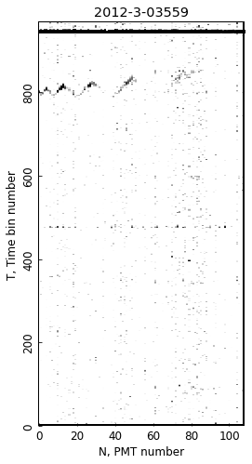
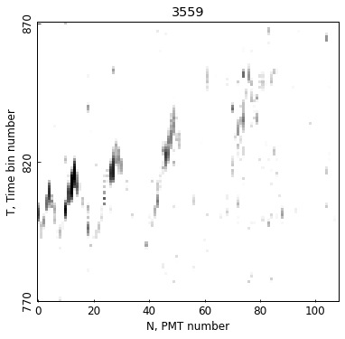
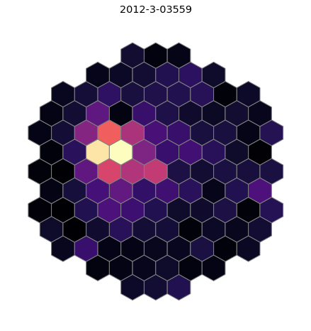
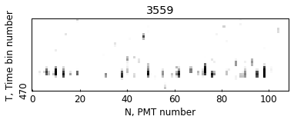
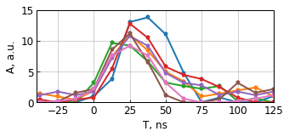
Unusual EAS event
H = 603 m
Ө = 17°
4 mks
1200 m
In trigger region:
pulses of 60-80 ns duration

Slide 7
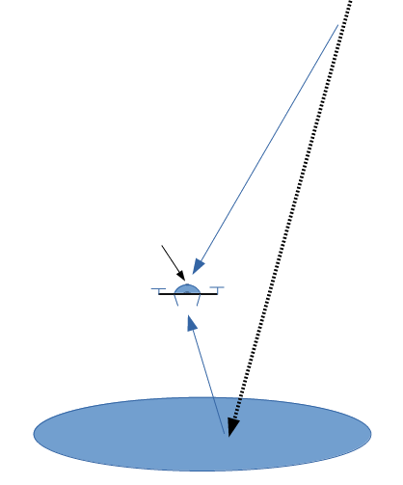
New SPHERE-3 Project
Direct light
Airmobile detector
An unmanned aerial vehicle as a carrier
Large mirror up to 2.5 m in diameter Light sensors: SiPM > 2000
Detection:
Direct Cherenkov light Reflected Cherenkov light
Direct light detector
EAS
axis
Reflected light

Slide 8
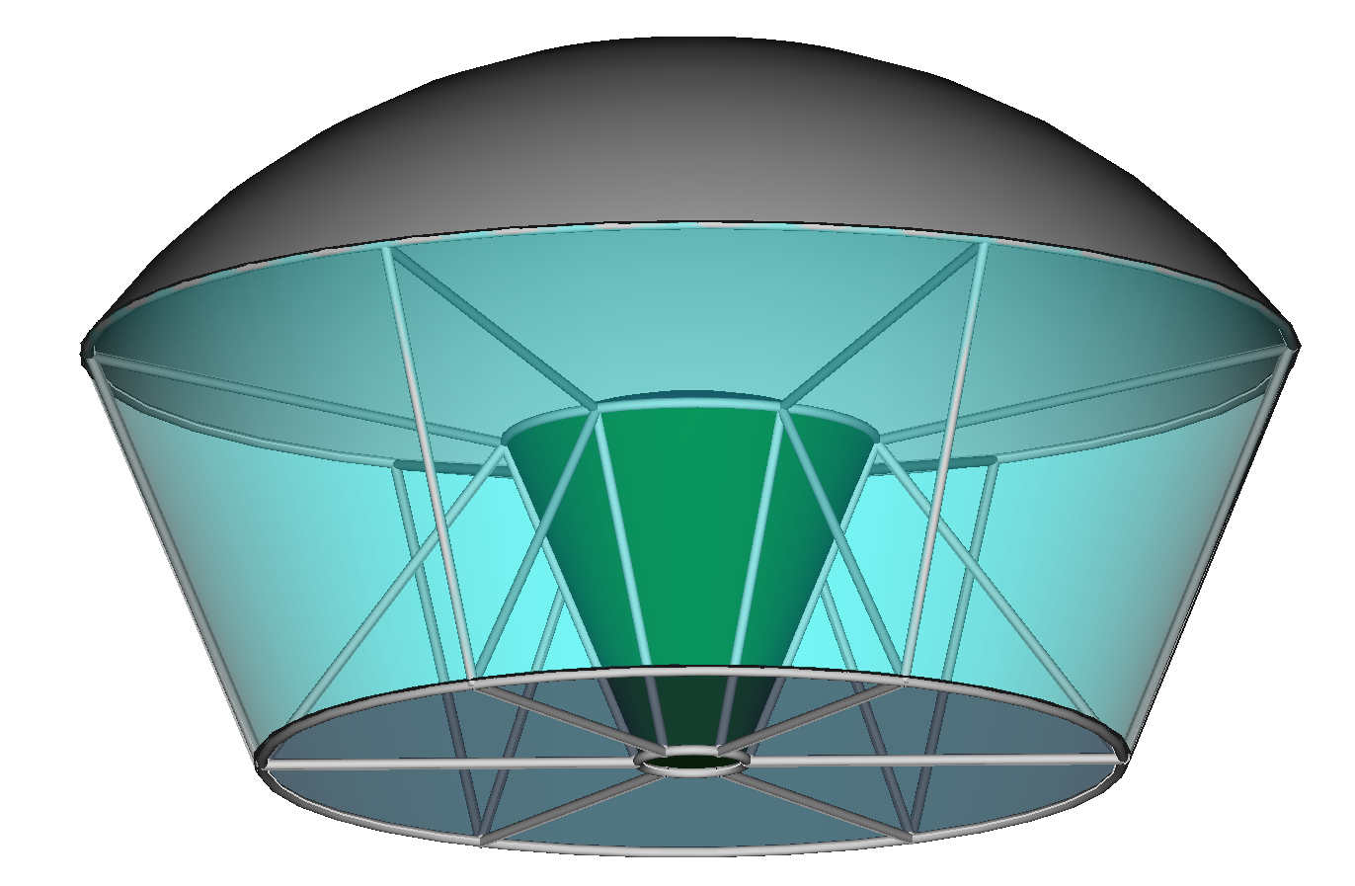
Preliminary version of the SPHERE-3 optical scheme
Direct light collector
to be optimized:
optical scheme
mosaic scheme
electronics
trigger algorithm
off-line processing algorithms
Aspherical mirror ⌀ 2160 mm
SIPM mosaic
⌀ 550 mm
Blend
Measuring equipment
Acrylic aspherical corrector
⌀ 1344 mm
S_{eff} = 1.18 m²

Slide 9
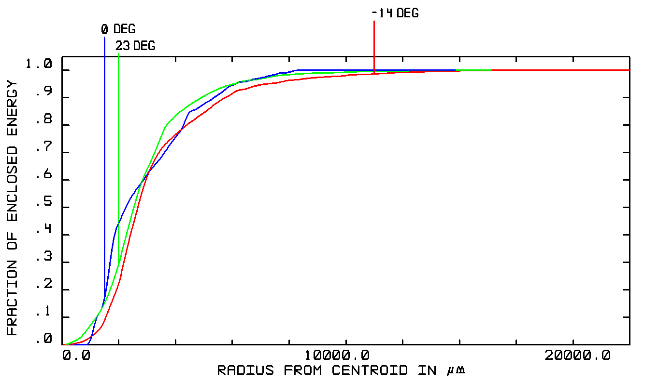
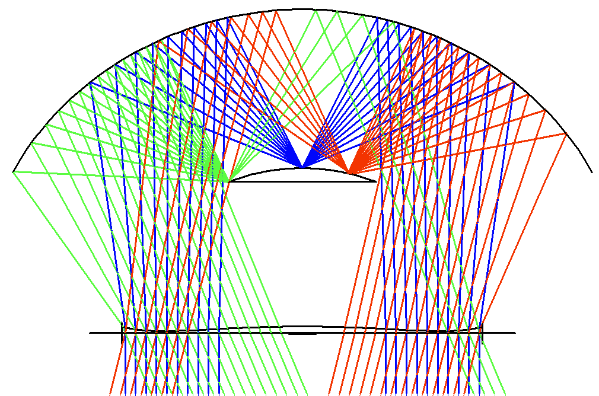
SPHERE-3 mirror model

Slide 10
Reflected and Direct Cherenkov light calculations
Primary: p, He, N, Fe
Еnergy: 1, 3, 10, 30, 100 PeV
Zenith angles: 10°, 15°, 20°
Hadron interaction models: QGSJET01, QGSJETII-04
Atmosphere: 3 models
Detector altitudes: 500m, 1000m, 2000m
Calculations are performed on the Lomonosov-2 supercomputer cluster of the Moscow State University.

Slide 11
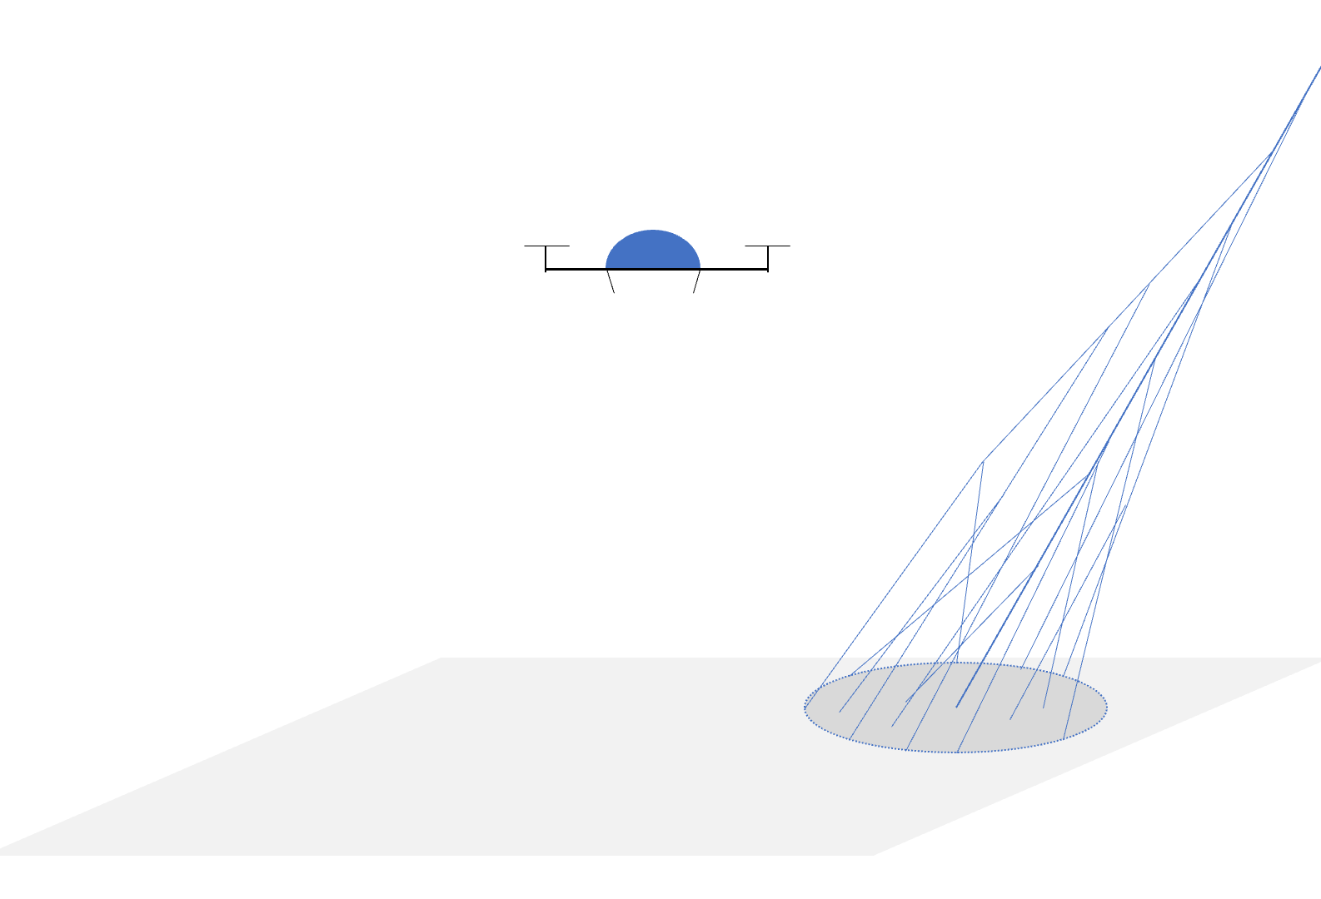
Reflected and Direct Cherenkov light calculations
Primary: p, He, N, Fe
Еnergy: 1, 3, 10, 30, 100 PeV
Zenith angles: 10°, 15°, 20°
Hadron interaction models: QGSJET01, QGSJETII-04
Atmosphere: 3 models
Detector altitudes: 500m, 1000m, 2000m
Calculations are performed on the Lomonosov-2 supercomputer cluster of the Moscow State University.

Slide 12
Calculation pipeline
Reflected Cherenkov Light
Axis * 100
Altitude * 3
2000m
Particle
Energy * 5
Θ Angle * 6
Int. Model * 2
Atmosph * 3
Params
1000m
H = 0m
GEANT4
H=500m
Reflected
Photoelectrons
Detector Optics Retina Images
CORSIKA
0.5 MB
40 MB
Cherenkov Photons
Direct Cherenkov Light
2000m
2000m
1000m
Direct light
Detector
Model
Angular distribution
1000m
One event size
H=500m
H=500m
500 MB
Lateral distribution

Slide 13
Database structure
Hadron interaction model
Energy
Atmosphere Model
Angle
Primary Particle
DataBase
QGSJET01
1 PeV
1
10º
P
QGSJETII04
3 PeV
2
15º
He
10 PeV
3
20º
N
30 PeV
Fe
100 PeV
Data
../P
CORSIKA
CORSIKA OUT
500 m
Ph.el. on snow
1000 m
Mosaic hits
2000 m
Direct CL

Slide 14
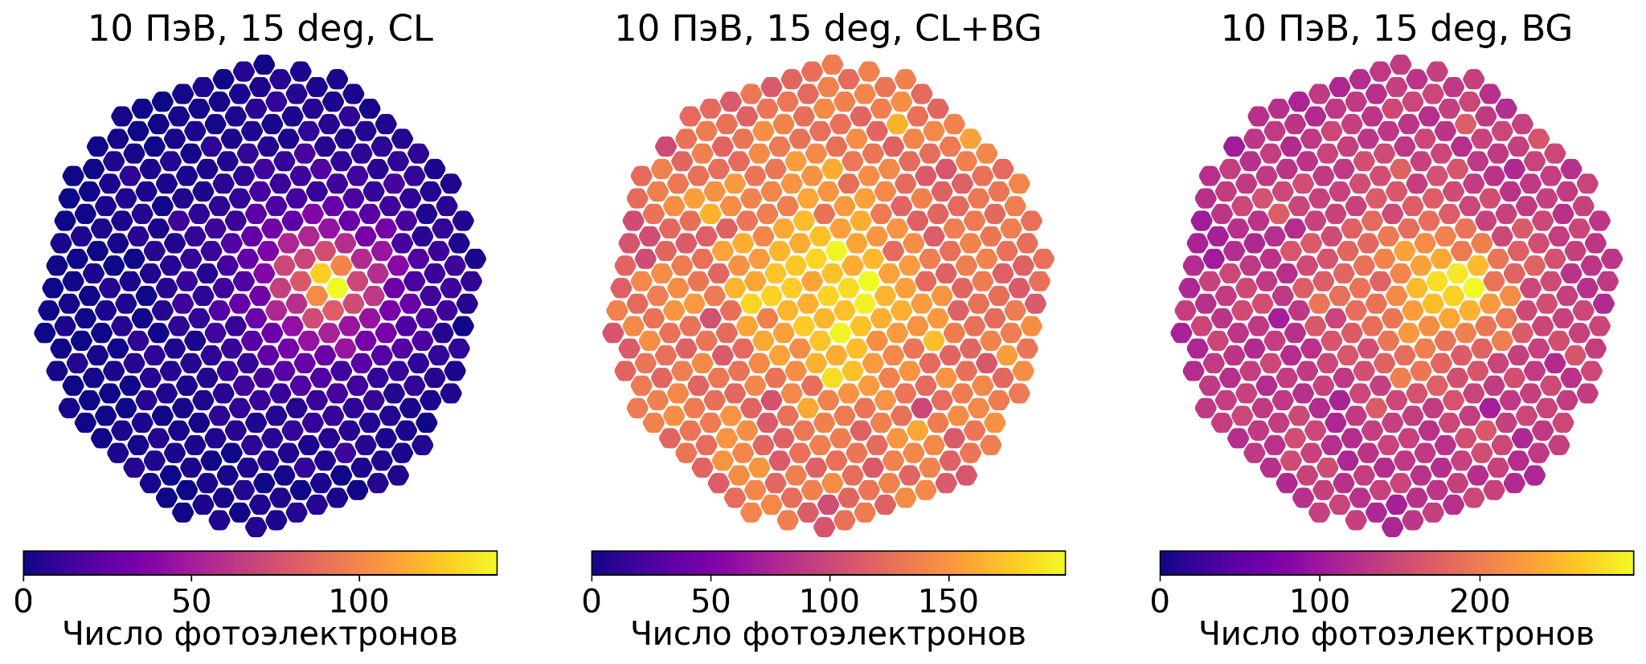
Artificial images of reflected EAS Cherenkov light
10 PeV, 15°
Cherenkov light Background Cherenkov light + Background

Slide 15
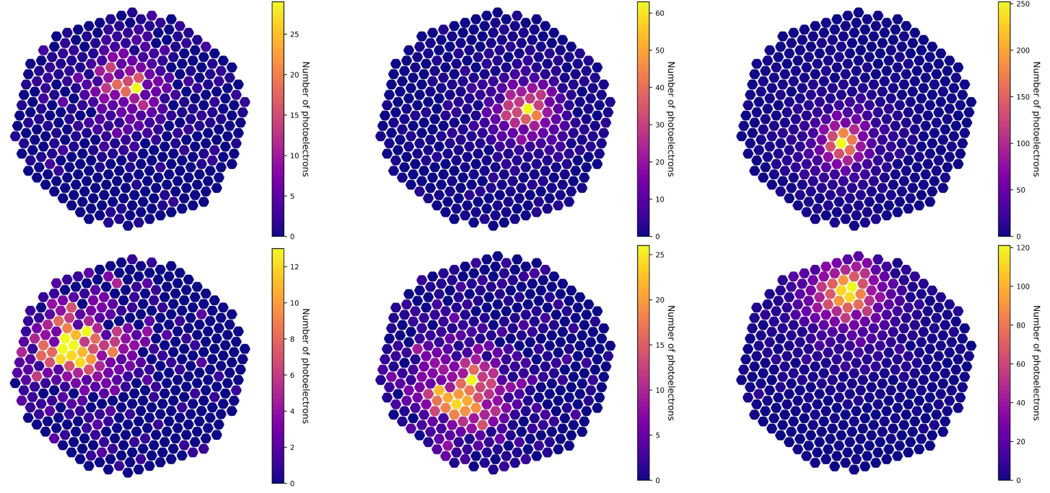
Artificial images of reflected EAS Cherenkov light
5 PeV 10 PeV 30 PeV

Slide 16
Direct Cherenkov light: Integral over the upper field of view
H = 1000 m
H = 2000 m
H = 500 m
Photoelectrons / S = 1 dm²
EAS: Proton 1 PeV, Ө=15°

Slide 17
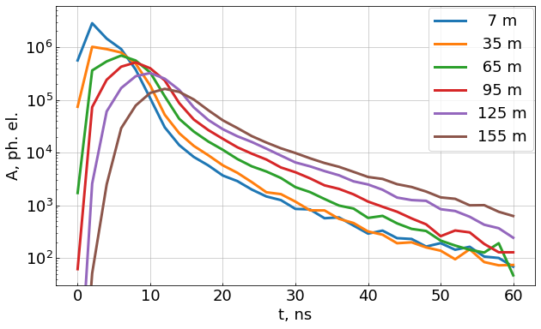
Direct Cherenkov light: Pulses on detector level
Detector:
H = 500 m View angle 50° Х 50° S = 1 dm² dt = 2 ns No electronics
EAS:
Proton 1 PeV, Ө=15°

Slide 18
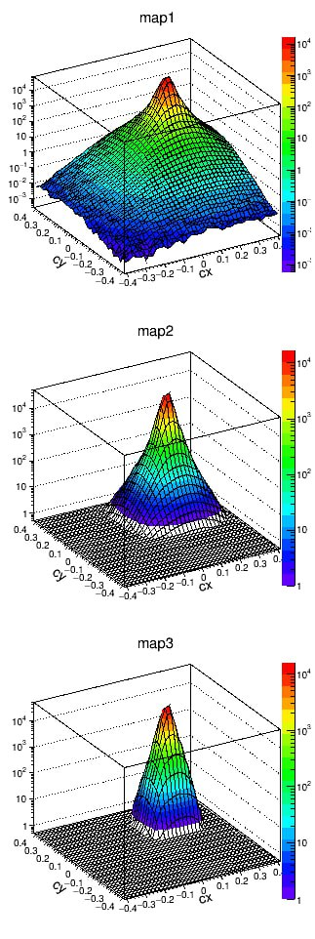
Direct Cherenkov light: Angular distribution
H = 1000 m
R = 100 m H = 500 m
Detector: View: 50 Х 50° Cell: 1° x 1° S = 1 dm² R = 100 m
EAS: Proton 1 PeV, Ө=15°
Ph.el. / 1 dm² / Cell
H = 2000 m

Slide 19
Conclusions
An event with direct and reflected Cherenkov light of EAS was found in the SPHERE-2 data. That was a starting point to use the direct Cherenkov light.
A preliminary version of the SPHERE-3 optical scheme is shown as a basis for further improvement and development of optimized optical schemes that will be combined with various schemes of sensitive mosaics, electronics, trigger algorithm and off-line processing algorithms.
A scheme for calculating artificial images of reflected and direct EAS Cherenkov light on the mosaic of optical sensors of the telescope is presented.
The description of the created database of artificial events of EAS is given.

Slide 20
Thank you for your attention!
The research is carried out at the expense of a grant from the Russian Science Foundation No 23-72-00006, https://rscf.ru/project/23-72-00006
e-mail: bonvech@yandex.ru
ISCRA-2023, 27-29 June 2023

Slide 21
Abstract
Paper contains the first results of our attempts in the development of a model of SPHERE-3 telescope for the primary cosmic ray studies in 1-1000 PeV energy range with reflected and direct Cherenkov light (CL) generated by extensive air showers (EAS).
The aim of the work is to develop an automated method for the design of SPHERE-3 telescope, which, on one hand, will enable it to obtain the best possible estimates of EAS primary parameters and, on the other, will result in a set of rules and recommendations on how to design other detectors of the type.
Handling of samples of CL images according to the available processing codes will give estimates of the uncertainties of the primary parameters, which integrally characterize the quality of measurements with a given version of the telescope and the procedures for their processing. As a result, the optimal version of the telescope will be selected and a general approach to the choice of its design and data processing algorithms will be developed.
A preliminary version of the SPHERE-3 optical scheme is shown as a basis for further improvement and development of optimized optical schemes that will be combined with various schemes of sensitive mosaics, electronics, trigger algorithm and off-line processing algorithms.
The description of the created database of artificial events of EAS with the generation of Cherenkov light for protons, nitrogen and iron nuclei with energies in the range of 1-100 PeV and zenith angles of 5-25 degrees according to two models of interaction and three models of the atmosphere is given.
A scheme for calculating artificial images of reflected and direct EAS Cherenkov light on the mosaic of optical sensors of the telescope is presented.

