Slide 1

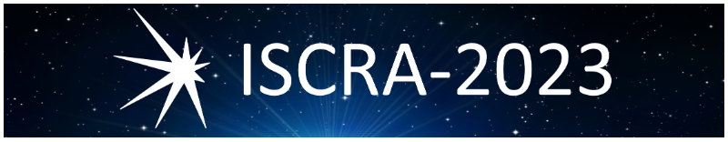
Hadronization as a key to the muon puzzle
National Research Nuclear University MEPhI (Moscow Engineering Physics Institute)
Nikolaenko R. V.
rvnikolaenko@mephi.ru
International Symposium on Cosmic Rays and Astrophysics
27 – 29 June 2023

Slide 2
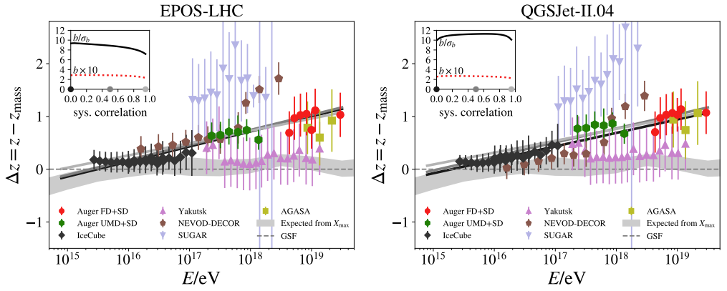
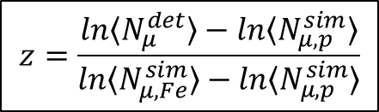
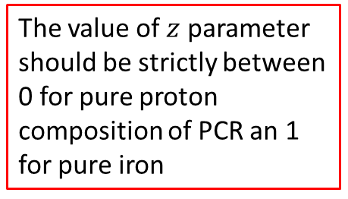
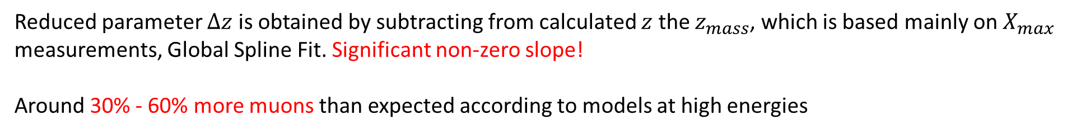
The muon puzzle
arXiv:2105.06148v2 [astro-ph.HE] 4 Apr 2022
$$z=\frac{ln〈N_{μ}^{det}〉−ln〈N_{μ, p}^{sim}〉}{ln〈N_{μ,Fe}^{sim}〉−ln〈N_{μ, p}^{sim}〉}$$
The value of $z$ parameter should be strictly between 0 for pure proton composition of PCR an 1 for pure iron
Reduced parameter $∆z$ is obtained by subtracting from calculated $z$ the $z_{mass}$, which is based mainly on $X_{max}$ measurements, Global Spline Fit. Significant non-zero slope!
Around 30% - 60% more muons than expected according to models at high energies

Slide 3
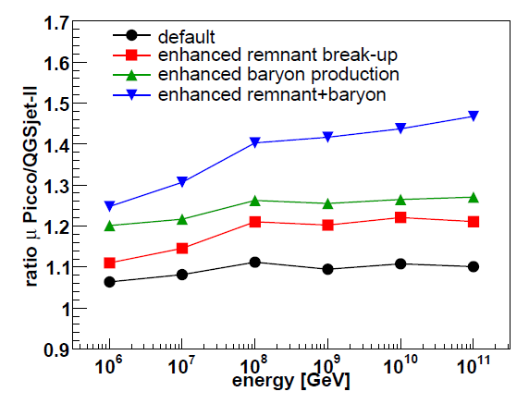
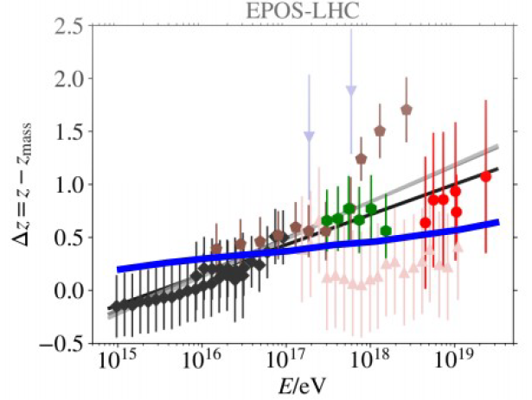
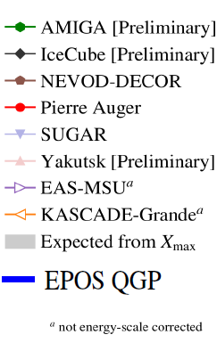
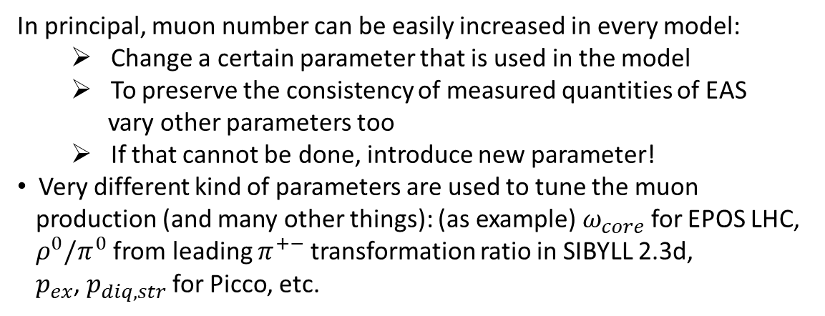
How do you change the number of muons? (1)
In principal, muon number can be easily increased in every model:
  Change a certain parameter that is used in the model
  To preserve the consistency of measured quantities of EAS
  vary other parameters too
  If that cannot be done, introduce new parameter!
  Very different kind of parameters are used to tune the muon
  production (and many other things): (as example) $ω_{core}$ for EPOS LHC,
  $ρ^{0}/π^{0}$ from leading $π^{+−}$ transformation ratio in SIBYLL 2.3d,
  $p_{ex}$, $p_{diq,str}$ for Picco, etc.
T. Pierog
arXiv:0712.1517v1 [hep-ph] 10 Dec 2007
Need to introduce the strong energy dependence for steering parameter!

Slide 4
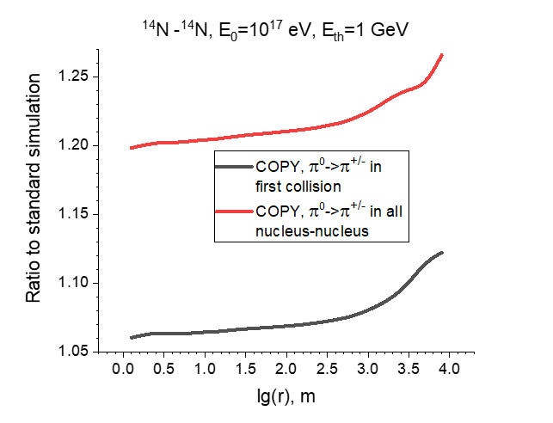

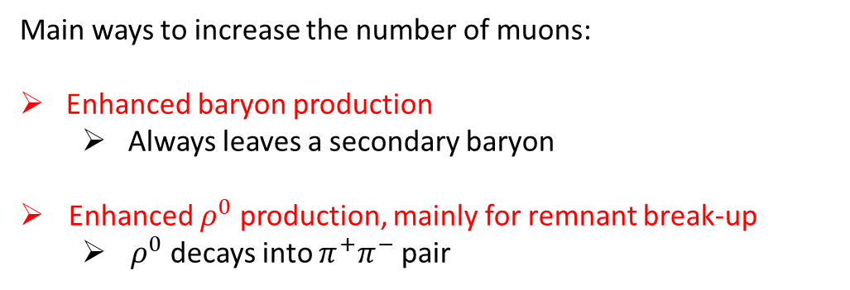

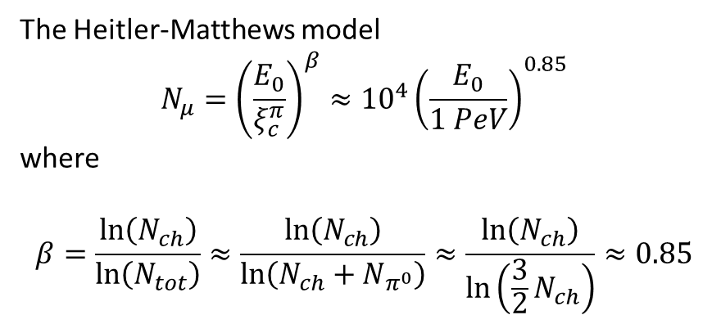


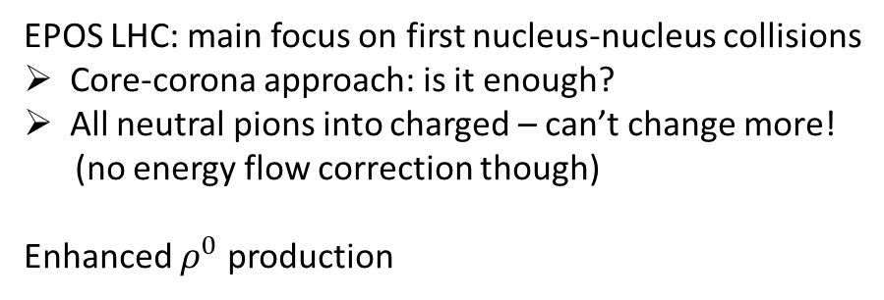


How do you change the number of muons? (2)
The Heitler-Matthews model
$$N_{μ}={\left(\frac{E_{0}}{ξ_{c}^{π}}\right)}^{β}≈{10}^{4}{\left(\frac{E_{0}}{1 PeV}\right)}^{0.85}$$
where
$$β=\frac{\ln\left(N_{ch}\right)}{\ln\left(N_{tot}\right)}≈\frac{\ln\left(N_{ch}\right)}{\ln\left(N_{ch}+N_{π^{0}}\right)}≈\frac{\ln\left(N_{ch}\right)}{\ln\left(\frac{3}{2}N_{ch}\right)}≈0.85$$
Main ways to increase the number of muons:
Enhanced baryon production
  Always leaves a secondary baryon
  Enhanced $ρ^{0}$ production, mainly for remnant break-up
    $ρ^{0}$ decays into $π^{+}π^{−}$ pair
EPOS LHC: main focus on first nucleus-nucleus collisions
Core-corona approach: is it enough?
All neutral pions into charged – can’t change more!
(no energy flow correction though)
Enhanced $ρ^{0}$ production
$$π^{±}+p → π^{0}+X$$
vs
$$π^{±}+p → ρ^{0}+X$$
$$γ+γ$$
$$π^{+}+π^{−}$$
Not that easy in reality: need to suppress
$$π^{±}+p → ρ^{±}+X$$
$$π^{±}+π^{0}$$

Slide 5
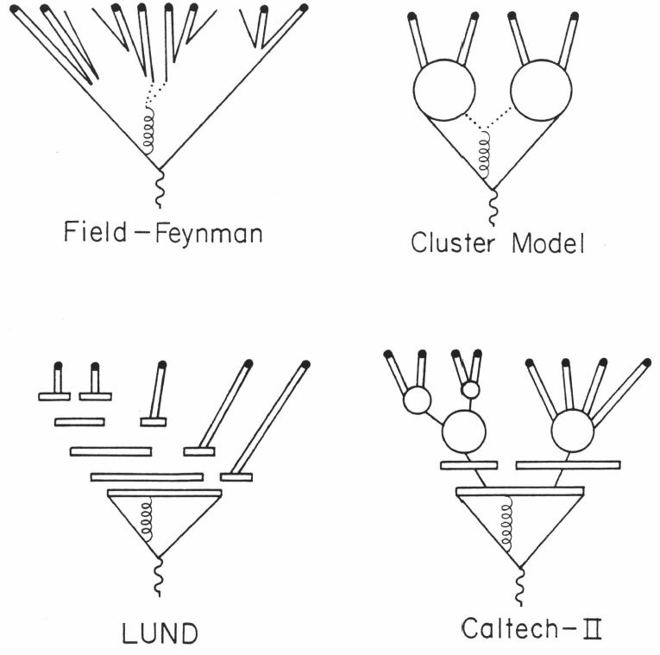
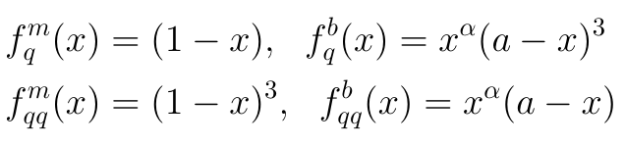
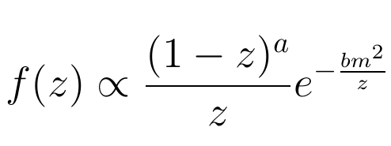
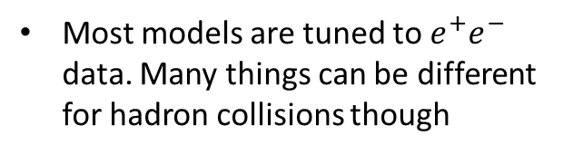
Models of hadronization
It is evident anyway, that the mechanism that is behind the excess of muons in UHECR is to be found in hadronization process. So how do models perform it?
Most models are tuned to $e^{+}e^{−}$ data. Many things can be different for hadron collisions though
Still used in QGSJET-II-04
(in generalized form)
Exact description from VENUS
Used in SIBYLL too!
PYTHIA – the embodiment of Lund Monte-Carlo
Many collective effects are included in PYTHIA 8 – rope fragmentation, junction formation, etc.
Used in NeXus 2.0, EPOS 1.99 and EPOS LHC (corona part)
Area law: the generalized version of decay law
Nambu-Goto Lagrangian formalism

Slide 6
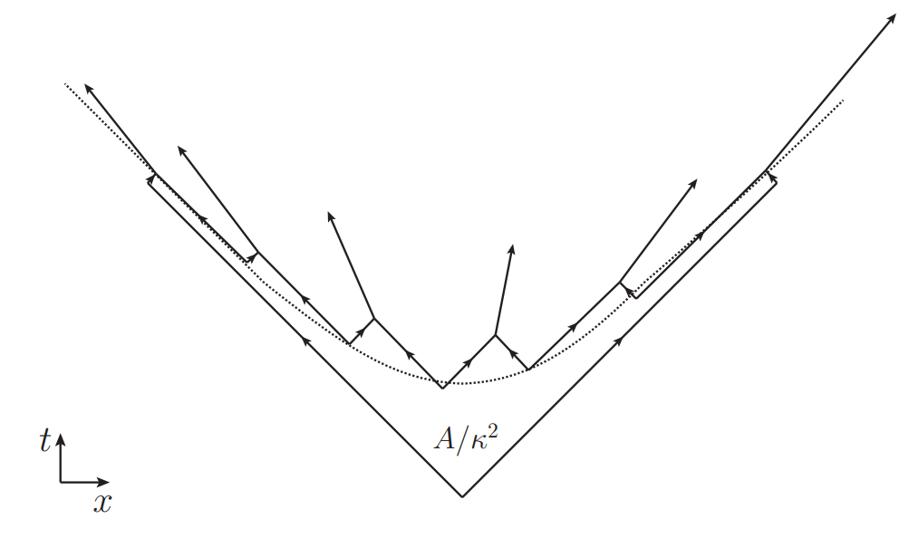
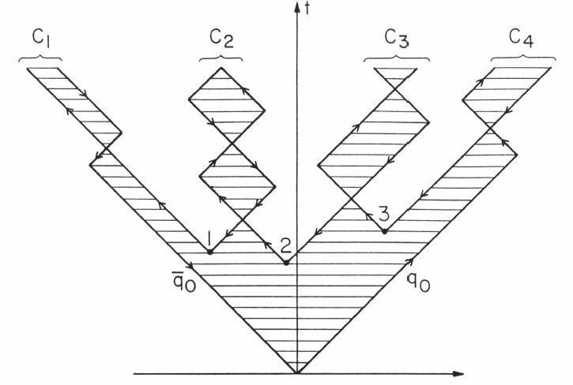
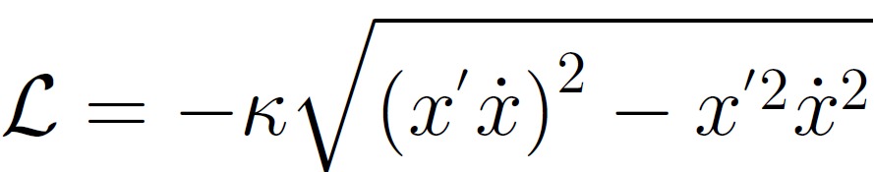
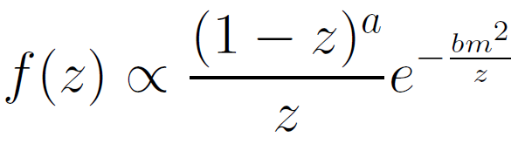
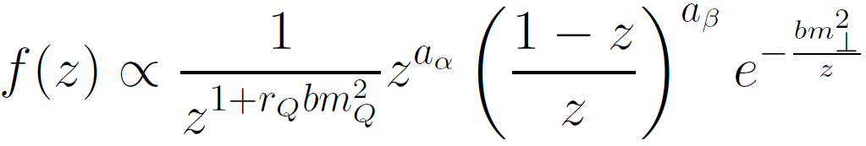

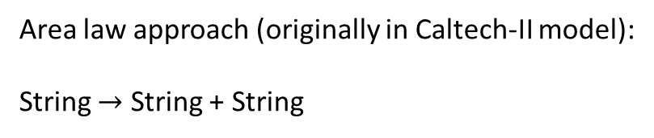
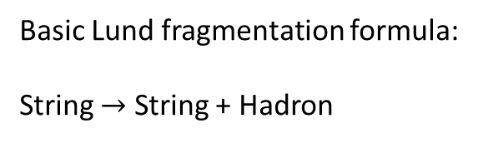

Lund string fragmentation vs Area law
Basic Lund fragmentation formula:
String $→$ String + Hadron
Area law approach (originally in Caltech-II model):
String $→$ String + String
Clusters decay in the end
$q\overline{q}$ pairs are formed along the hyperbola on
the time-space sheet of the string
String fragmentation functions: define the distribution of the fraction of momentum, carried by produced hadron
Nambu-Goto Lagrangian
Seems to be a more general approach
String break-up probability

Slide 7
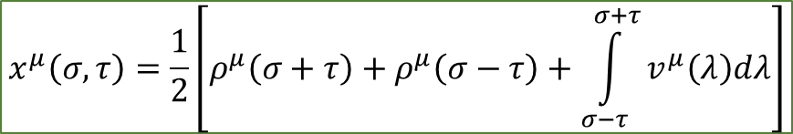







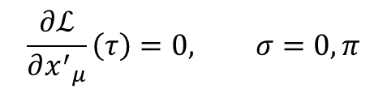

String motion calculation technique
$$ℒ=−κ\sqrt{{\left(x^{′}\dot{x}\right)}^{2}−{x^{′}}^{2}{\dot{x}}^{2}},$$
where
Have the Nambu-Goto Lagrangian:
$$x^{μ}=x^{μ}\left(σ,τ\right)$$
After variation and minimization obtain motion equations:
$$\frac{∂}{∂τ}\frac{∂ℒ}{∂{\dot{x}}_{μ}}+\frac{∂}{∂σ}\frac{∂ℒ}{∂{x′}_{μ}}=0$$
$$\frac{∂ℒ}{∂{x^{′}}_{μ}}\left(τ\right)=0, σ=0, π$$
with boundary conditions
the string ends are free
Use additional gauge to fix the solutions:
$${\dot{x}}^{2}+{x′}^{2}=0, \dot{x}x^{′}=0$$
Solve the wave equation that was obtained after simplifying the equations of motion:
$$\frac{∂^{2}x_{μ}}{∂τ^{2}}−\frac{∂^{2}x_{μ}}{∂σ^{2}}=0$$
$$x^{μ}\left(σ,τ\right)=\frac{1}{2}\left[ρ^{μ}\left(σ+τ\right)+ρ^{μ}\left(σ−τ\right)+\int_{σ−τ}^{σ+τ}{v^{μ}\left(λ\right)dλ}\right]$$
The general solution:
$$ρ^{μ}\left(λ\right)=x^{μ}\left(λ,0\right)$$
$$v^{μ}\left(λ\right)={\dot{x}}^{μ}(λ,0)$$
where
is the initial string shape and
is the initial string velocity
The certain ansatz is made in current models: the initially point-like string are used ($ρ^{μ}\left(λ\right)=0)$ and with piecewise constant function $v^{μ}\left(λ\right)={v^{μ}}_{k}$, $1≤k≤n.$ All partons on the string are identified as “kinks” and are set to have the velocity of $v_{k}$. To implement the Area law it is now left to calculate the area of the time-space surface of the string:
$$dA=\sqrt{{\left(x^{′}\dot{x}\right)}^{2}−{x^{′}}^{2}{\dot{x}}^{2}}dσdτ$$
Decay law:
$$P_{0}\left(A\right)=e^{−λA}$$

Slide 8
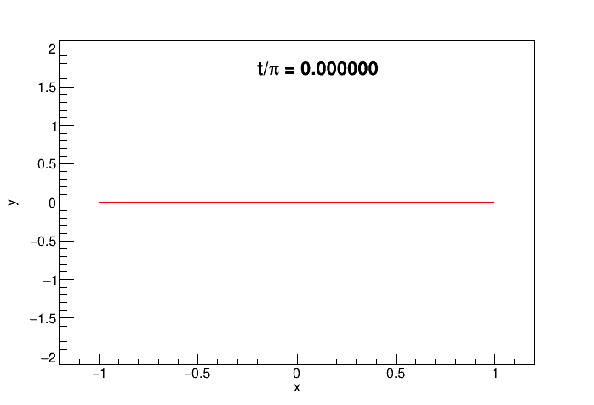
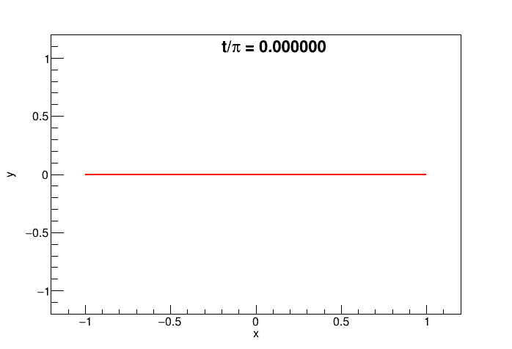

Ways to improve the scheme
The first problem arises due to the assumption of strings being initially point-like:
It is questionable if string can even form in that way, as confining potential is linear to distance between partons, so a flux tube of color field that is called a string should always be an extended object;
In the collisions of hadrons the partons at the ends of the string can be significantly distanced due to multiple elementary scatterings that occur on the hadron size scale.
Piecewise-constant string
Linear velocity function
$$J=\frac{4γL}{π}$$

Slide 9
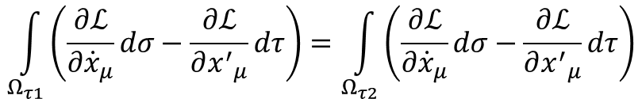
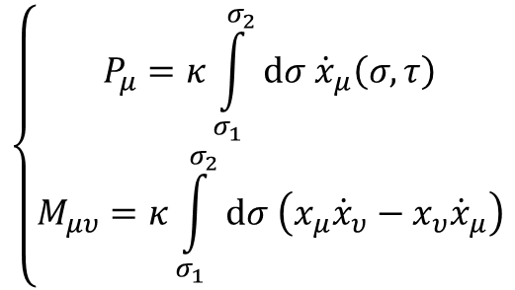
Proper angular momentum treatment
Strictly speaking, one should use the same technique to properly calculate other attributes of the string like its angular momentum, $J$. The Lagrange formalism we used above allows to do so.
The invariance of the Nambu-Goto action to the Poincaré transformations leads to the following laws of conservation:
$$\int_{Ω_{τ1}}^{ }{\left(\frac{∂ℒ}{∂{\dot{x}}_{μ}}dσ−\frac{∂ℒ}{∂{x^{′}}_{μ}}dτ\right)=\int_{Ω_{τ2}}^{ }{\left(\frac{∂ℒ}{∂{\dot{x}}_{μ}}dσ−\frac{∂ℒ}{∂{x^{′}}_{μ}}dτ\right)}}$$
- conservation of the string momentum 4-vector
$$\int_{Ω_{τ1}}^{ }{x_{μ}\left(\frac{∂ℒ}{∂{\dot{x}}^{υ}}dσ−\frac{∂ℒ}{∂{x^{′}}^{υ}}dτ\right)−x_{υ}\left(\frac{∂ℒ}{∂{\dot{x}}^{μ}}dσ−\frac{∂ℒ}{∂{x^{′}}^{μ}}dτ\right)=\int_{Ω_{τ2}}^{ }{x_{μ}\left(\frac{∂ℒ}{∂{\dot{x}}^{υ}}dσ−\frac{∂ℒ}{∂{x^{′}}^{υ}}dτ\right)−x_{υ}\left(\frac{∂ℒ}{∂{\dot{x}}^{μ}}dσ−\frac{∂ℒ}{∂{x^{′}}^{μ}}dτ\right)}}$$
- conservation of the string angular momentum. Through these we can obtain
$$\left\{\begin{aligned}P_{μ}=κ\int_{σ_{1}}^{σ_{2}}{dσ{ \dot{x}}_{μ}\left(σ,τ\right)} \\ M_{μυ}=κ\int_{σ_{1}}^{σ_{2}}{dσ \left(x_{μ}{\dot{x}}_{υ}−x_{υ}{\dot{x}}_{μ}\right)}\end{aligned}\right.$$
Taking string angular momentum into account, the influence on fragmentation scheme may be obtained. Systems with non-zero spin might be produced more often due to angular momentum conservation. This can be essential to baryon and vector mesons production.

Slide 10
Conclusion
Models of hadronic interactions usually contain a set of parameters that allow them to vary the number of muons by large extent.
Several important physics assumptions have been proposed in different works. They tend to use additional parameterization to implement changes.
However, the theoretical basis for the explanation of such effects is lacking. Also the strong energy dependence should be explained within the framework of consistent theoretical approach.
Models of hadronization process are the top priority for the consideration. An extension of existing framework might give the improvements in baryon and meson resonance production in hadron and nucleus collisions.
The exact mechanism of the enhancement of charged component is still unclear.

Slide 11
Thank you for your attention!

Slide 12
BACKUP

Slide 13
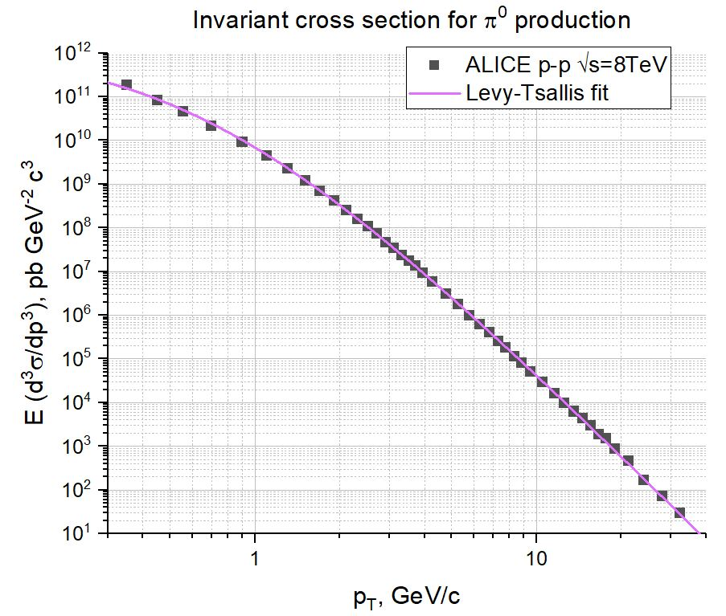
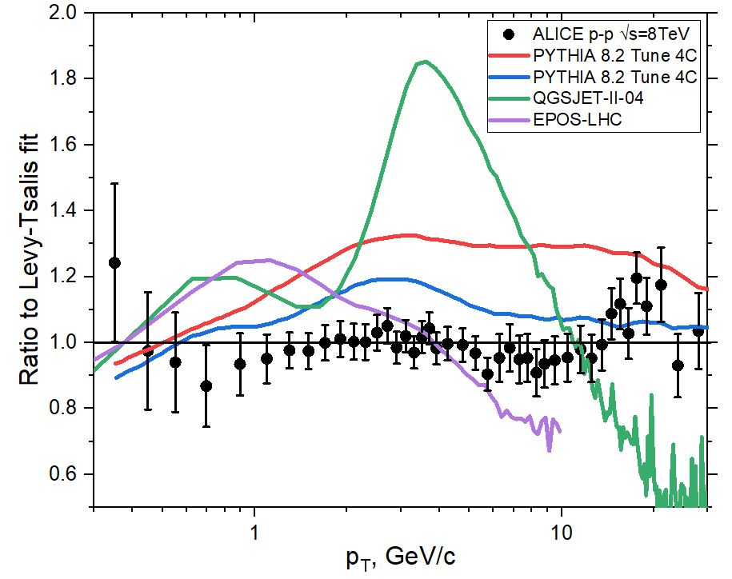
Neutral mesons data (1)

Slide 14
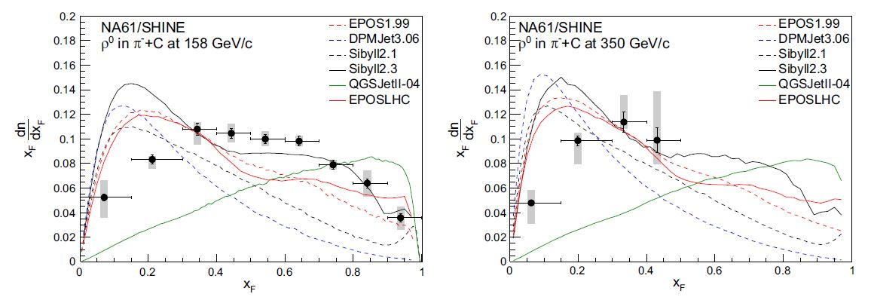
Neutral mesons data (2)

Slide 15
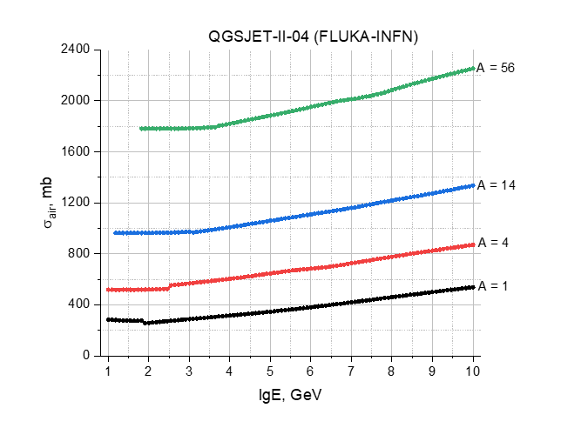
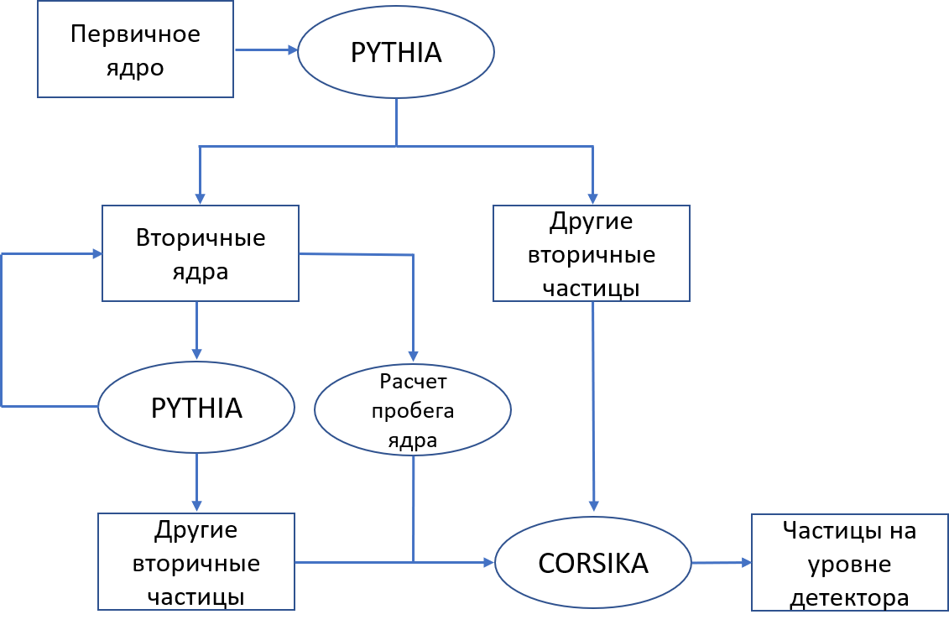
Interface between CORSIKA and PYTHIA
Primary
nucleus
Secondary
nuclei
Other
secondary
particles
Mean
free path
Other
secondary
particles
Particles at
detector
level
General scheme of the interface. “STACKIN” option is used in CORSIKA for stack input of particles to begin the simulation with.
Nucleus-air total cross-sections obtained from QGSJET-II-04 and FLUKA-INFN models. Mean free path is then calculated using Linsley’s parameterization for the atmosphere.

Slide 16
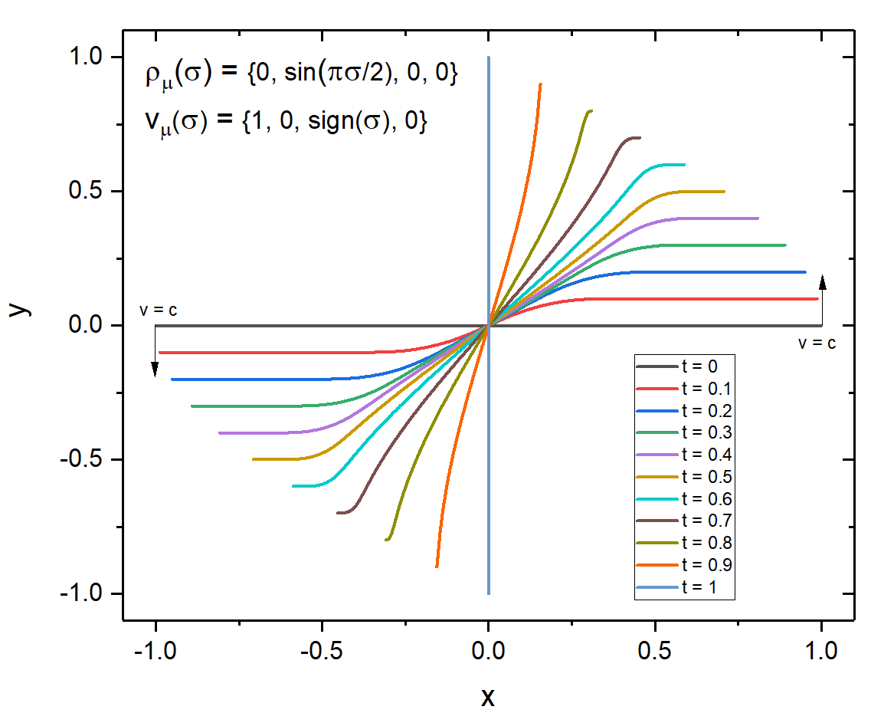
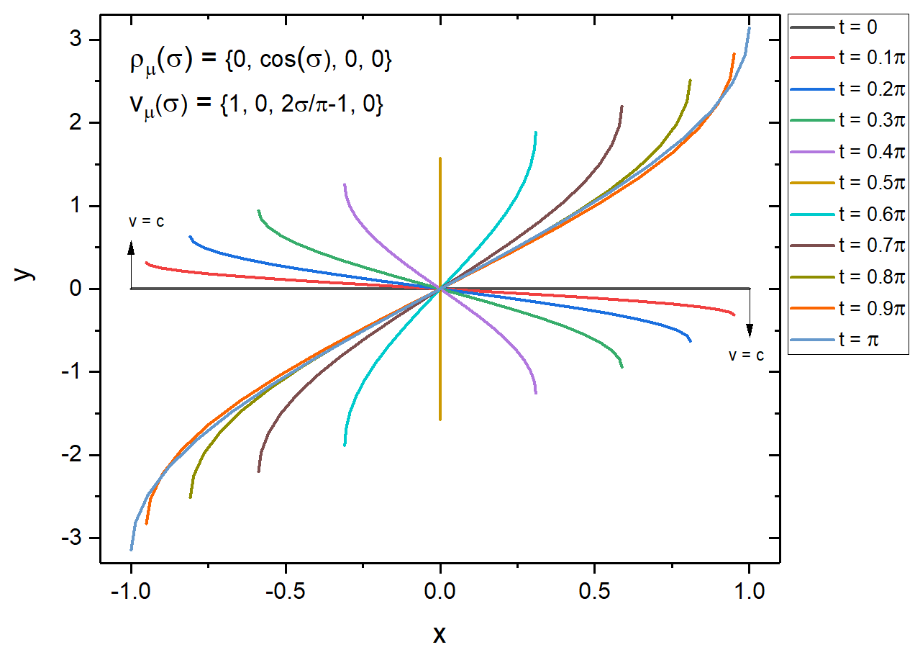
String motion examples (without animation)

Slide 17
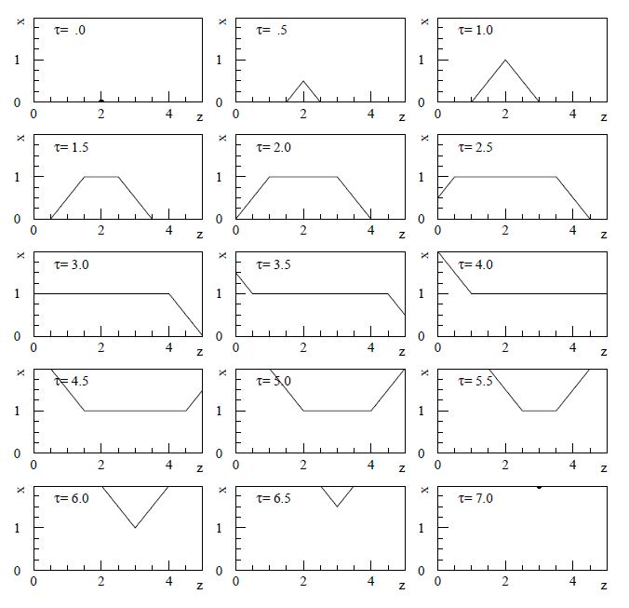
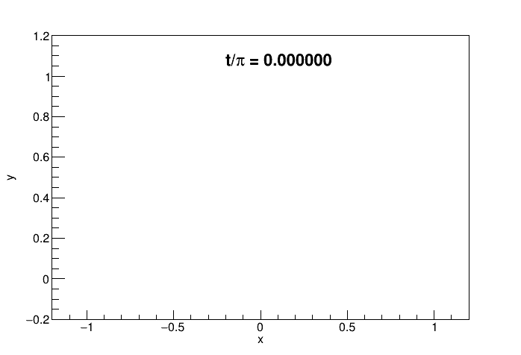
String motion example (comparison with NeXus 2.0)
Note: not exactly the same interpretation of initial conditions

