Slide 1
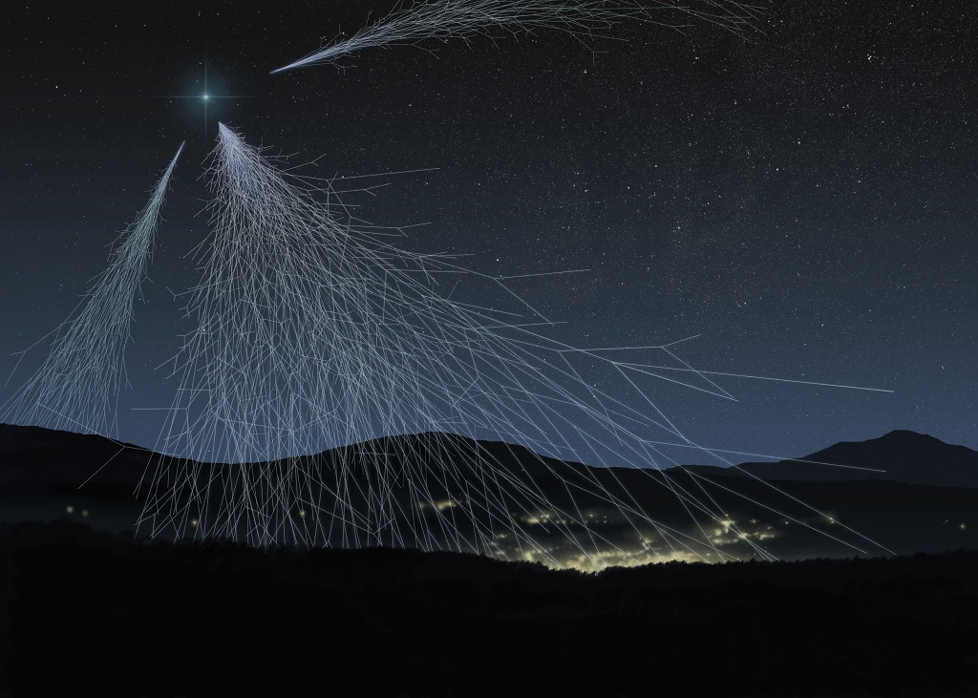


Energy deposit of EAS cores detected by the facilities of the Experimental Complex NEVOD
S.S. Khokhlov, M.B. Amelchakov, A.G. Bogdanov, A.N. Dmitrieva, D.M. Gromushkin, E.P. Khomchuk, V.V. Kindin, A.Yu. Konovalova, K.R. Nugaeva, N.B. Ponomareva, I.A. Shulzhenko, E.A. Yuzhakova
The 4th International Symposium on Cosmic Rays and Astrophysics
June 28, 2023

Slide 2
Introduction
EAS studies are the only source of information on nucleus-nucleus interactions at very high energies;
A large number of experimental results have not yet been explained within the frameworks of a unified approach;
A particular interest are shower cores containing simultaneously electron-photon, muon and hadron EAS components.

Slide 3
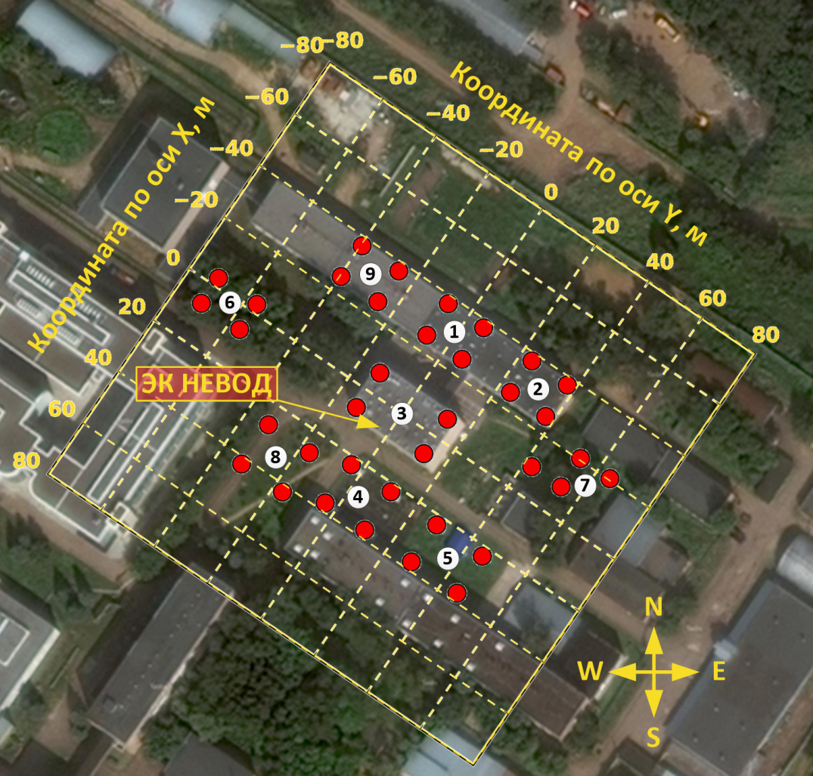
The NEVOD-EAS array
144 detectors;
36 detector stations;
9 clusters;
Cluster size: 15 × 15 m²;
Array area: 10⁴ m²;
Energy range: 10¹⁵ - 10¹⁷ eV.

Slide 4
Reconstruction of coordinates of the axis of the shower and shower size
Simulation in the CORSIKA: QGSJET-II-04 + FLUKA 2020.0.3
The accuracy of reconstruction of the coordinates of the shower axis is ~ 3.0 m.
The accuracy of the shower size reconstruction is ~ 12 %.

Slide 5
Cherenkov water calorimeter NEVOD
Volume 2000 m³.
The detecting system is formed by a spatial lattice of quasispherical modules (QSM) which include six PMTs with flat cathodes directed along the coordinate axes.
91 QSM in 25 strings (step 1 x 1 x 1.25 m³).
Dynamic range for each PMT 1 – 10⁵ ph.e.
Small step of spatial lattice and a wide dynamic range allow the detector to operate in the calorimetric mode.

Slide 6
Examples of calorimetric studies with
Cherenkov water detector
The average muon energy increases with zenith angle.
Mean experimental cascade curves.

Slide 7
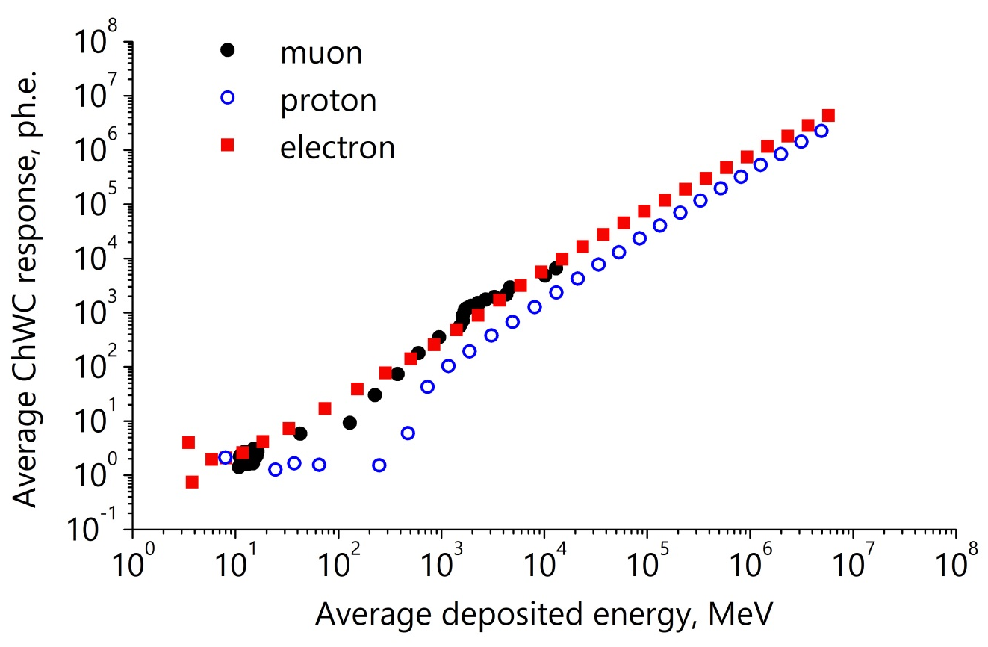
Simulation of CWC response on leptons and hadrons
To a first approximation the response of CWC is proportional to deposited energy starting with 1GeV.
The coefficients of proportionality:
muon: 𝑘_{𝜇} = 0.6 ph.e./MeV;
electron: 𝑘_{𝑒} = 0.7 ph.e./MeV;
proton: 𝑘_{𝑝} = 0.3 ph.e./MeV.

Slide 8
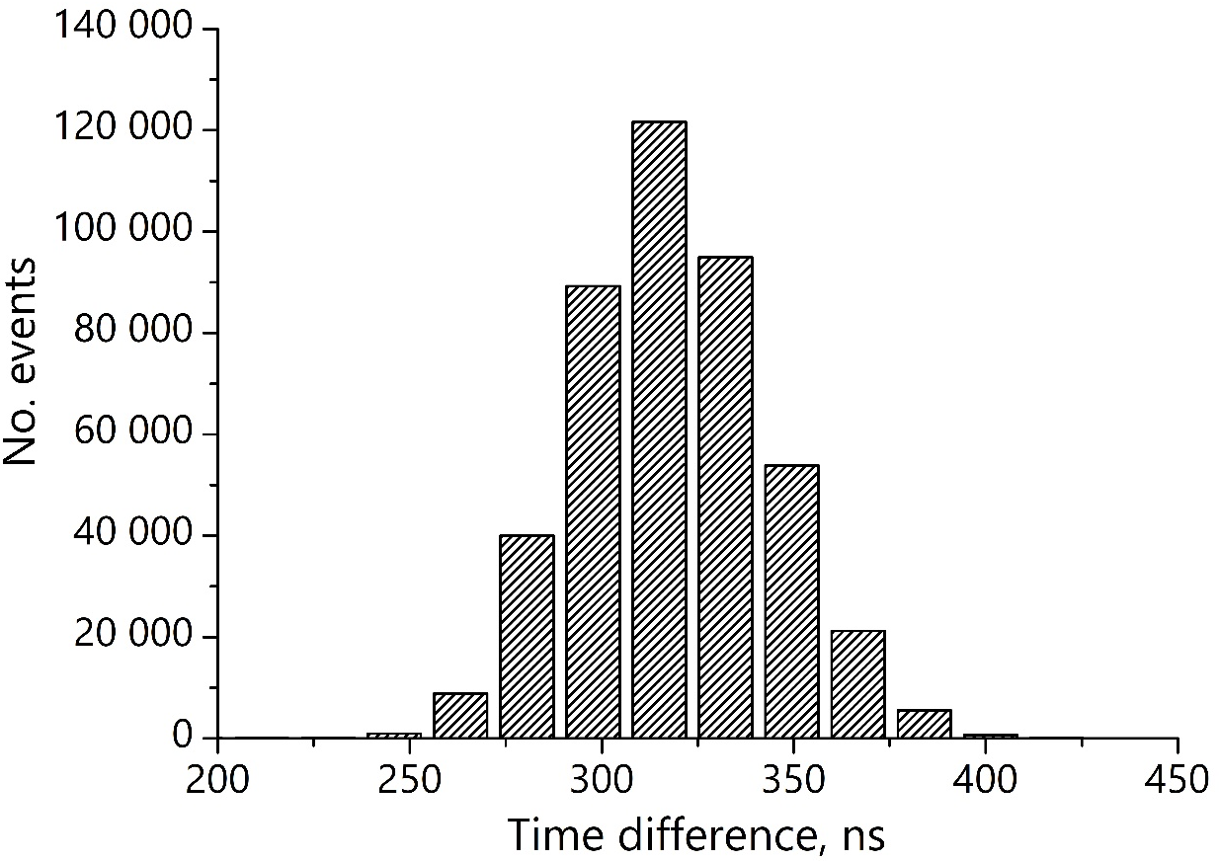
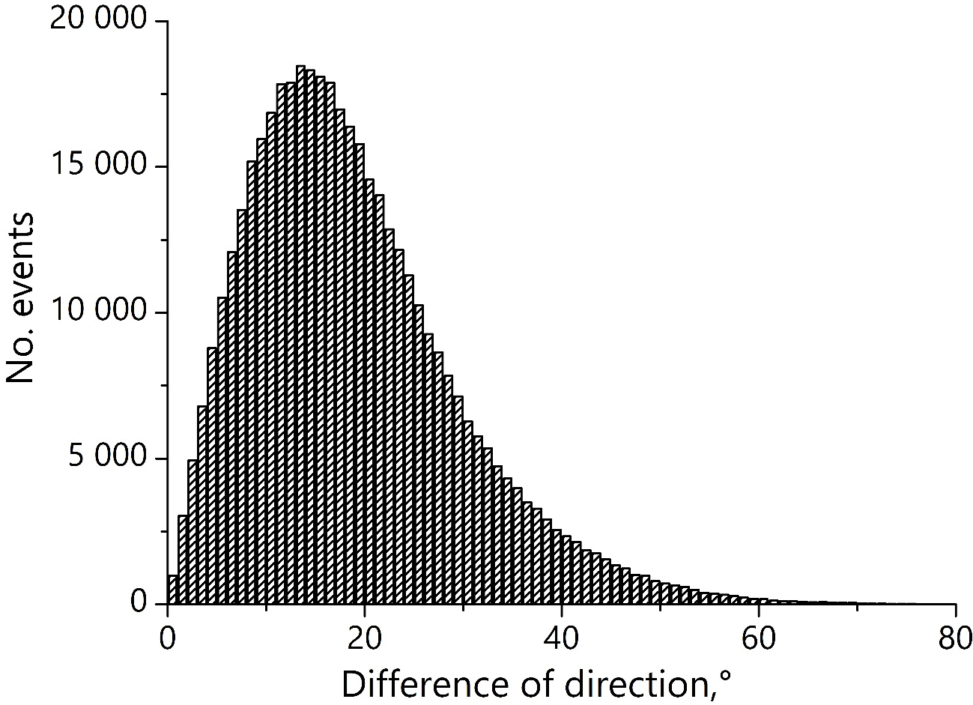
Combining of events
Time difference between
CWC and NEVOD-EAS
Difference of directions between
CWC and NEVOD-EAS
<dT> = 326.9 ns.
σ = 28.4 ns.
<α> = 18.9° ; FWHM = 21°.
<cosα> = 0.93.

Slide 9
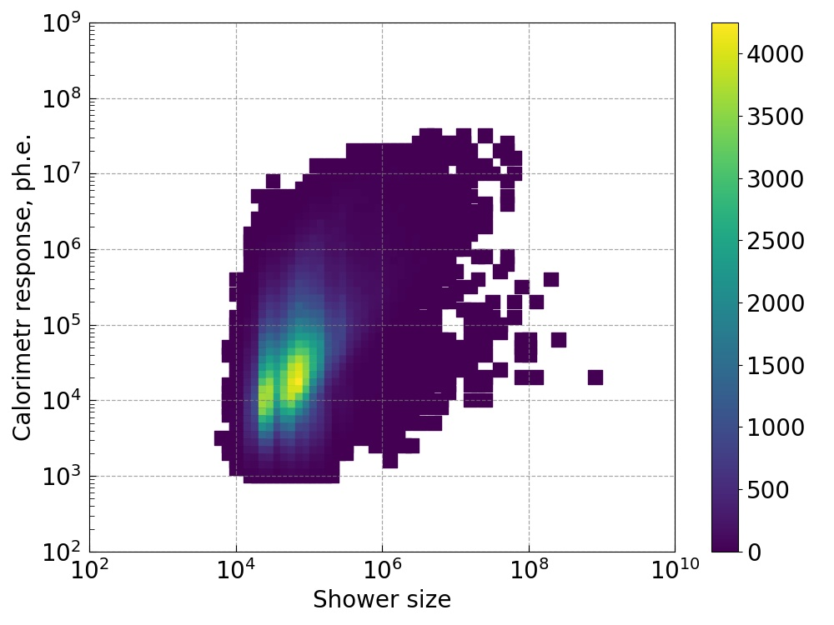
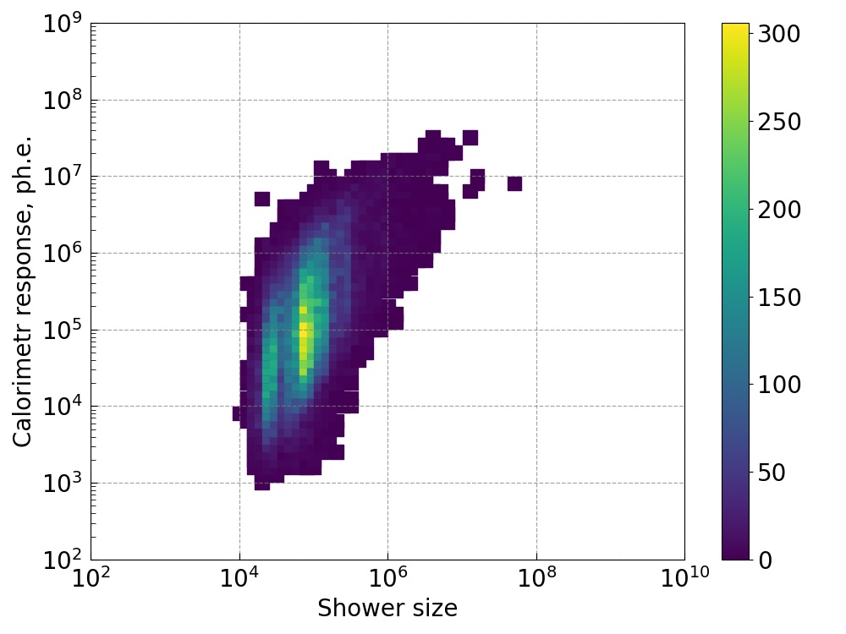
Correlation of shower size and energy deposit in the CWC
The EAS axis inside the CWC volume
(d < 5 m).
All combined events.

Slide 10
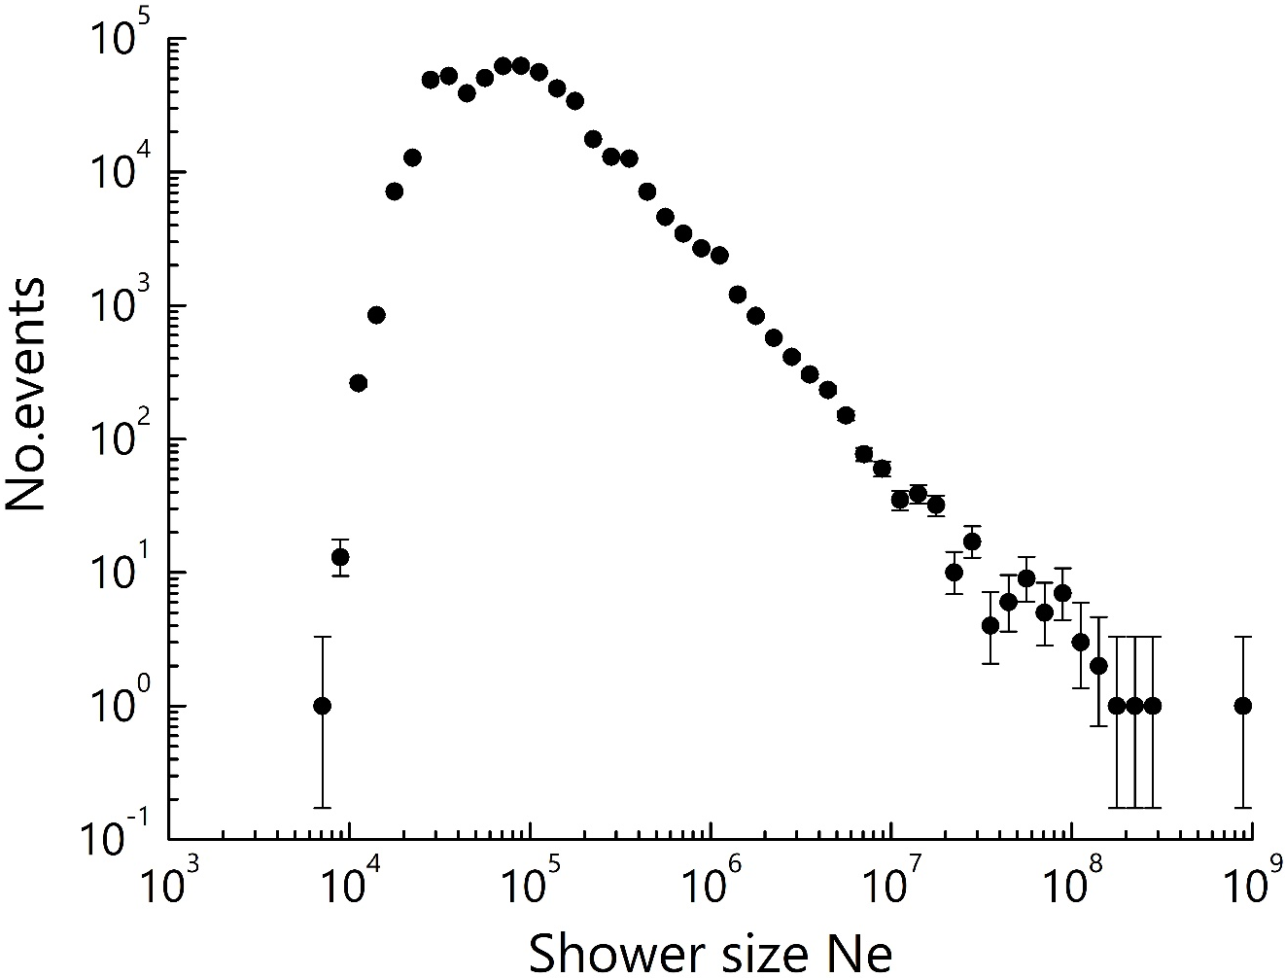
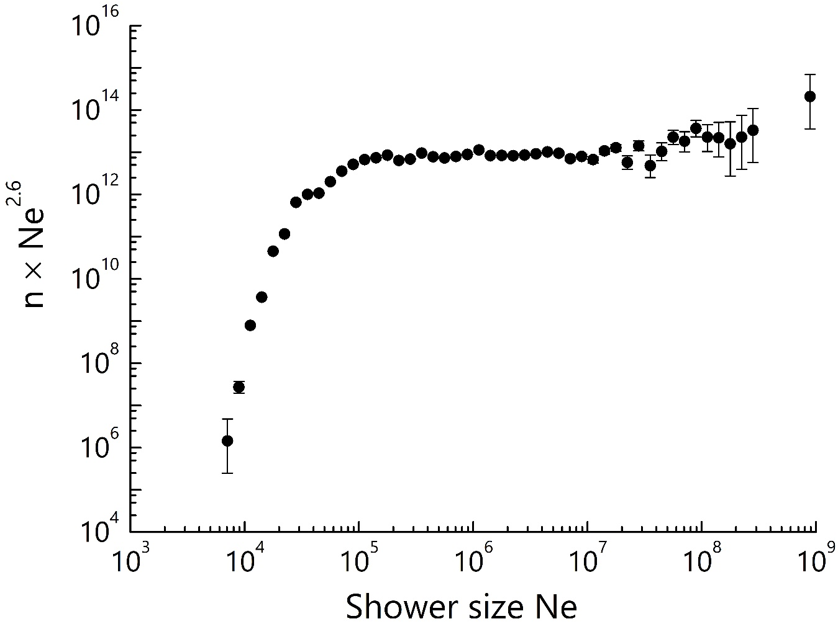
Spectrum of shower size measured with NEVOD-EAS
In the spectrum of shower size a feature above values 10⁷ particles is observed.

Slide 11
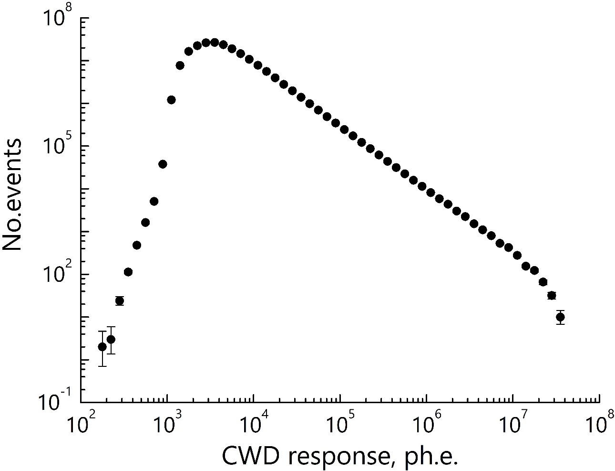
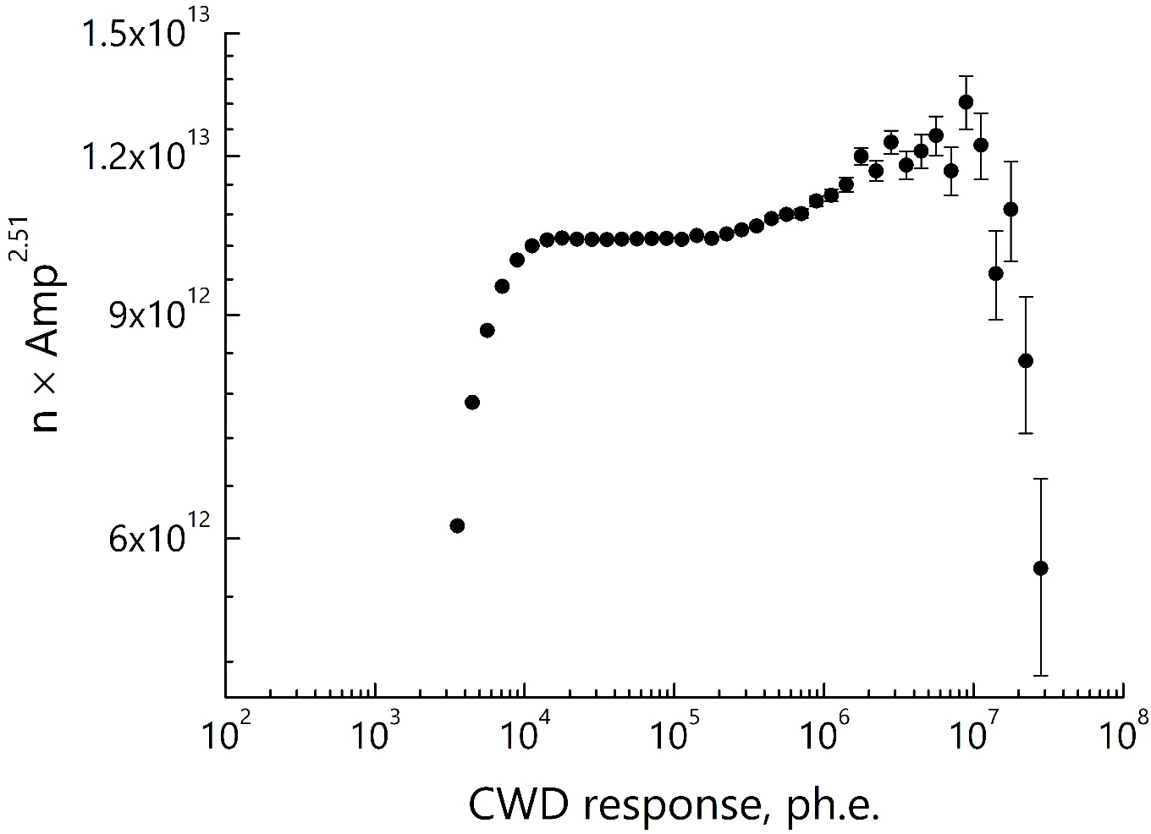
Spectrum of energy deposit measured with CWD
In the spectrum of CWC response a feature above values 10^{5.5} photoelectrons also is observed. The feature in spectrum of CWC response if correspond to specificity of shower size spectrum.

Slide 12
Conclusion
The Experimental complex NEVOD makes it possible to carry out simultaneous studies of the electron-photon, muon and hadronic components of extensive air showers.
A comparison of particle directions in air-showers reconstructed with Cherenkov water calorimeter and NEVOD-EAS array gives angle accuracy of 18°.
In the spectra measured with Cherenkov water detector and the NEVOD-EAS coincident features are observed with shower size above 10⁷ particles.

Slide 13
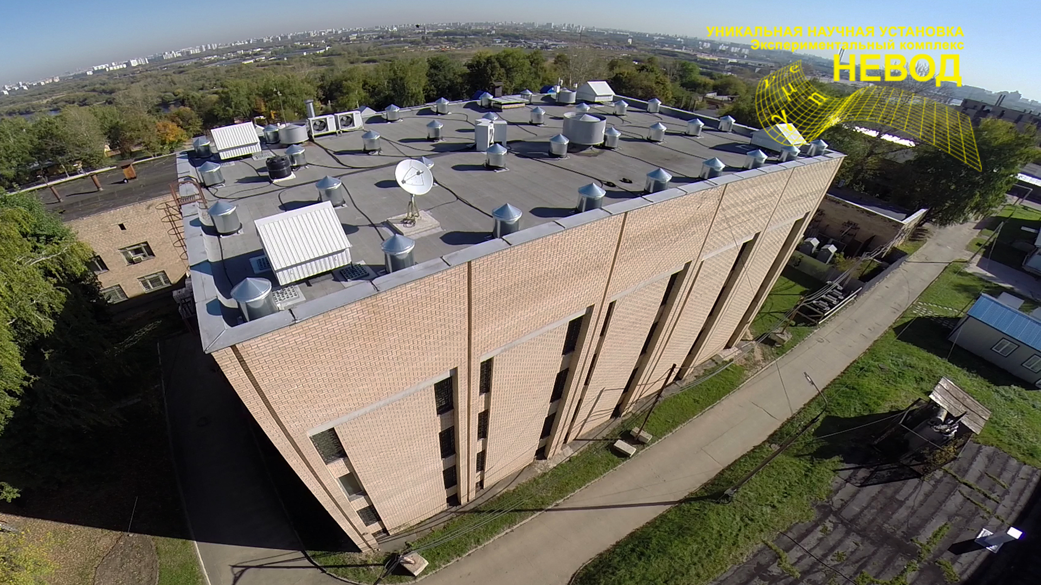
Thank you for your attention!
http://nevod.mephi.ru/

