Slide 1
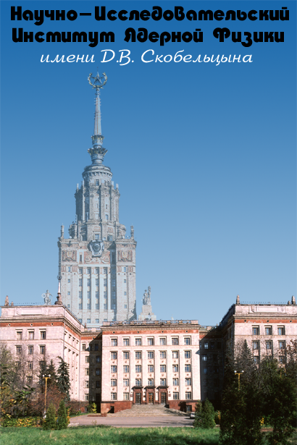
Orbital High Energy Cosmic Rays Observatory - stages of developmen
D. Podorozhny, D. Karmanov, A. Kurganov, A. Panov, L. Tkachev, A. Turundaevskiy

Slide 3
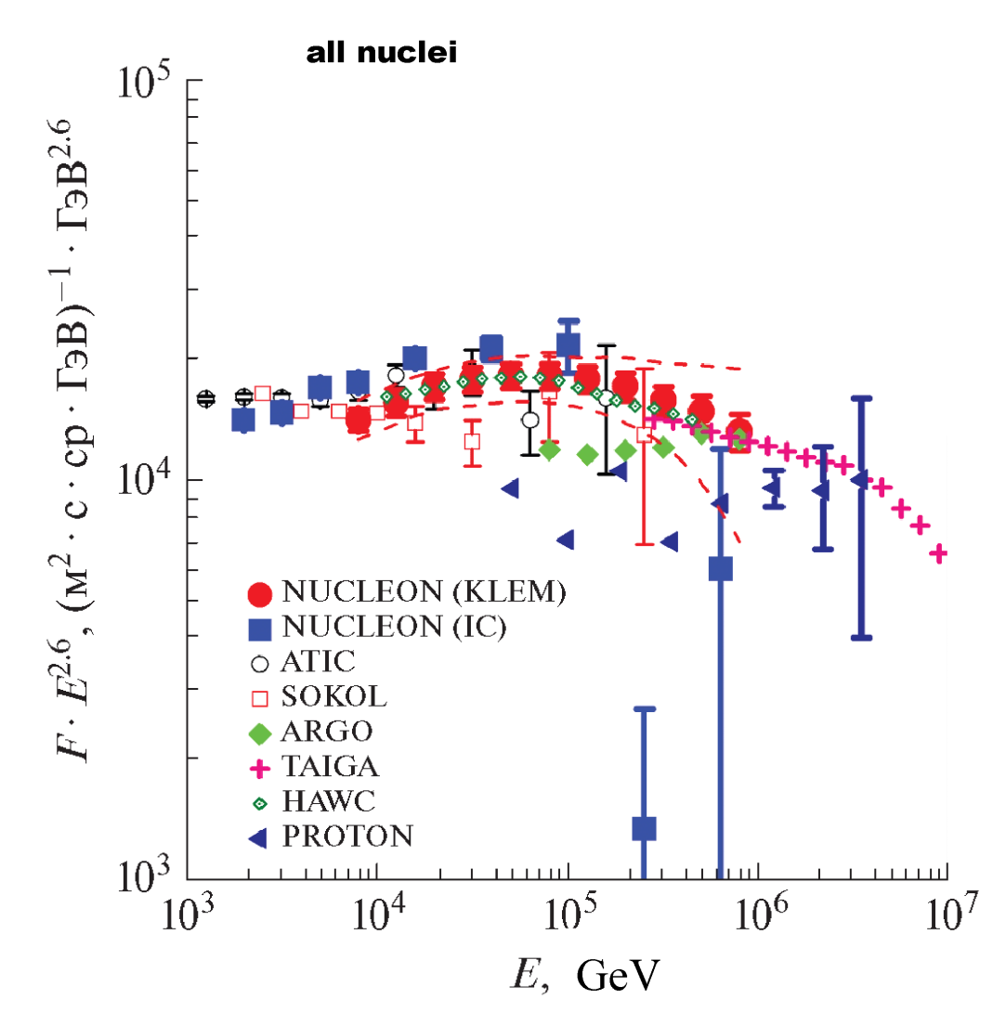
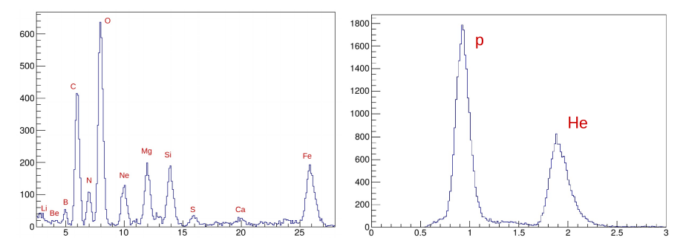
To 2021 it’s information about abundant CR up to 500 TeV with charge resolution.
It is finded a few CR features
What's next?

Slide 4
The integral spectrum of CR (m² sr year)
(>E) 10¹⁴ 10¹⁵ 10¹⁶ 10¹⁷
2100 46 0.8 0.0054
For 10¹⁵ - 10¹⁶ eV range exploring it’s necessary at least 100 par. >10¹⁶ eV
The main requirement - effective exposure factor must be ~120 m² cr year
Title | Years | Effective exposure factor m² sr year | Range eV | Components
Fermi | since 2008 | 10 | 2*10⁷-3*10¹¹ 2*10¹⁰-10¹² | Gamma Electrons
AMS02 | Since 2011 | 5 | <2*10¹² эВ/Z 10⁸-10¹² | Nuclei Electrons
NUCLEON | 2015- 2020 | 2.4 0.7 | 10¹¹-5*10¹⁴ 5*10¹⁰ -5*10¹² | Nuclei Electrons
Calet | since 2015 | 0.5 0.3 | 10⁹-2*10¹³ 10⁹-2*10¹² | Nuclei Electrons Gamma
Dampe | since 2015 | 1 | 10¹¹-10¹⁵ 5*10⁹-10¹² | Nuclei Electrons Gamma
ISS-CREAM | since 2017 | ~3 | 10¹²-10¹⁵ | Nuclei Electrons
HERD |  | 10 | 10¹¹-3*10¹⁵ 10⁸-5*10¹² | Nuclei Electrons Gamma
Gamma-400 |  | 4 | 10⁸-3*10¹⁵ 10⁸-5*10¹² | Nuclei Electrons Gamma

Slide 5
HERO
“High Energy Rays Observatory”
supported by the Russian Academy of Sciences and included in the Russian Federal Space Program
R&D stage is ended in 2020
Main physical Requirements:
Effective exposure factor >120 m² sr year
Energy resolution
for Protons at 10¹⁵-10¹⁶ eV < 30%
at 10¹²-10¹⁵ eV < 20%
for Nuclei at 10¹²-10¹⁶ eV < 15-20%
for Leptons at 3*10¹¹-10¹³ eV ~ 1%
Only technology of
Heavy 3D Ionization Calorimeter

Slide 6
Main Requirements: Weight
Modern Russian launch vehicles, Existing, and under development
By R&D specification
Three versions of HERO calorimeter were considered
10 tons
30 tons
70 tons
[Афанасьев И.Б. Локомотивы нового поколения. Русский космос, 15 (2020), 34-39]

Slide 7
Other requirements:
- relatively fast apparatus development (less than 5 years)
- relatively cheap production
mission success (high reliability)
Do not use new technologies
Only those that have reliably worked in space
for several years
NUCLЕON - base

Slide 8
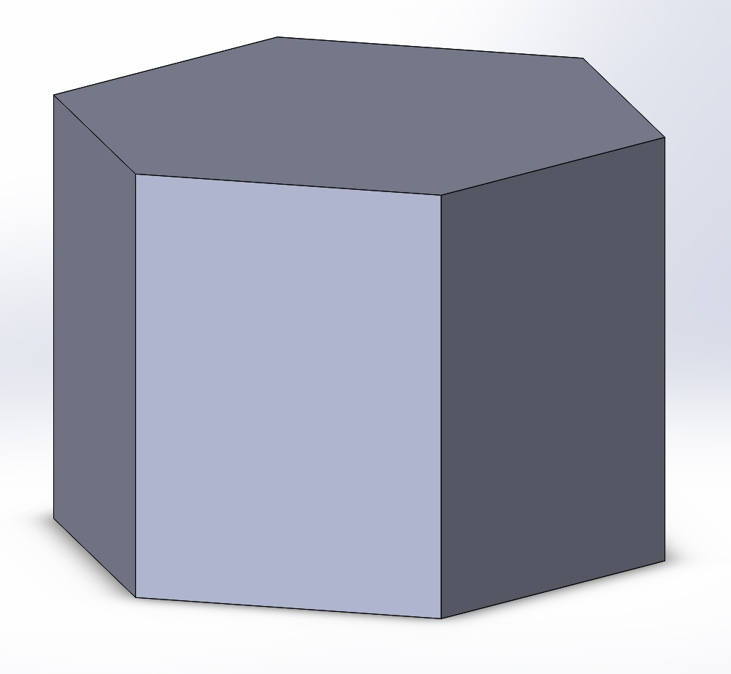
IC shape optimization
After wild simulations the most optimal shape – 3D IC of a prism form placed lateral surface to the Earth
two limiting forms of the prism: “pancake“, "pencil"
IC substance. optimal - a combination of a very heavy (tungsten) and very light (polystyrene) to optimize development electromagnetic and hadronic cascades

Slide 9
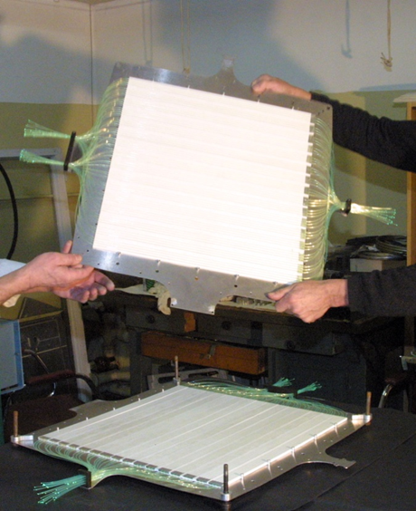
IC consists of N identical layers. Each layer is a hexagonal plane, 24+3 mm thick, with three layers of polystyrene scintillator (ρ~1.0 g/cm3, h=8 mm) with 56 2.5cm strips oriented at 60º angle relative to each other and a tungsten-copper-nickel alloy absorber (ρ~16/5 g/cm3, h=3 mm)

Slide 10
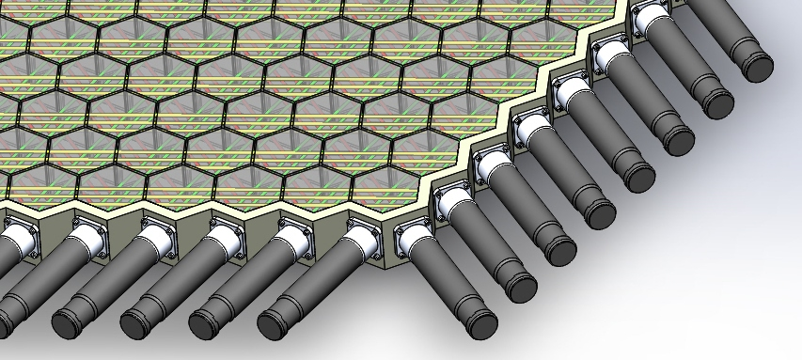
60º strip orientation, 3 layers of scintillator per layer of absorber (Totaling to 51 4-layer stacks + 1 additional absorber layer)
90º strip orientation, 2 layers of scintillator per layer of absorber (Totaling to 77 3-layer stacks + 1 additional absorber layer)
Both strip constructions provide nearly the same angular and spatial resolution, but 60º is preferable due to reliability and more efficient usage of PMTs

Slide 11
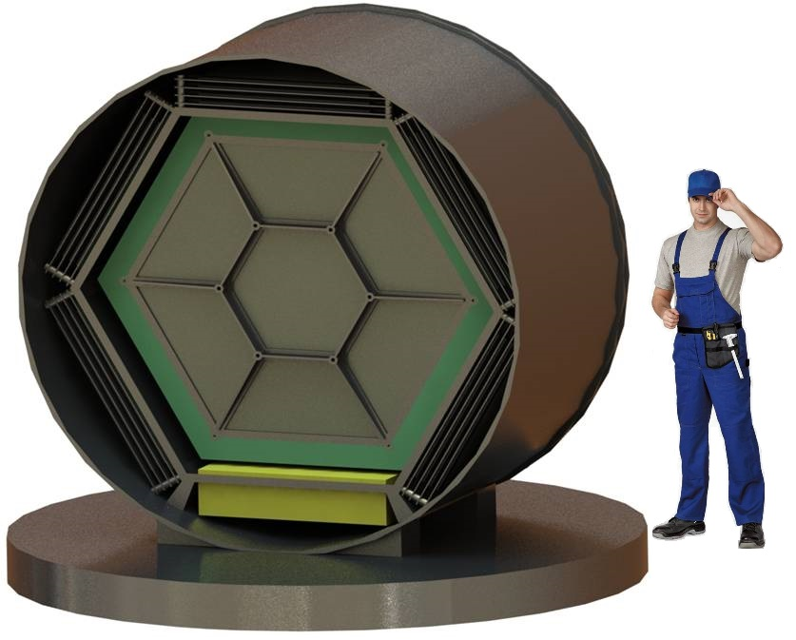
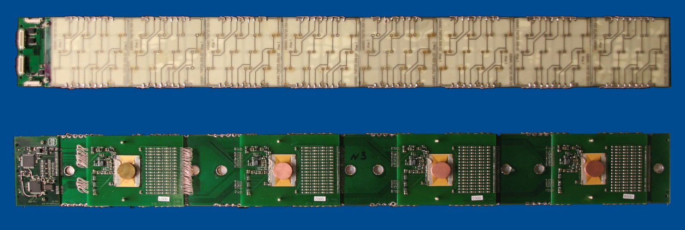
Surrounding the IC is the charge measurement system consisting of silicon detectors (pad size is about 1cm²). Four layers
Leders construction is similar to NUCLEON one. Expected charge resolution is better then 0.2 ch. u. (Pads in HERO are three times less than in nucleon)

Slide 12
Geometry optimization and energy resolution
Energy resolution of 4% at 10 m2ster geom. factor!
10 tons
6700+270000 Readout channels
30 tons
14.000+570000 Readout channels
70 tons
32.700+1050000 Readout channels

Slide 13
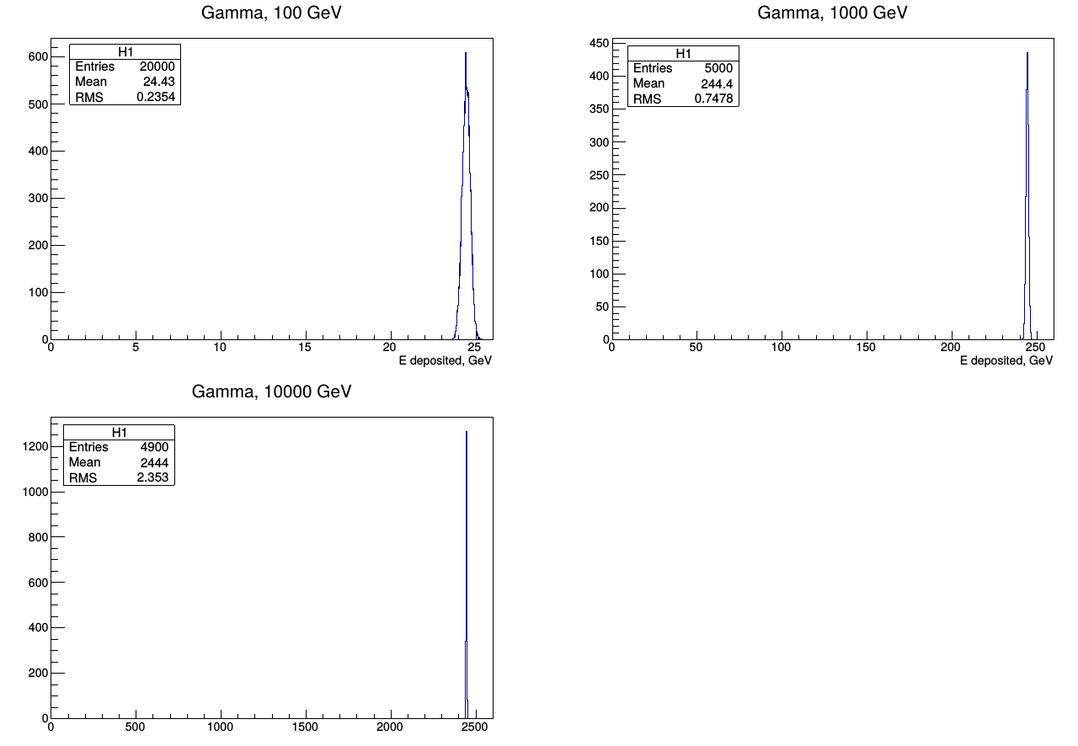
Energy Resolution for gamma quanta, IC of 3λ, 52 X₀
Res = 0.96%
Res = 0.31%
only physical fluctuations !
Res = 0.096%

Slide 14
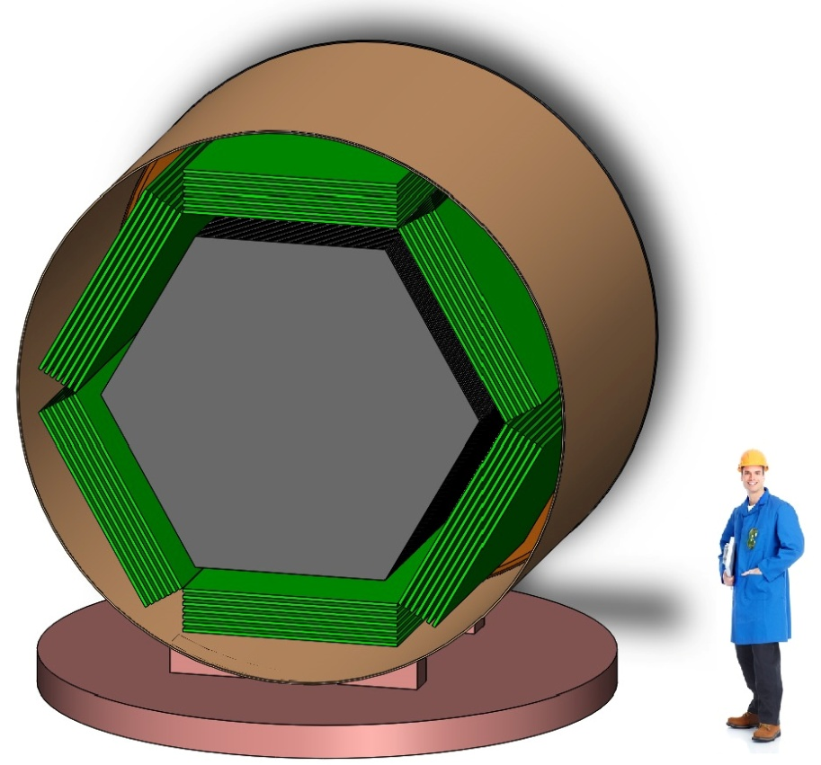
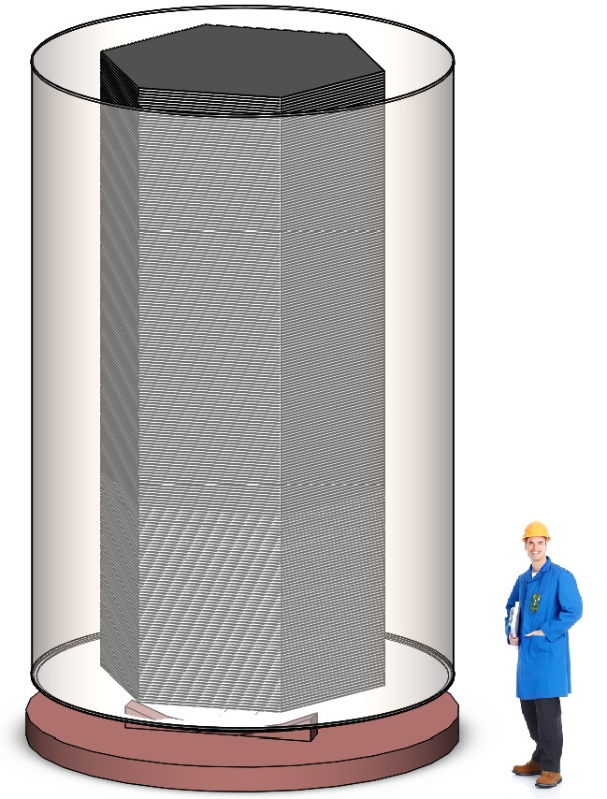

Slide 15
Angle reconstruction mean error (degrees) for 10-ton configuration
Particle | Strip width 1.25 cm | Strip width 2.5 cm | Strip width 5.0 cm
p, 1 TeV | 0.57 +- 0.01 | 0.56 +- 0.01 | 0.75 +- 0.02
p, 10 TeV | 0.29 +- 0.01 | 0.30 +- 0.01 | 0.49 +- 0.01
p, 100 TeV | 0.22 +- 0.01 | 0.24 +- 0.01 | 0.43 +- 0.01
γ, 100 GeV | 1.17 +- 0.02 | 1.38 +- 0.02 | 2.20 +- 0.03
γ, 300 GeV | 1.07 +- 0.02 | 1.21 +- 0.02 | 1.97 +- 0.03
γ, 1000 GeV | 0.94 +- 0.02 | 1.07 +- 0.02 | 1.80 +- 0.02
γ, 3000 GeV | 0.92 +- 0.02 | 1.03 +- 0.02 | 1.65 +- 0.02
The expected spatial and angular resolution are sufficient for adequate reconstruction of charge using CMS

Slide 16
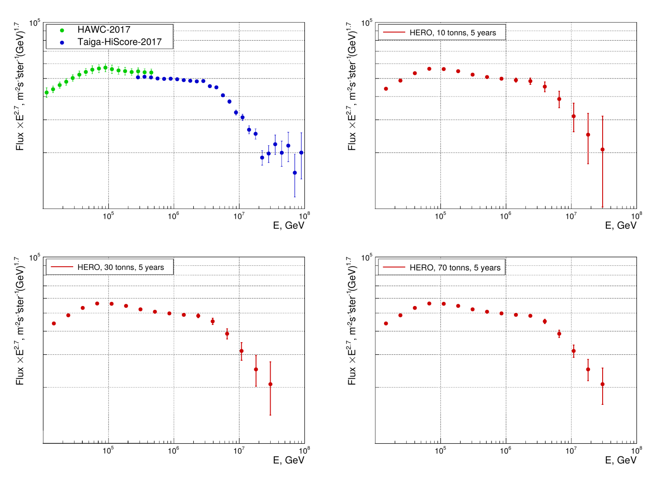
Expected statistics

Slide 17
Main objectives of HERO mission
- The chemical composition of cosmic rays with an elemental charge resolution in the region of the "Christiansen-Kulikov CR knee" (energy 1-100PeV);
A precise determination of the composition of CR in the energy range from several TeV to 1PeV (high statistics and energy resolution);
Investigation of the electron spectrum from hundreds of GeV to multi-TeV range
The gamma-ray and electron spectra in a wide energy range with an ultrahigh energy resolution (monoenergetic lines from dark matter annihilation);
CR composition of heavy and superheavy nuclei behind the peak of iron
The study of the anisotropy of cosmic rays

