Slide 1
Lisitsin M.V., Khokhlov S.S., Nikolaenko R.V., Petrukhin A.A.
Studying of the muon energy spectrum in the Baikal-GVD neutrino telescope
24th of June 2025

Slide 2
Relevance of the study of TeV muons
Muon energy spectrum is important for estimating processes of muon generation including charmed particles and other fast processes.
Muon energy spectrum allows evaluation of the atmospheric neutrino background at searches of astrophysical neutrinos.
Currently, the statistically reliable data on the energy spectrum of muons is available up to energies of ~20 TeV only.
So far, only giga volume water detectors, such as IceCube, Baikal-GVD, KM3NeT, etc. are capable of detecting high energy muons
The goal of the work
Evaluation of the statistics in Baikal-GVD for the muon energy spectrum above 10 TeV.

Slide 3
Cubic kilometer Baikal-GVD neutrino telescope
Under construction in the southern part of Lake Baikal since 2016
Total PMTs: > 4000
Total clusters: 14
Instrumented depth: 750 m - 1275 m
Cluster radius: ~ 60 m.
Distance between two clusters: ~ 300 m.
1 km³ by 2027/2028
Schematic view of the Baikal-GVD detector

Slide 4
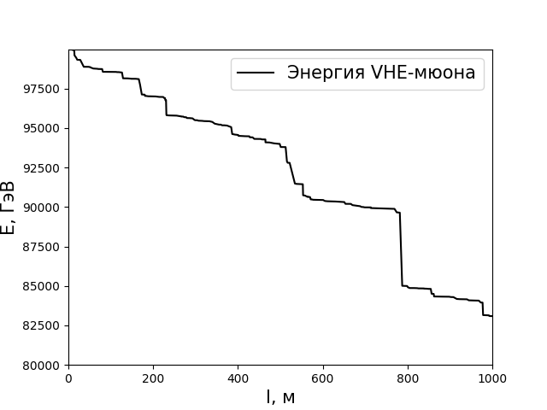
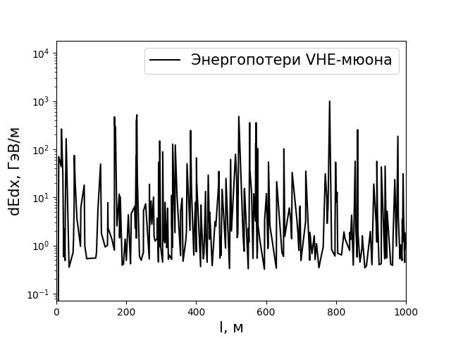
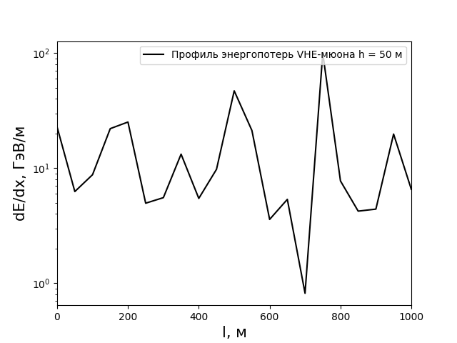
Energy losses of muon in the water
It is impossible to experimentally obtain the dependence of the muon energy on depth.
Longitudinal energy loss profiles can be measured in water detectors.
Example of simulated muon with energy of 100 TeV in the 1 km layer of water
GeV/m
GeV/m
GeV
m
m
m
Dependence of muon energy on depth
Dependence of muon energy loss on depth
Dependence of muon energy loss on depth with a step of 50 m

Slide 5
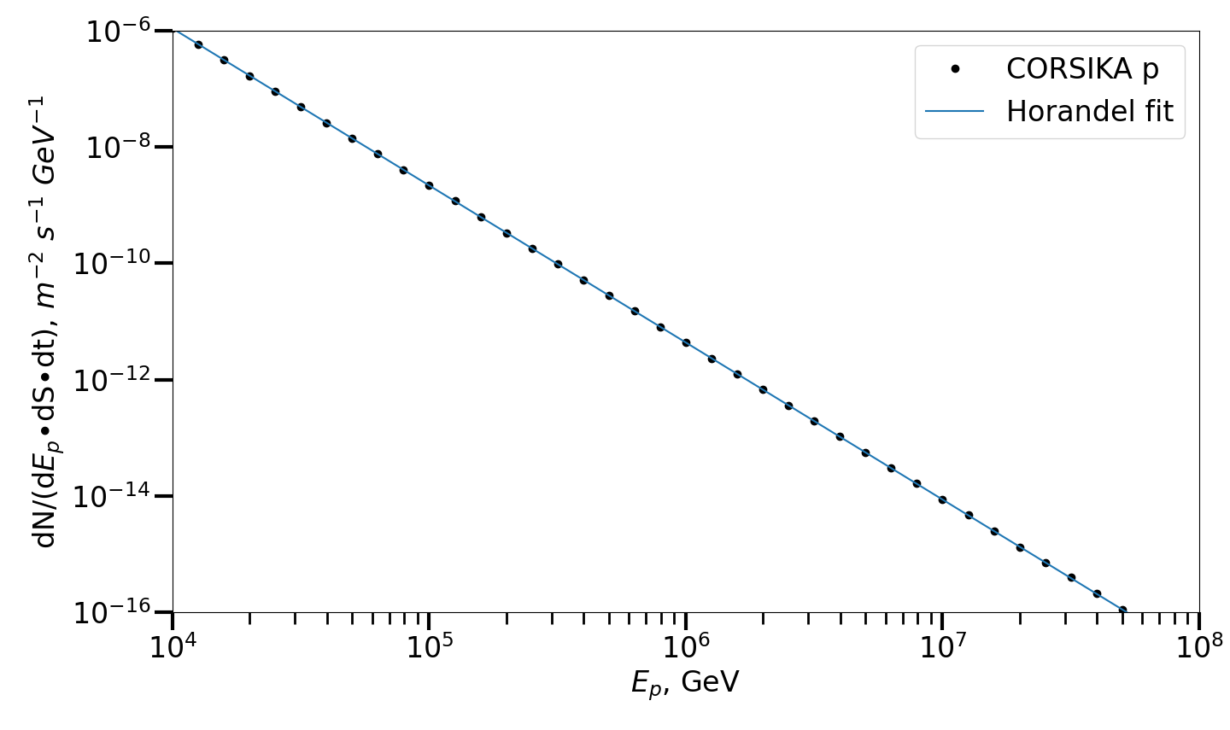
Simulation of muon bundles propagation through the water in CORSIKA, PROPOSAL
$$\frac{dN}{dEp}\left(h=0\right)=F_{0}∙E^{−2.7}$$
Ω = 2π
$\frac{dN}{dEp}$ = 69.1·10³ ${\left[m^{2} s sr GeV\right]}^{−1}$
(at 1 GeV) (J. Horandel, Astropart.Phys. 19, 2003, 193-200)
γ = -2.7
N_{all sim.} = 9·10⁵
5 runs: 1. 10¹³ – 5·10¹³ eV
2. 5·10¹³ – 10¹⁴ eV
3. 10¹⁴ – 5·10¹⁴ eV
4. 5·10¹⁴ – 10¹⁵ eV
5. 10¹⁵ eV – 10¹⁷ eV
Normalized spectrum of primary particles used in CORSKIKA

Slide 6
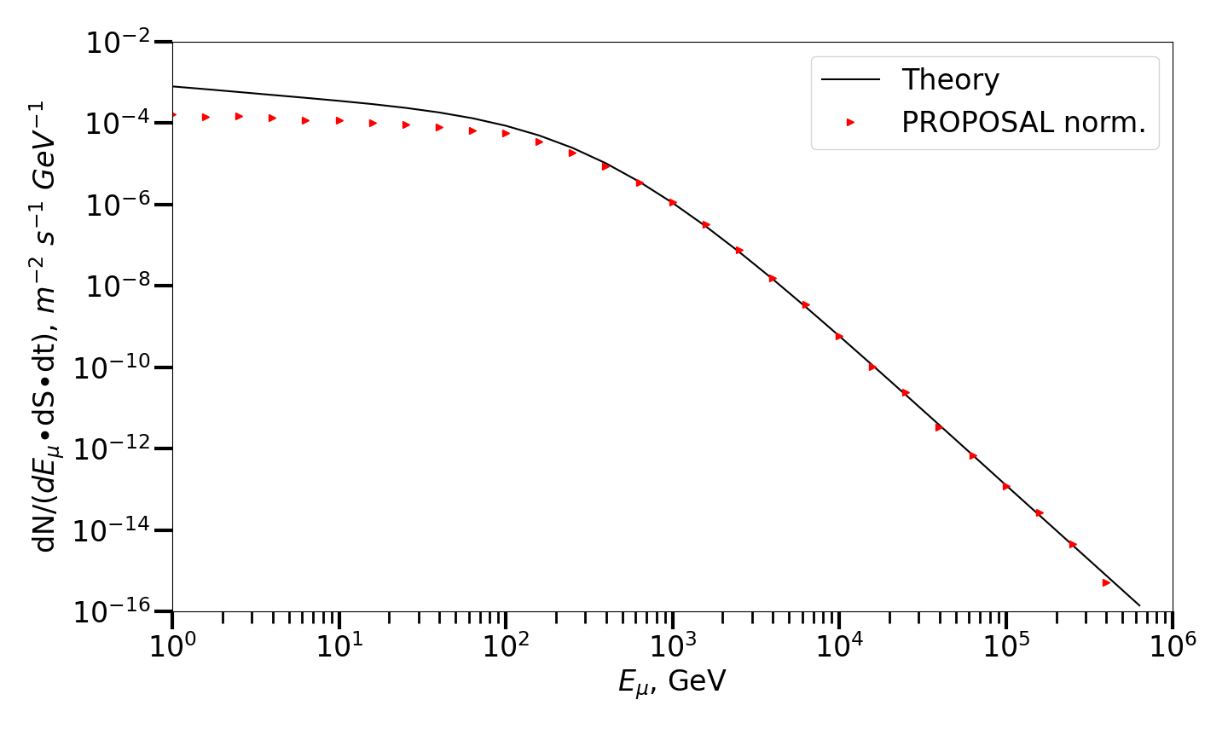
Normalized and theoretical muon spectra at depth of 1 km (PROPOSAL)
$$\frac{dN}{dE}\left(h,θ\right)=20.478∙\frac{e^{\left(−βb_{eff}h\right)}}{\cos{θ}}{\left(E+\frac{a}{b_{eff}^{′}}{(1−e}^{−βb_{eff}^{′}h})\right)}^{−\left(β+1\right)}$$
Muon spectrum at depth of 1 km at zenith angle of θ
β = -2.7
N_{all sim.} = 15·10⁶
$\overline{E_{μ}}≈289$ GeV
$exp⁡(\overline{lnE_{μ}})≈123$ GeV
$med E_{μ}≈129$ GeV
$mod E_{μ}≈100$ GeV
Normalized muon spectrum at depth of 1 km and theoretical estimations obtained with PROPOSAL.

Slide 7
Calculation of the spectrum of muon cascades at depth for Baikal-GVD
$$\frac{dN}{dE}\left(h=0\right)=\frac{20.478∙E^{−3.7}}{{cm}^{2} s sr GeV}∙\frac{1}{\cos{θ}}$$
Simplified Gaisser equation for muon spectrum at the Earth's surface at zenith angle θ.
$$\frac{dN}{dE}\left(h,θ\right)=20.478∙\frac{e^{\left(−βb_{eff}h\right)}}{\cos{θ}}{\left(E+\frac{a}{b_{eff}^{′}}{(1−e}^{−βb_{eff}^{′}h})\right)}^{−\left(β+1\right)}$$
Equation for muon spectrum at depth h at zenith angle θ.
$$b_{eff}=\sum_{i}{\int_{0}^{1}{σ_{i}\frac{1−{\left(1−v\right)}^{β}}{γ_{μ}}dv}}, v=\frac{ε}{E}; \frac{b^{′}eff}{b}=\frac{βk−1}{β−1}, k=\frac{b_{eff}}{b},$$
Correction coefficients to consider energy losses fluctuations.
Thus, muon cascades spectrum within volume V and with dN/dE muon spectrum at depth h can be found using:
$$\frac{dN_{c}}{dε}(ε)=\int_{0}^{V}{\int_{0}^{θ}{\int_{E0}^{∞}{\frac{dN}{dE}\left(h,θ\right)∙σ(E,ε) dEdθdV}}}$$

Slide 8
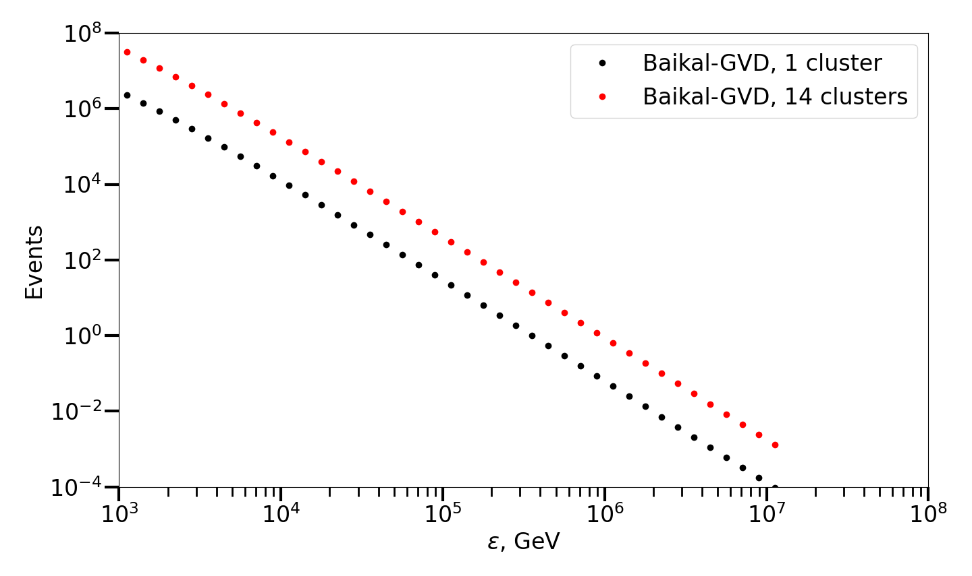
Calculation of the spectrum of muon cascades for Baikal-GVD
Estimated number of registered cascades per year
> 10 TeV
Baikal-GVD (1 cluster): ~ 2·10⁴
Baikal-GVD (14 clusters): ~ 3·10⁵
> 100 TeV
Baikal-GVD (1 cluster): ~ 50
Baikal-GVD (14 clusters): ~ 600
1 PeV
Baikal-GVD (1 cluster): ~ .1
Baikal-GVD (14 clusters): ~ 2
Estimated spectrum of muon cascades for Baikal-GVD
(for 1 and 14 clusters) for 1 year.

Slide 9
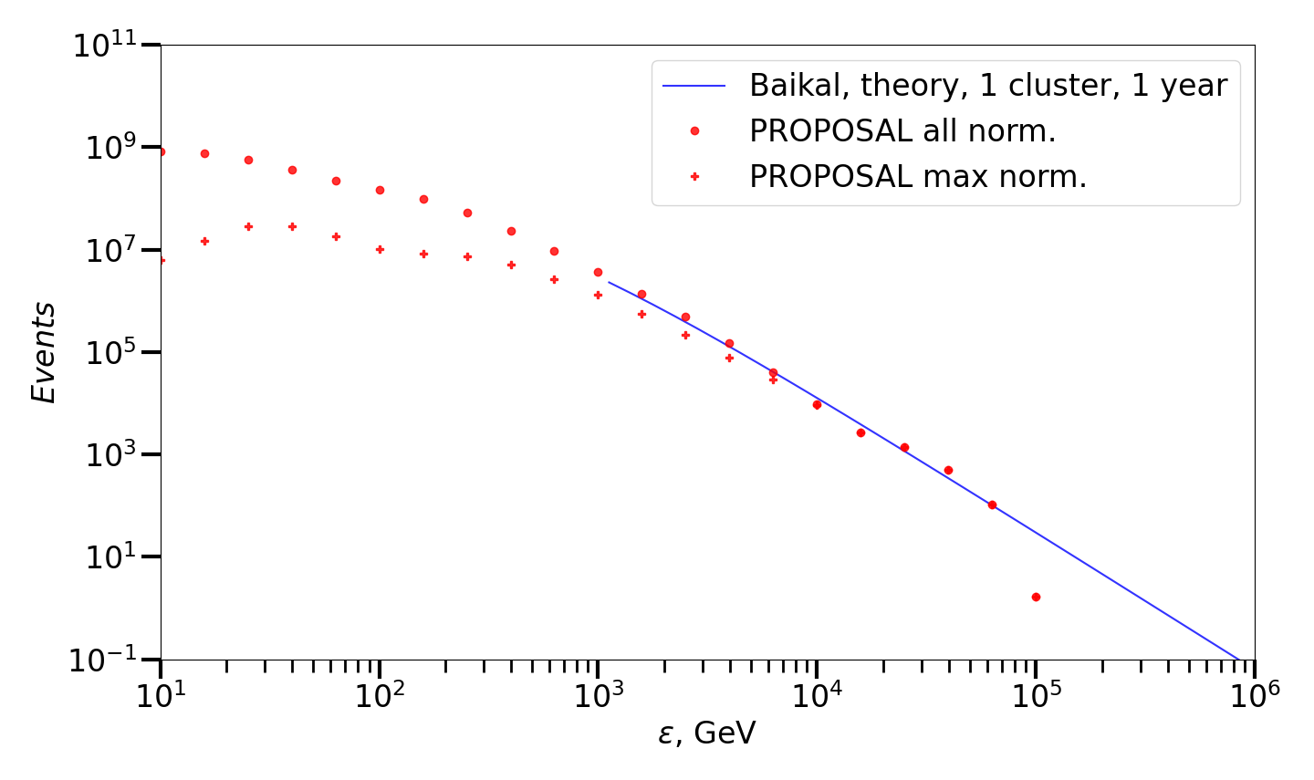
Cascade spectra comparison
N_{all est.} = 4.7·10⁹
N_{max est.} = 1.5·10⁸
$\overline{E_{μ}}≈289$ GeV
$exp⁡(\overline{lnE_{μ}})≈123$ GeV
$med E_{μ}≈129$ GeV
$mod E_{μ}≈100$ GeV
Normalized and theoretical cascade spectra obtained using PROPOSAL

Slide 10
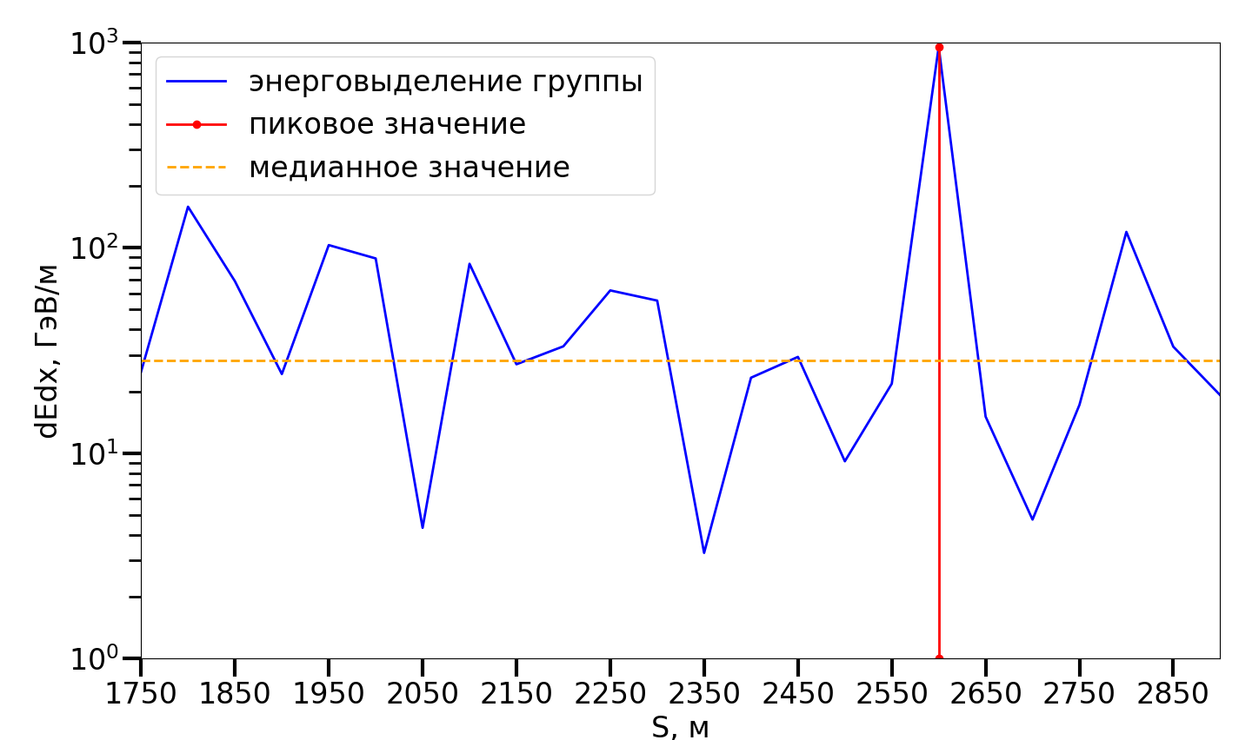
Peak-median parameter for searching VHE muon cascades
Energy loss of muons:
$$−\frac{dE_{μ}}{dx}=a(E_{μ})+b\left(E_{μ}\right)E_{μ}$$
The contribution of various processes to the muon ($E_{μ}=100 TeV$) energy loss:
δ-electrons: ≈ 0.3 %;
pair production: ≈ 49 %;
bremsstrahlung: ≈ 35 %;
photonucl. interaction: ≈ 15 %.
Using the peak-median value allows selecting events with large cascades.
The presence of such cascades may indicate the presence of a VHE muon in a bundle.
peak-median$=\frac{\max\left(\frac{dE}{dS}\right)}{median\left(\frac{dE}{dS}\right)}$
Muon bundle energy loss
Peak value
Median value
GeV/m
m
Example of peak-median value estimation

Slide 11
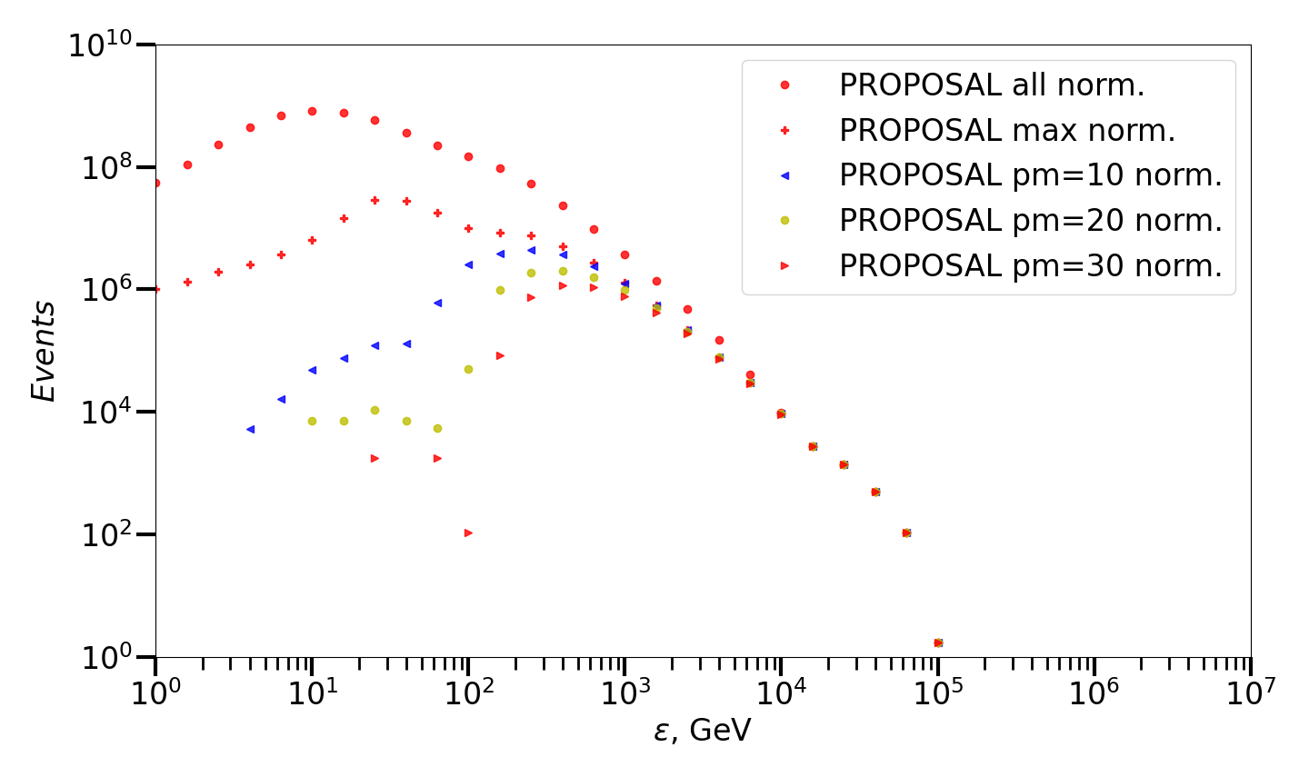
Muon cascades spectrum with peak-median filtration
Estimated number of all cascades, maximum cascades and cascades from pm-filtered bundles:
N_{all est.} = 4.7·10⁹
N_{max est.} = 1.5·10⁸
N_{pm10 est.} = 1.9·10⁷
N_{pm20 est.} = 8.3·10⁶
N_{pm30 est.} = 4.6·10⁶
Normalized cascade spectra obtained with PROPOSAL: all cascades, maximum and cascades from pm-filtered bundles

Slide 12
Conclusion
Theoretical estimations show that analyzing muon cascades in Baikal-GVD allows measuring the muon energy spectrum up to PeV.
A preliminary comparison of simulated in PROPOSAL and theoretical spectra shows that simulation is correct and can be used for further studying.

Slide 13
Thank you for your attention!
Lisitsin M.V., Khokhlov S.S., Nikolaenko R.V. , Petrukhin A.A.
24.06.2025

