Slide 1
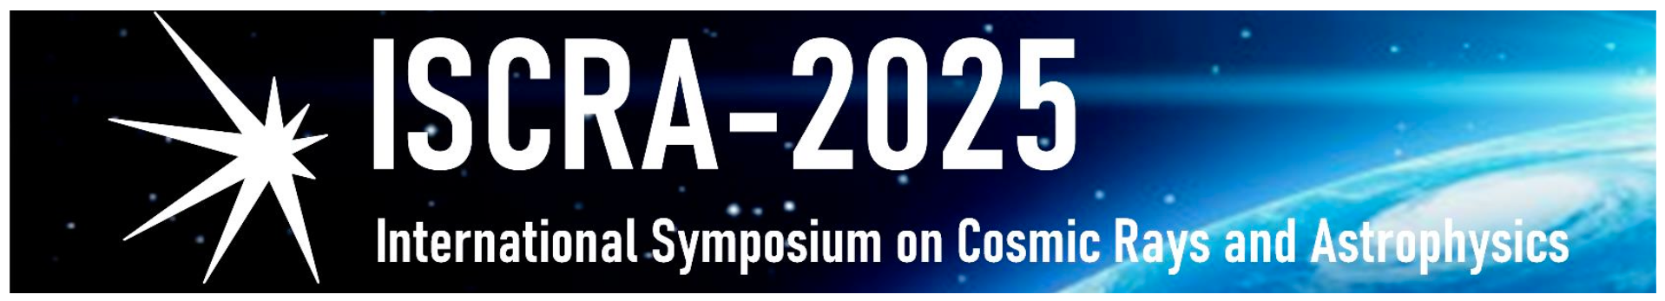
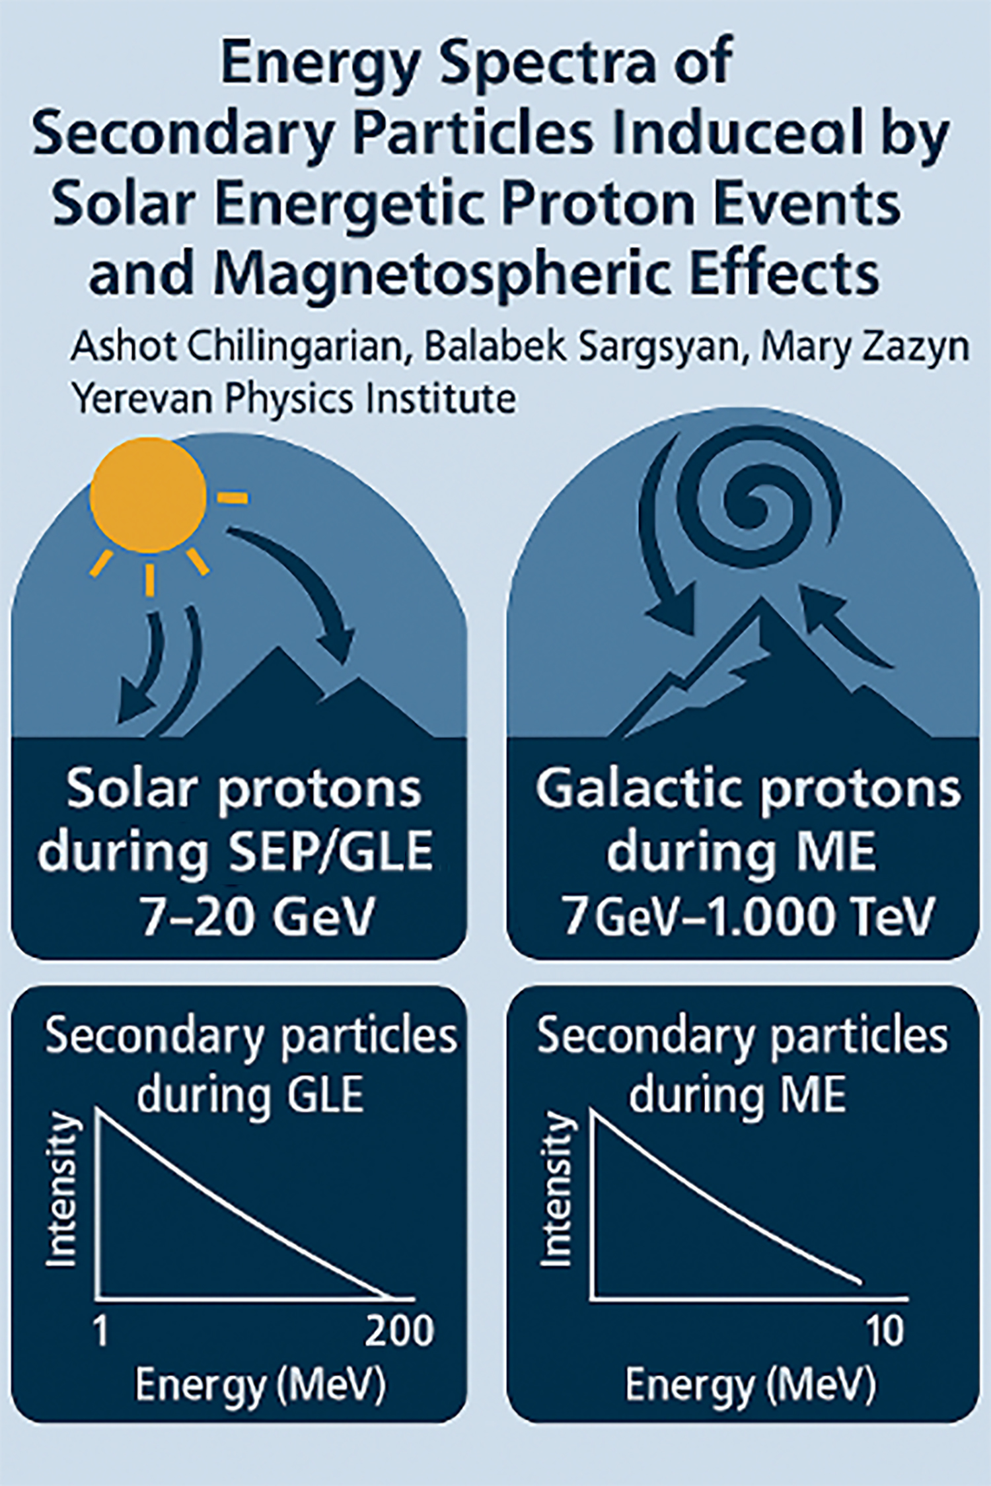
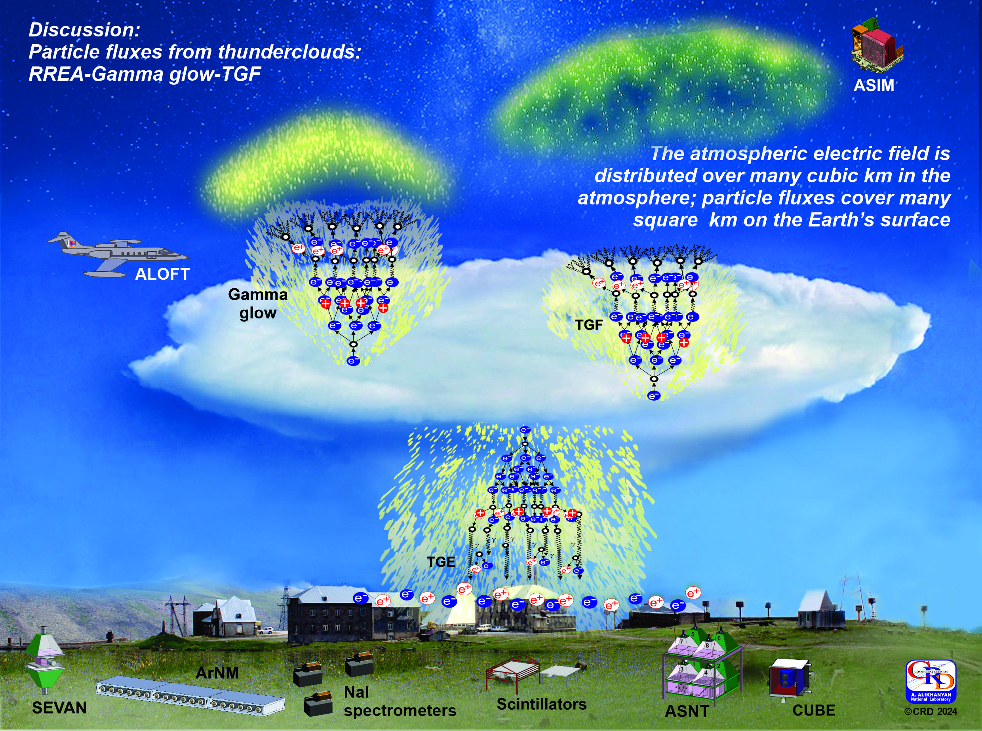
COMPARISON OF GLE EVENT OF 11 MAY 2024 AND MAGNETOSPHERIC EFFECT on 5 NOVEMBER 2023
A.Chilingarian
Yerevan Physics Institute
Electron
Accelerator
E>2 kV/cm

Slide 2
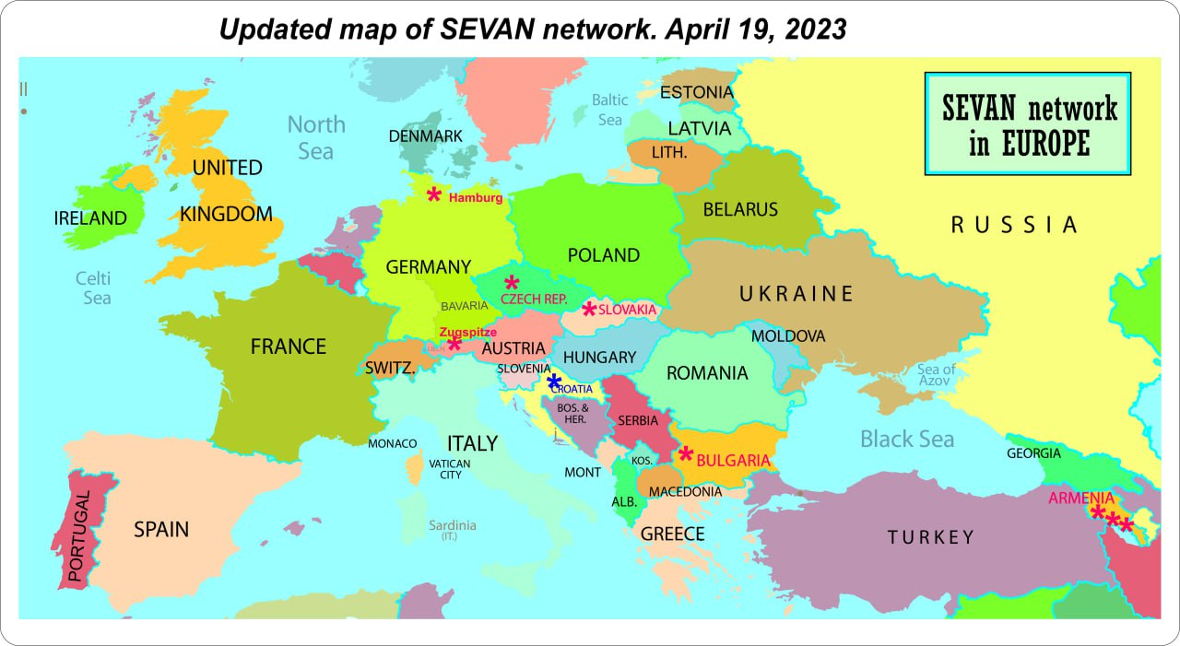
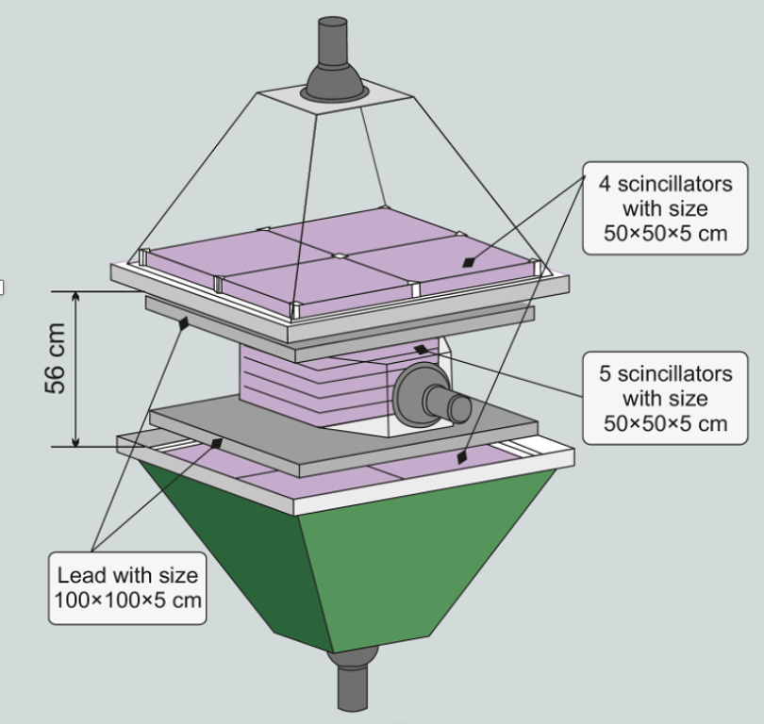
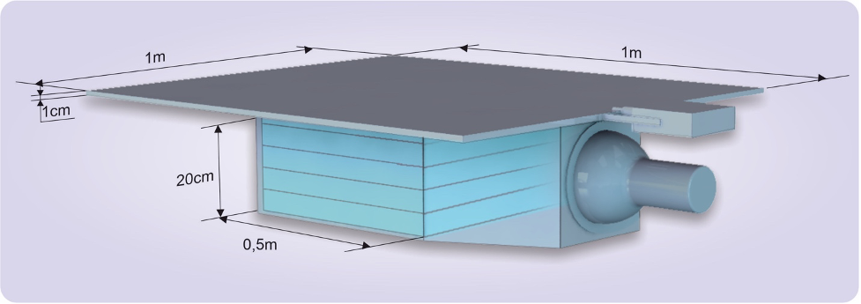
The SEVAN network (Space Environment Viewing and Analysis Network), as part of the United Nations Basic Space Science (UNBSS) activities, was supported by the International Heliophysical Year 2007 and the UN Office for Outer Space Affairs. CRD experts developed a new class of hybrid particle detectors capable of measuring both neutral and charged particles. The network's initial rollout included installations in Croatia, Bulgaria, and India. Expansion continued with the installation of SEVAN detectors in Slovakia, Germany (Hamburg and Berlin), the Czech Republic, and atop Zugspitze, Germany's highest peak, in 2023. Local SEVAN groups foster a community for research in solar physics and high-energy atmospheric physics by analyzing neutrons and muons modulated during solar violent events and recording increased fluxes of electrons and gamma rays during thunderstorms, RREA/TGE events.
SEVAN
SEVAN
Newly developed SEVAN-light detector measures separately charged and neutral particle energy releases in a 25 cm thick scintillator.
SEVAN light

Slide 3

SEVAN-light installed on Aragats and Zugspitze just in time to observe Solar events of the 25th cycle
NM community: no GLE detection on middle altitudes: flux enhancement caused by the rising (recovery) phase of FD and ME
GLE is seen only by Antarctic NMs, and solar protons' maximum energy is probably less than 2.4 GeV.
Middle latitude detectors, both NMs and SEVAN units, register GLE.
The Maximum Energy of Solar protons was 8-10 GeV.
The November 5, 2023, solar event was a significant magnetospheric effect, and 11 May was not.
Updated definition of magnetospheric event.

Slide 4
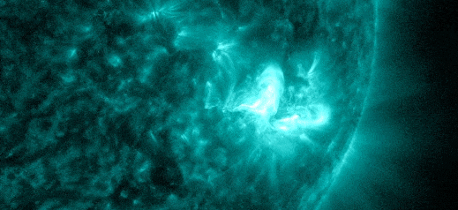
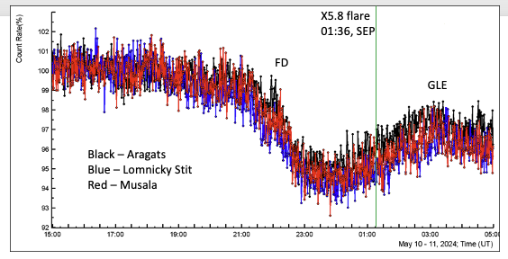
THE STRONGEST X-FLARE accelerates protons and sends them to the Earth!
SEVAN detection of the Forbush decrease (FD) of global cosmic ray flux due to the arrival of magnetized plasma from the violent solar burst and ground level enhancement (GLE) from solar protons from the X5.8 flare. We see the precise correlated time series from the SEVAN detectors located on Mt. Aragats (40.25°N, 44.15°E, altitude 3200 m), Musala (42.1°N, 23.35°E, altitude 2930 m), and Lomnicky Stit (49.2°N, 20.22°E, altitude 2635 m).
Giant sunspot AR3664 unleashed another X-flare on May 11th @ 01:39 UT, in a series of flares that send magnetized plasma ejecta in the direction of the Earth. NASA's Solar Dynamics Observatory captured a bright ultraviolet flash from the category X5.8 explosion.

Slide 5
Summary of solar events 25th cycle: ME and GLE

Slide 6
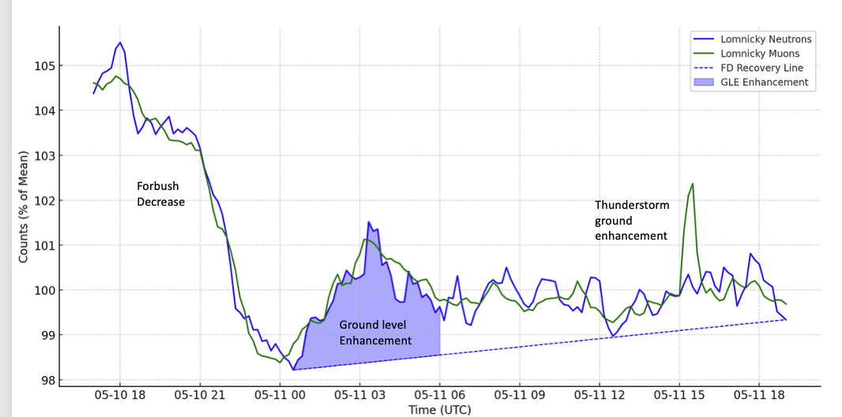
FD/GLE detection at Lomnicky Stit by Neutron Monitor and SEVAN

Slide 7
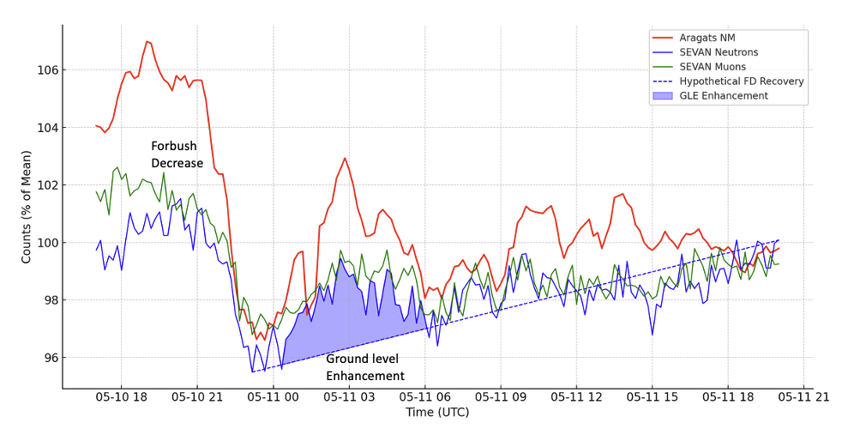
FD/GLE detection at Lomnicky Stit by Neutron Monitor and SEVAN

Slide 8
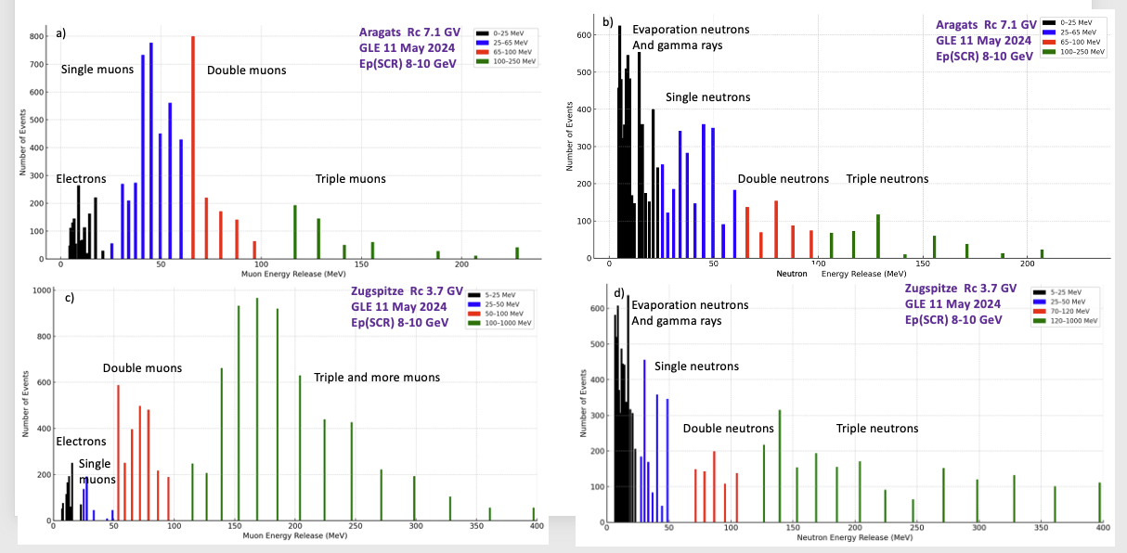
Solar events: ME on 5 November and GLE on 11 May

Slide 9
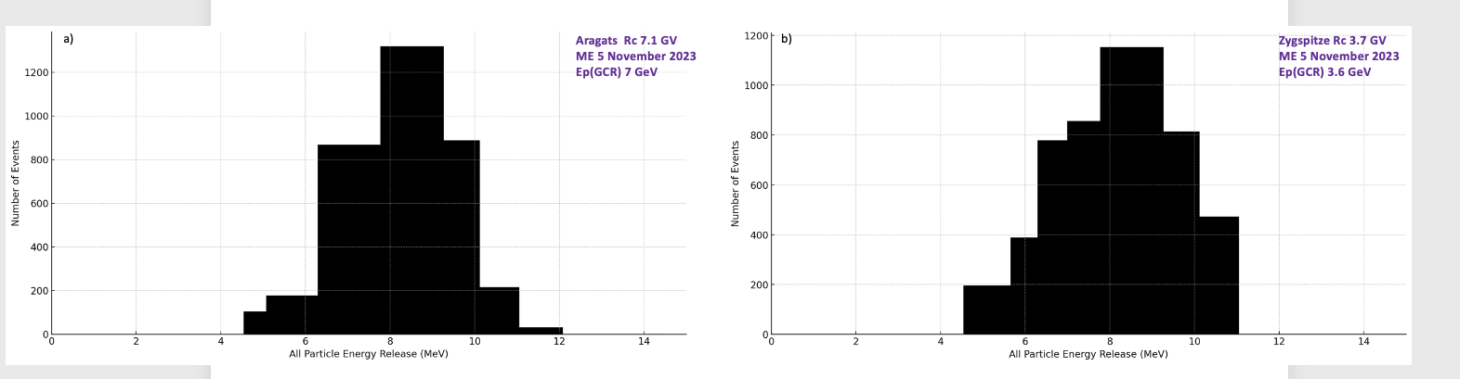
Solar events: magnetospheric effect on 5. Nov.

Slide 10
Solar Events as reflected in in Energy Spectra of kascade particles
Measuring secondary energy spectra shows that the number of secondaries rises sharply for each additional GeV above 7 GeV. With a little extra energy (8–10 GeV), you can trigger a deep avalanche (large, energetic cascade, many high-energy particles).
ME event (initiated by GCR protons with energies below 7 GeV):
  Spectrum is steep (spectral index ~–4 or steeper).
  Secondaries are low-energy, below 10 MeV.
GLE event (initiated by SEP events 8–10 GeV protons):
  Spectrum is flatter (index ~–2 to 2.5), extending above 200 MeV.
  Abundant high-energy neutrons and muons—double and tripple coincidences
The hard tail is the “fingerprint” of an extreme solar event, impossible to mimic through small reductions in cutoff during a ME.

Slide 11
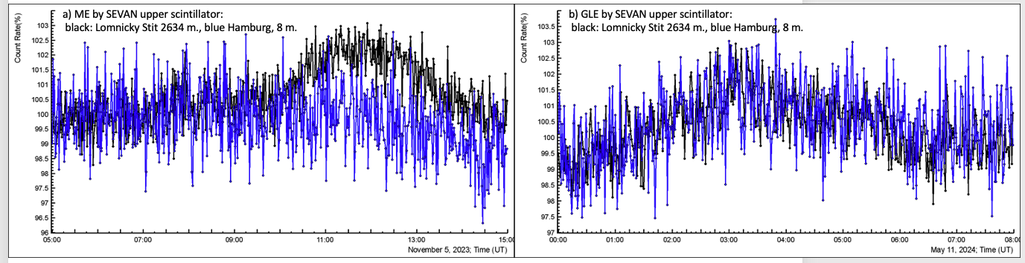
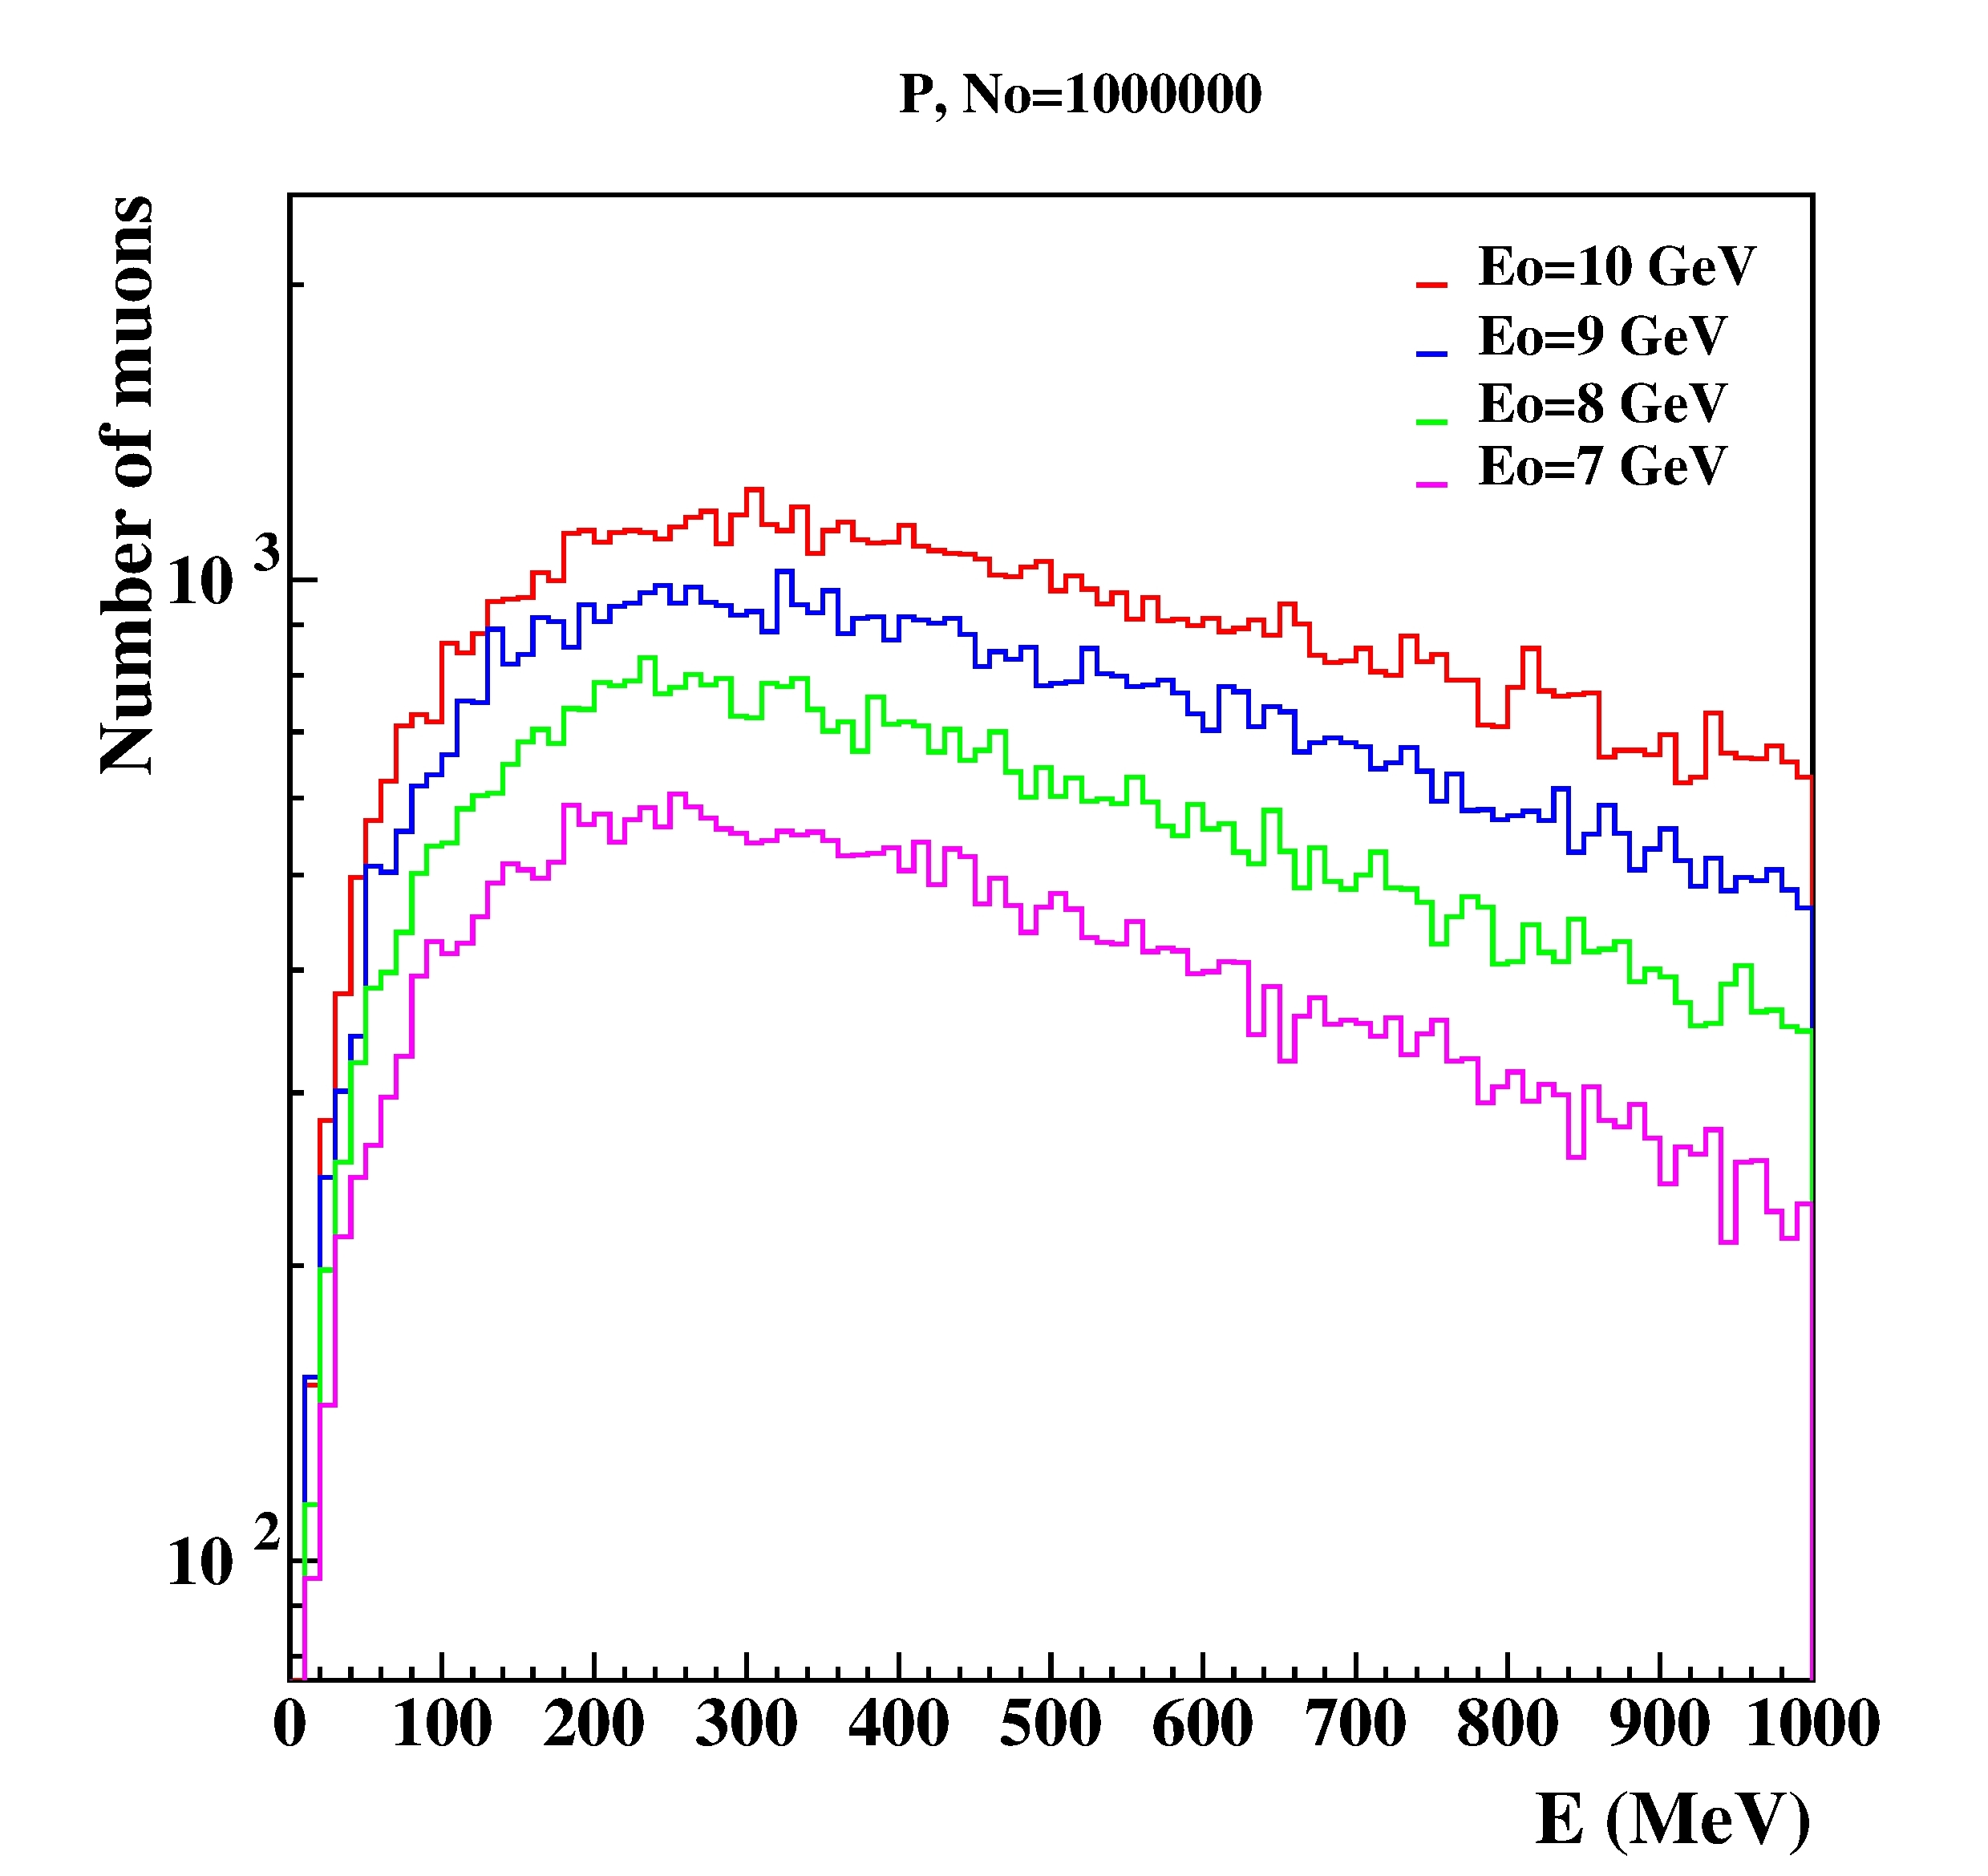
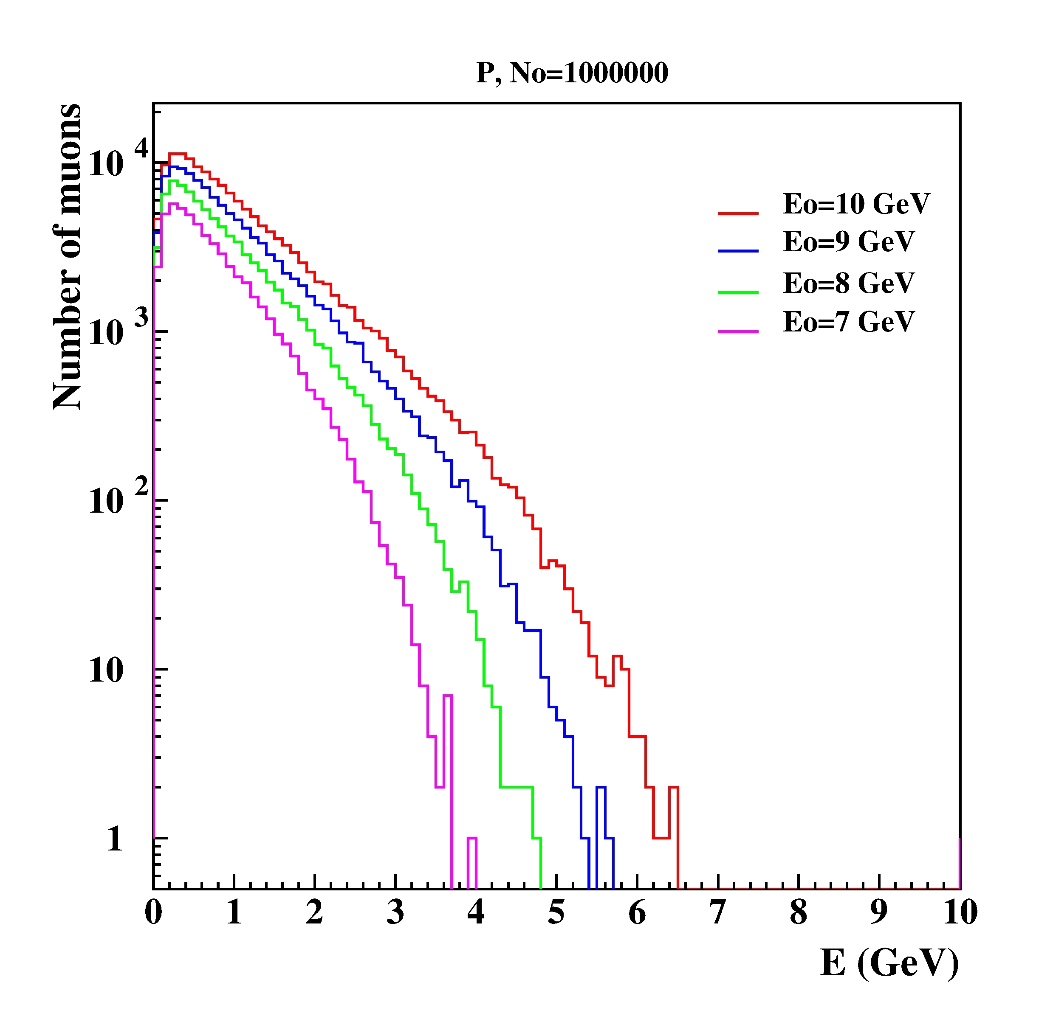
‘High and low altitude SEVAN detectors during GLE and ME: atmospheric cutoff
Eo (GeV) | µ+&µ- | e+&e- | γ
7 | 0.054 | 0.040 | 0.218
8 | 0.081 | 0.058 | 0.311
9 | 0.112 | 0.079 | 0.420
10 | 0.145 | 0.101 | 0.538

Slide 12
Definition of the Magnetospheric Effect. Our classification consists of the following criteria:
Observation by High-Latitude and Middle-Latitude Detectors: Antarctic and near-polar neutron monitors do not register flux enhancements, whereas middle-latitude NMs and muon detectors consistently observe count rate increases.
Influence of Atmospheric Cutoff Rigidity: Due to atmospheric cutoff rigidity, NMs and SEVAN detectors located on mountain tops at middle latitudes exhibit flux enhancements, while those at sea level do not.
Distinct Energy Spectra: The energy spectra of shower particles measured during ME events differ significantly from other causes of flux enhancement, making this criterion essential for ME identification.

