Slide 1



PROTON ACCELERATION RATE
REQUIRED FOR THE GLE EVENTS
OF THE 24th AND 25th SOLAR CYCLES
Alexei Struminsky, Vadim Ozheredov, Andrei Sadovskii
Space Research Institute Moscow,
and
Irina Grigorieva
Main Pulkovo Astronomical Observatory, Saint-Petersburg
ISCRA, METHI June 24-26, 2025
Notes:
1

Slide 2

https://www.esa.int/Science_Exploration/Space_Science/Integral
The mission Integral was the first space observatory to simultaneously observe objects in gamma rays, X-rays, and visible light. Its principal targets were violent explosions known as gamma-ray bursts, powerful phenomena such as supernova explosions, and regions in the Universe thought to contain black holes.
Launch: 17 October 2002
Mission end: 28 February 2025
Orbit: highly elliptical around Earth
Observed: gamma rays, X-rays, visible light
Targets: gamma-ray bursts, black holes, supernovae
By product INTEGRAL observed solar hard X-rays, solar and galactic cosmic rays

Slide 3
ACS SPI
The AntiCoincidence Shield of the SPectrometer on the INTEGRAL (ACS SPI) records primary and secondary HXR https://isdc.unige.ch/~savchenk/spiacs-online/spiacspnlc.pl.
The secondary HXR is due to galactic and solar CR protons.
The AntiCoincidence Shield of the SPectrometer on the INTEGRAL (ACS SPI) records primary and secondary HXR E > 100 keV
https://isdc.unige.ch/~savchenk/spiacs-online/spiacspnlc.pl.
The count rate in the minimum of solar activity is ~ 6800 counts per 50 ms and corresponds to >100 MeV GCR ~0.1 pfu., i.e. 3.5 10⁻⁵ pfu >100 MeV).
No standard detectors registering >100 MeV proton fluxes with such accuracy. The onset of a significant increase in the ACS SPI count rate of concurrently or after a solar HXR burst is a moment of the first solar proton arrival to the Earth orbit .
The monitor of radiation environment in L2, light curves of ART XC >60 keV https://monitor.srg.cosmos.ru
The ACS SPI is a perfect instrument for studies of temporal relation between solar HXR flares and associated solar proton enhancements.
The onset of a significant increase in the ACS SPI count rate of concurrently or after a solar HXR burst might be considered as a moment of the first solar protons arrival to the Earth’s orbit with energy less than 430 MeV — the atmospheric cutoff.
The count rate in the minimum of solar activity is ~ 6800 counts per 50 ms and corresponds to >100 MeV GCR ~0.1 pfu., i.e. 3.5 10⁻⁵ pfu >100 MeV).
No standard detectors registering >100 MeV proton fluxes with such accuracy.

Slide 4
Registration of GLE and subGLE
Sub GLE – response of two high altitude NMs, protons with energy less than atmospheric cutoff ~430 MeV
GLE –response of two NMs, one of them is not high altitude, protons with energy more than atmosperic and geomagnetic cutoff
Spectrum of GLE protons is not only the result of their acceleration, but also of their propagation.

Slide 5
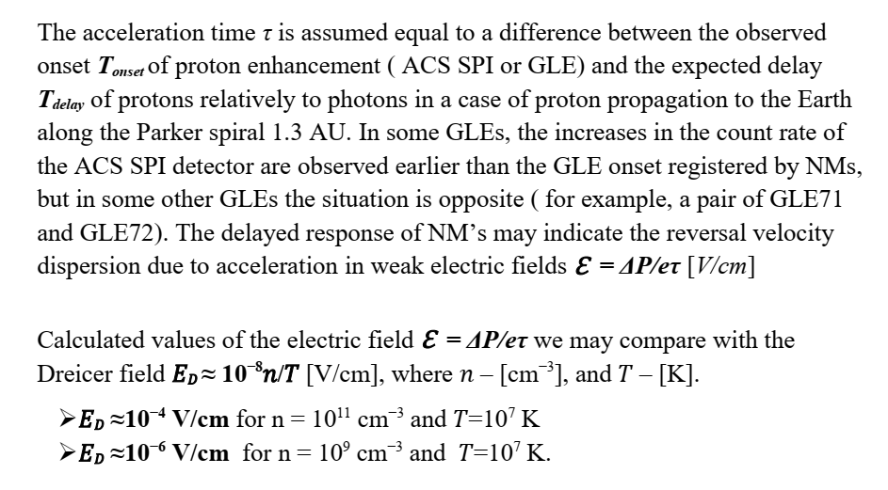
METHODS

Slide 6
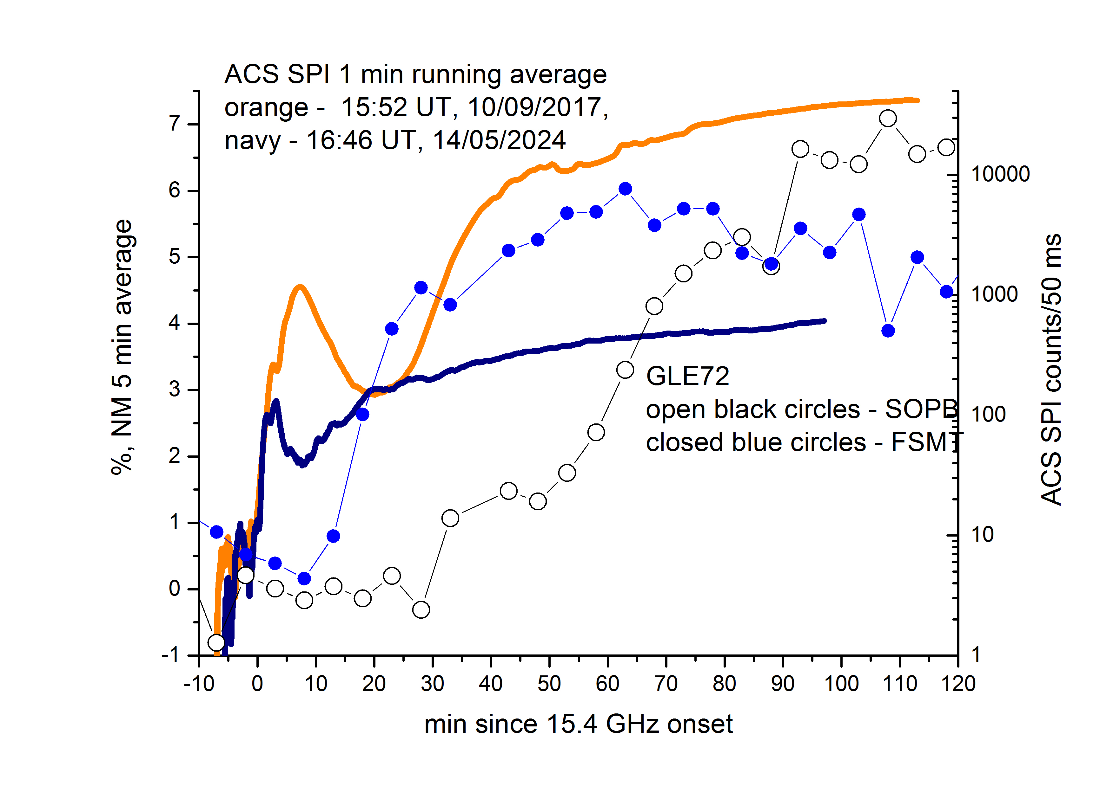
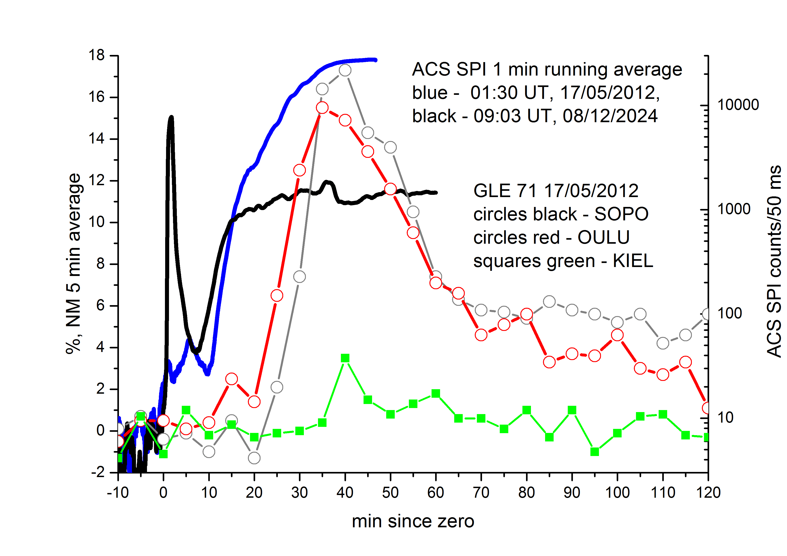
GLE71 17/05/2012
GLE72 10/09/2017
date | NM onset, min | P, MV | β | T delay, min | τ, min | Ɛ, V/cm
17/05/2012 | +13 OULU | 996 | 0.73 | 6.5 | 6.5 | 7.3 E-5
 | +20 KIEL | 2360 | 0.92 | 3.4 | 16.7 | 7.4 E-5
10/09/2017 | +8 FSMT | 996 | 0.73 | 6.5 | 1.5 | 3.2 E-4
 | +18 LMSK | 3840 | 0.97 | 2.8 | 15.2 | 1.4 E-4

Slide 7
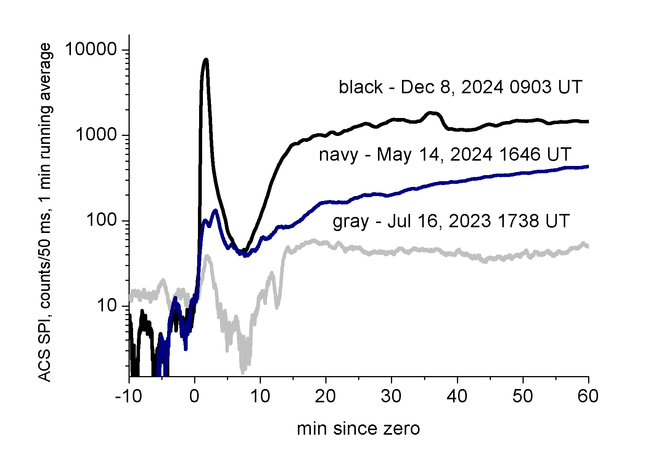
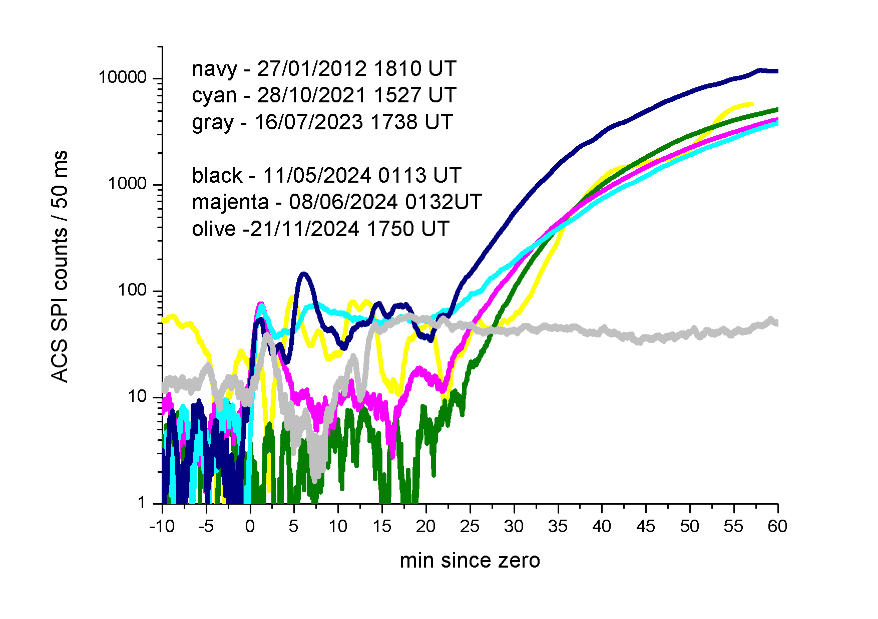
«Early» and weak proton enhancements registered by ACS SPI associated with impulsive flares on July 16, 2023 (S23W58, M4.0), May 14 мая (S18W89, X8.7) and December 8 (S08W54, X2.2) 2024 may be considered as pattern examples for initial stage of large SEP events (Struminsky et al., 2025).
The GLE events of the 25th solar cycle:
GLE 73 28/10/2021 (S26W05, X1.1)
GLE 74 11/05/2024 (S15W45, X5.8)
GLE 75 08/06/2024 (S18W53, M9.7)
GLE 76 21/11/2024 (behind the limb)
The subGLE events of the 24th cycle:
January 27, 2012 (N27W71, X1.7)
January 06, 2014 (behind the limb)

Slide 8
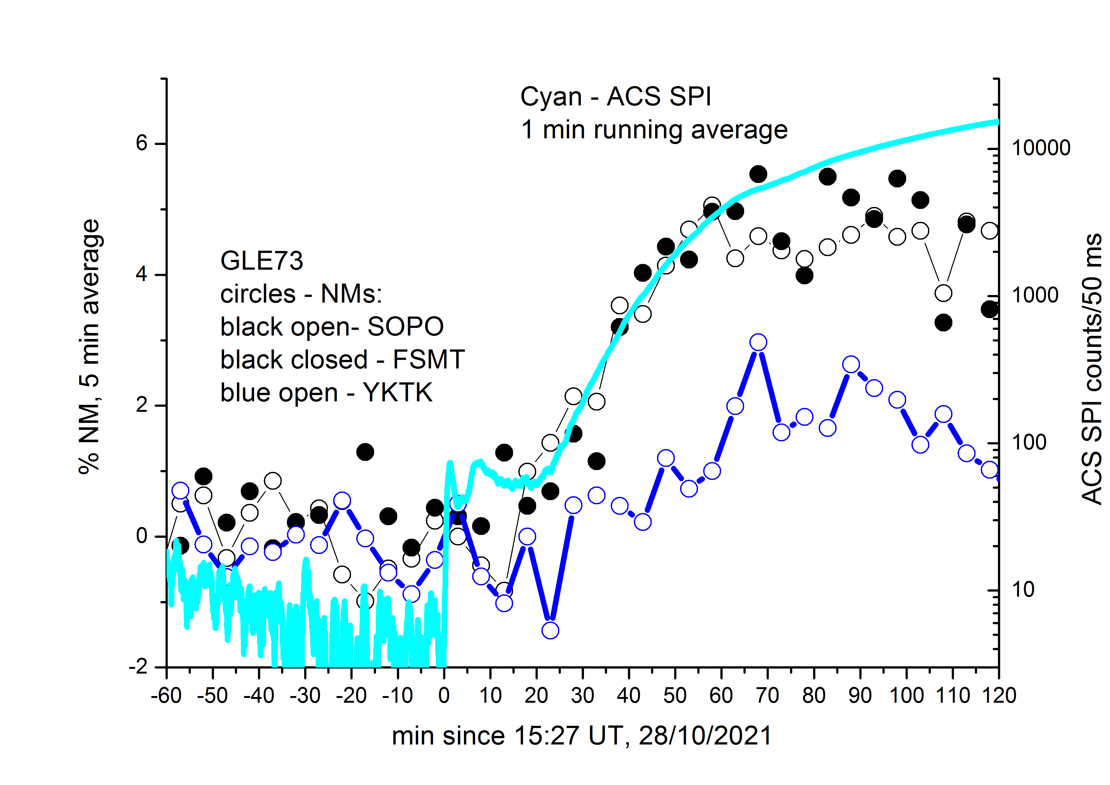
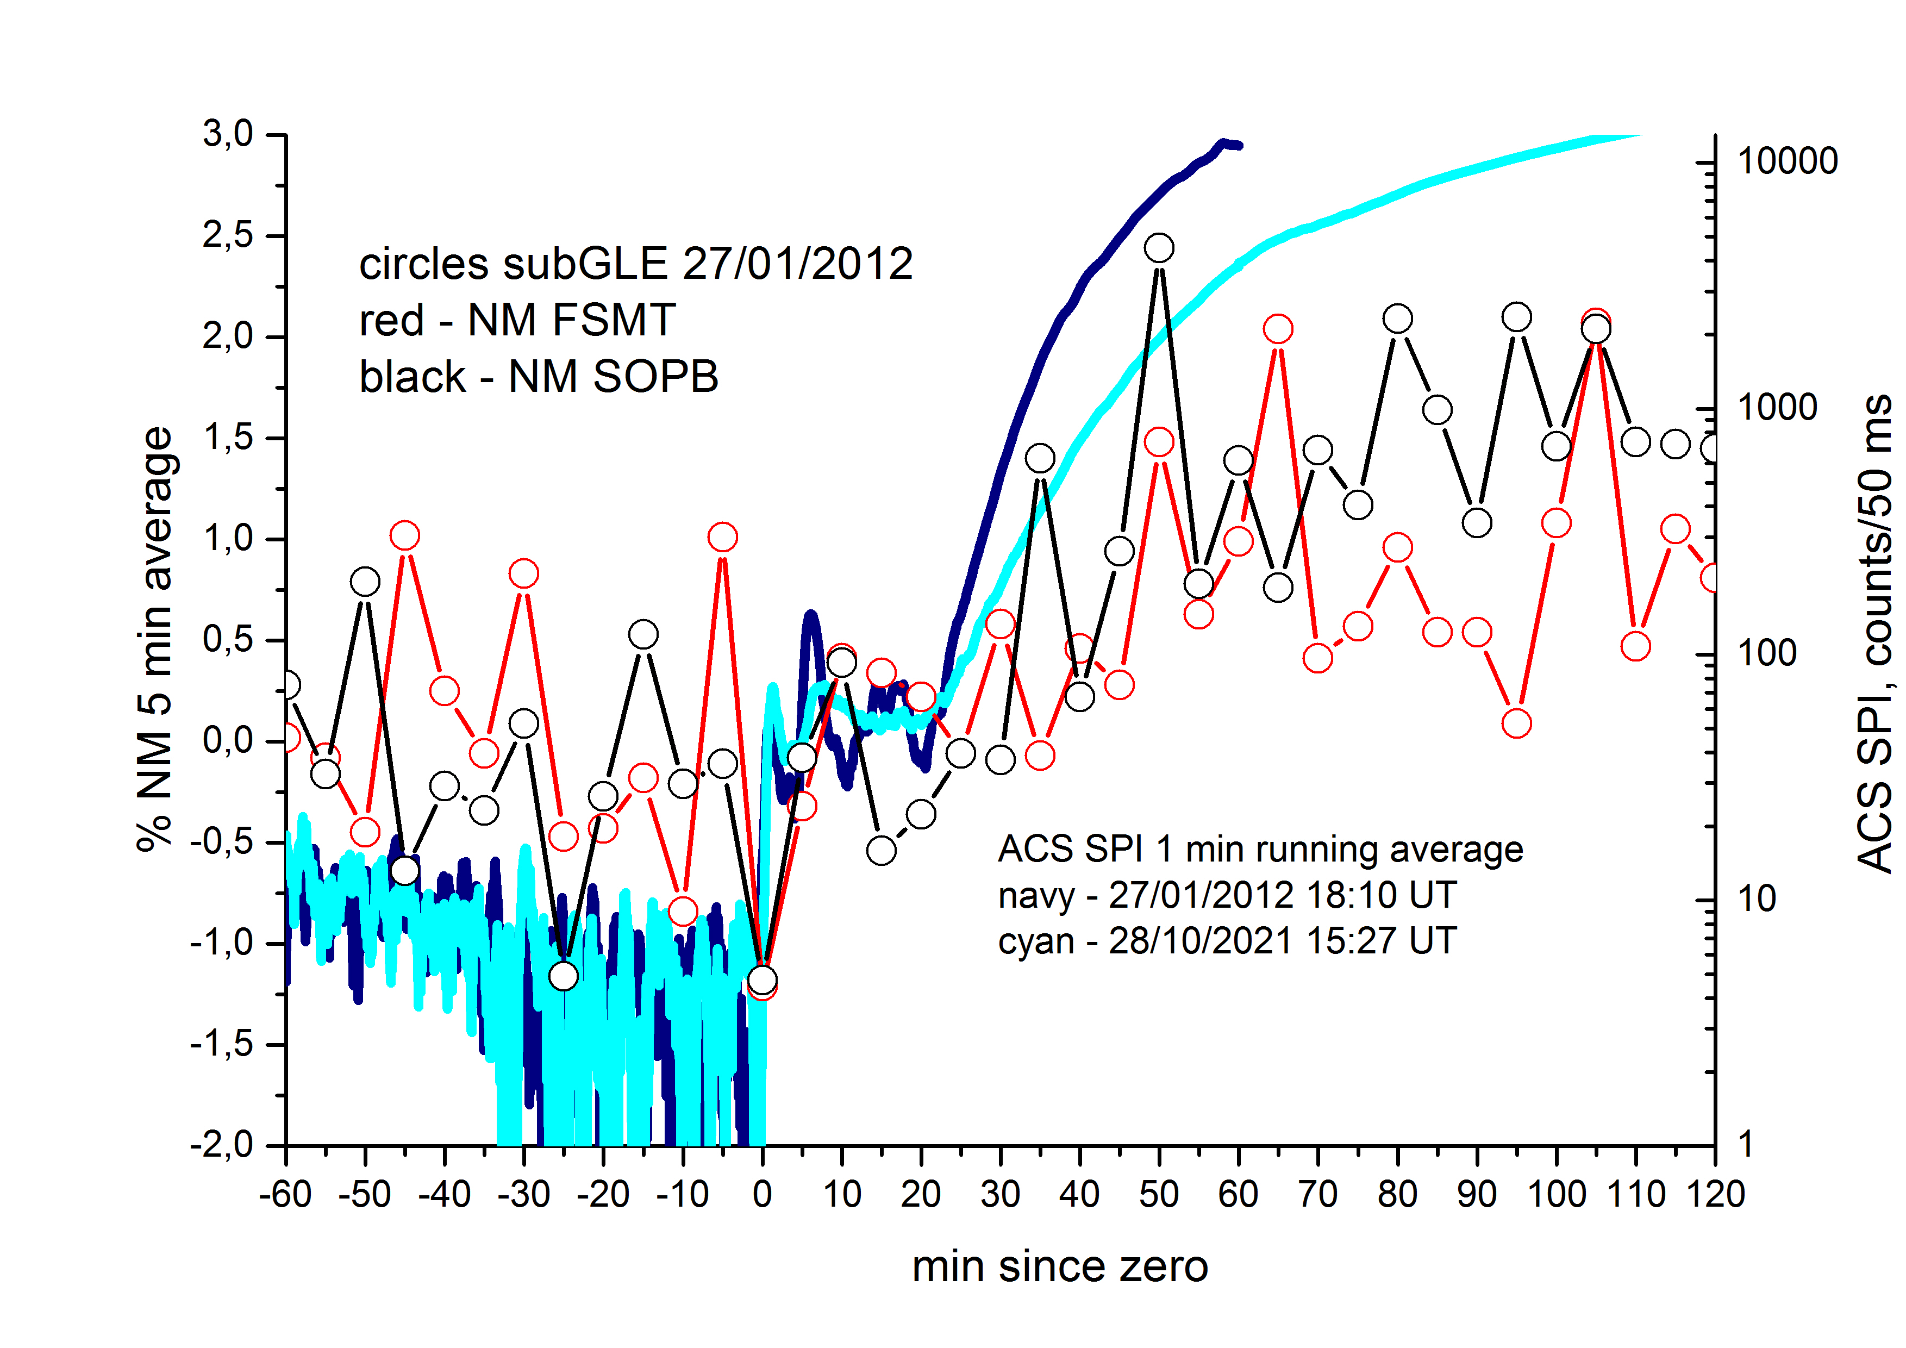
GLE73 28/10/2021
SubGLE 27/01/2012
date | NM onset, min | P, MV | β | T delay, min | τ, min | Ɛ, V/cm
28/10/2021 | +18 SOPO | 808 | 0.65 | 8.3 | 9.7 | 3.8 E-5
 | +23 FSMT | 996 | 0.73 | 6.5 | 16.5 | 3.4 E-5
 | +38 YKTK | 1650 | 0.87 | 4.1 | 33.9 | 2.5 E-5
27/01/2012 | +15 SOPO | 808 | 0.65 | 6.5 | 8.5 | 4.4 E-5

Slide 9
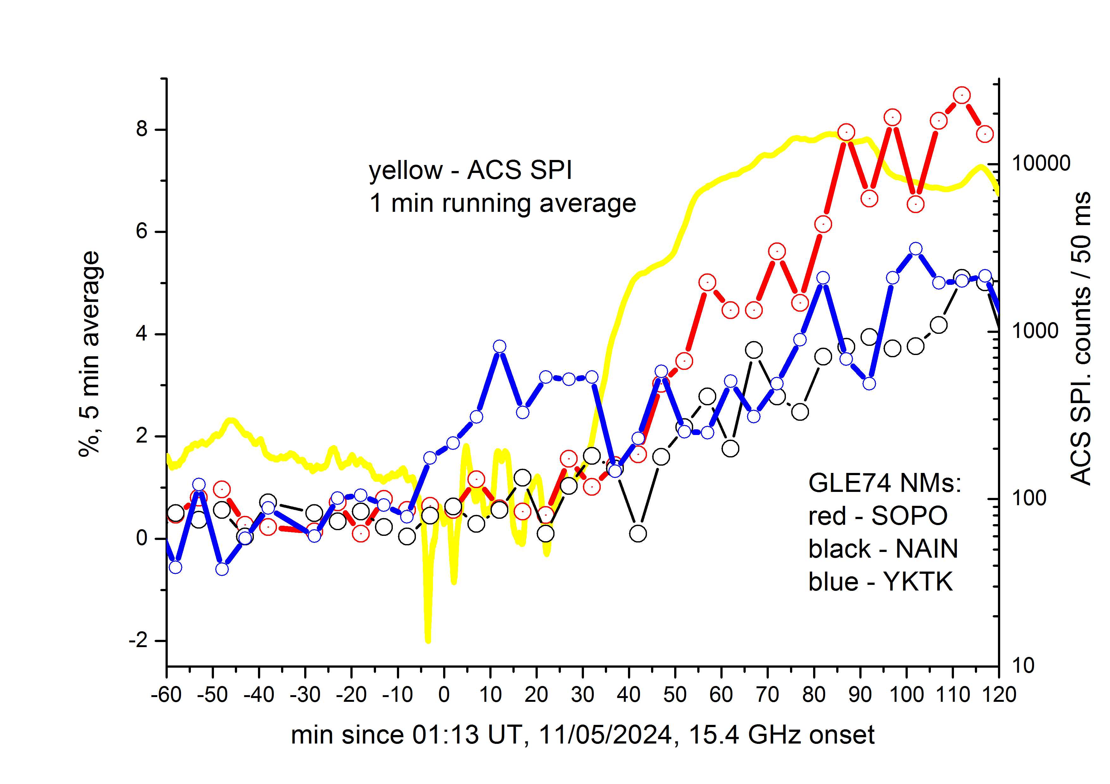
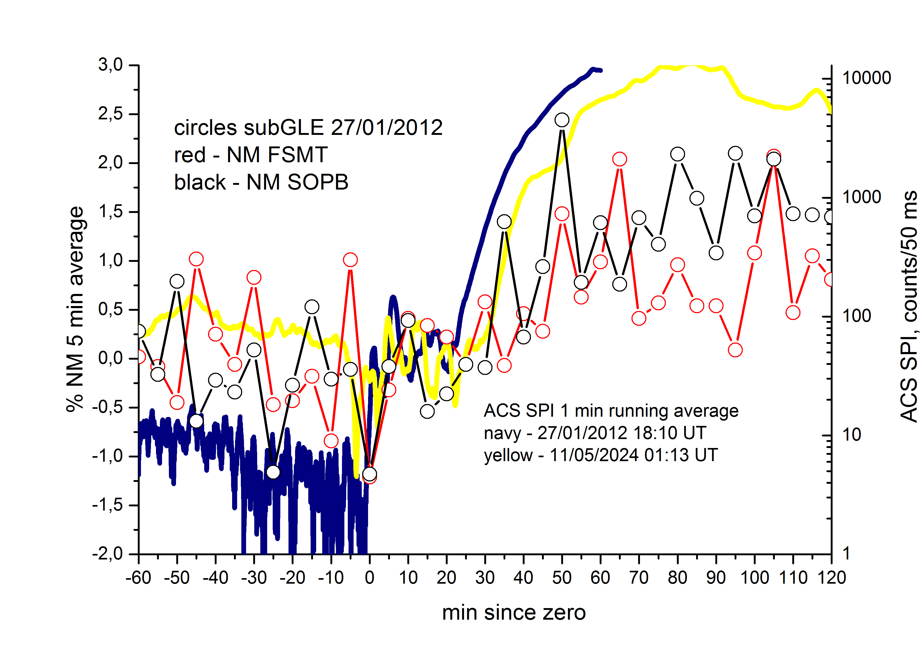
SubGLE 27/01/2012
GLE74 11/05/2024
date | NM onset, min | P, MV | β | T delay, min | τ, min | Ɛ, V/cm
11/05/2024 | +18 SOPO | 808 | 0.65 | 8.3 | 9.7 | 3.8 E-5
 | +23 NAIN | 996 | 0.73 | 6.5 | 16.5 | 3.4 E-5
 | +38 YKTK | 1650 | 0.87 | 4.1 | 33.9 | 2.5 E-5

Slide 10
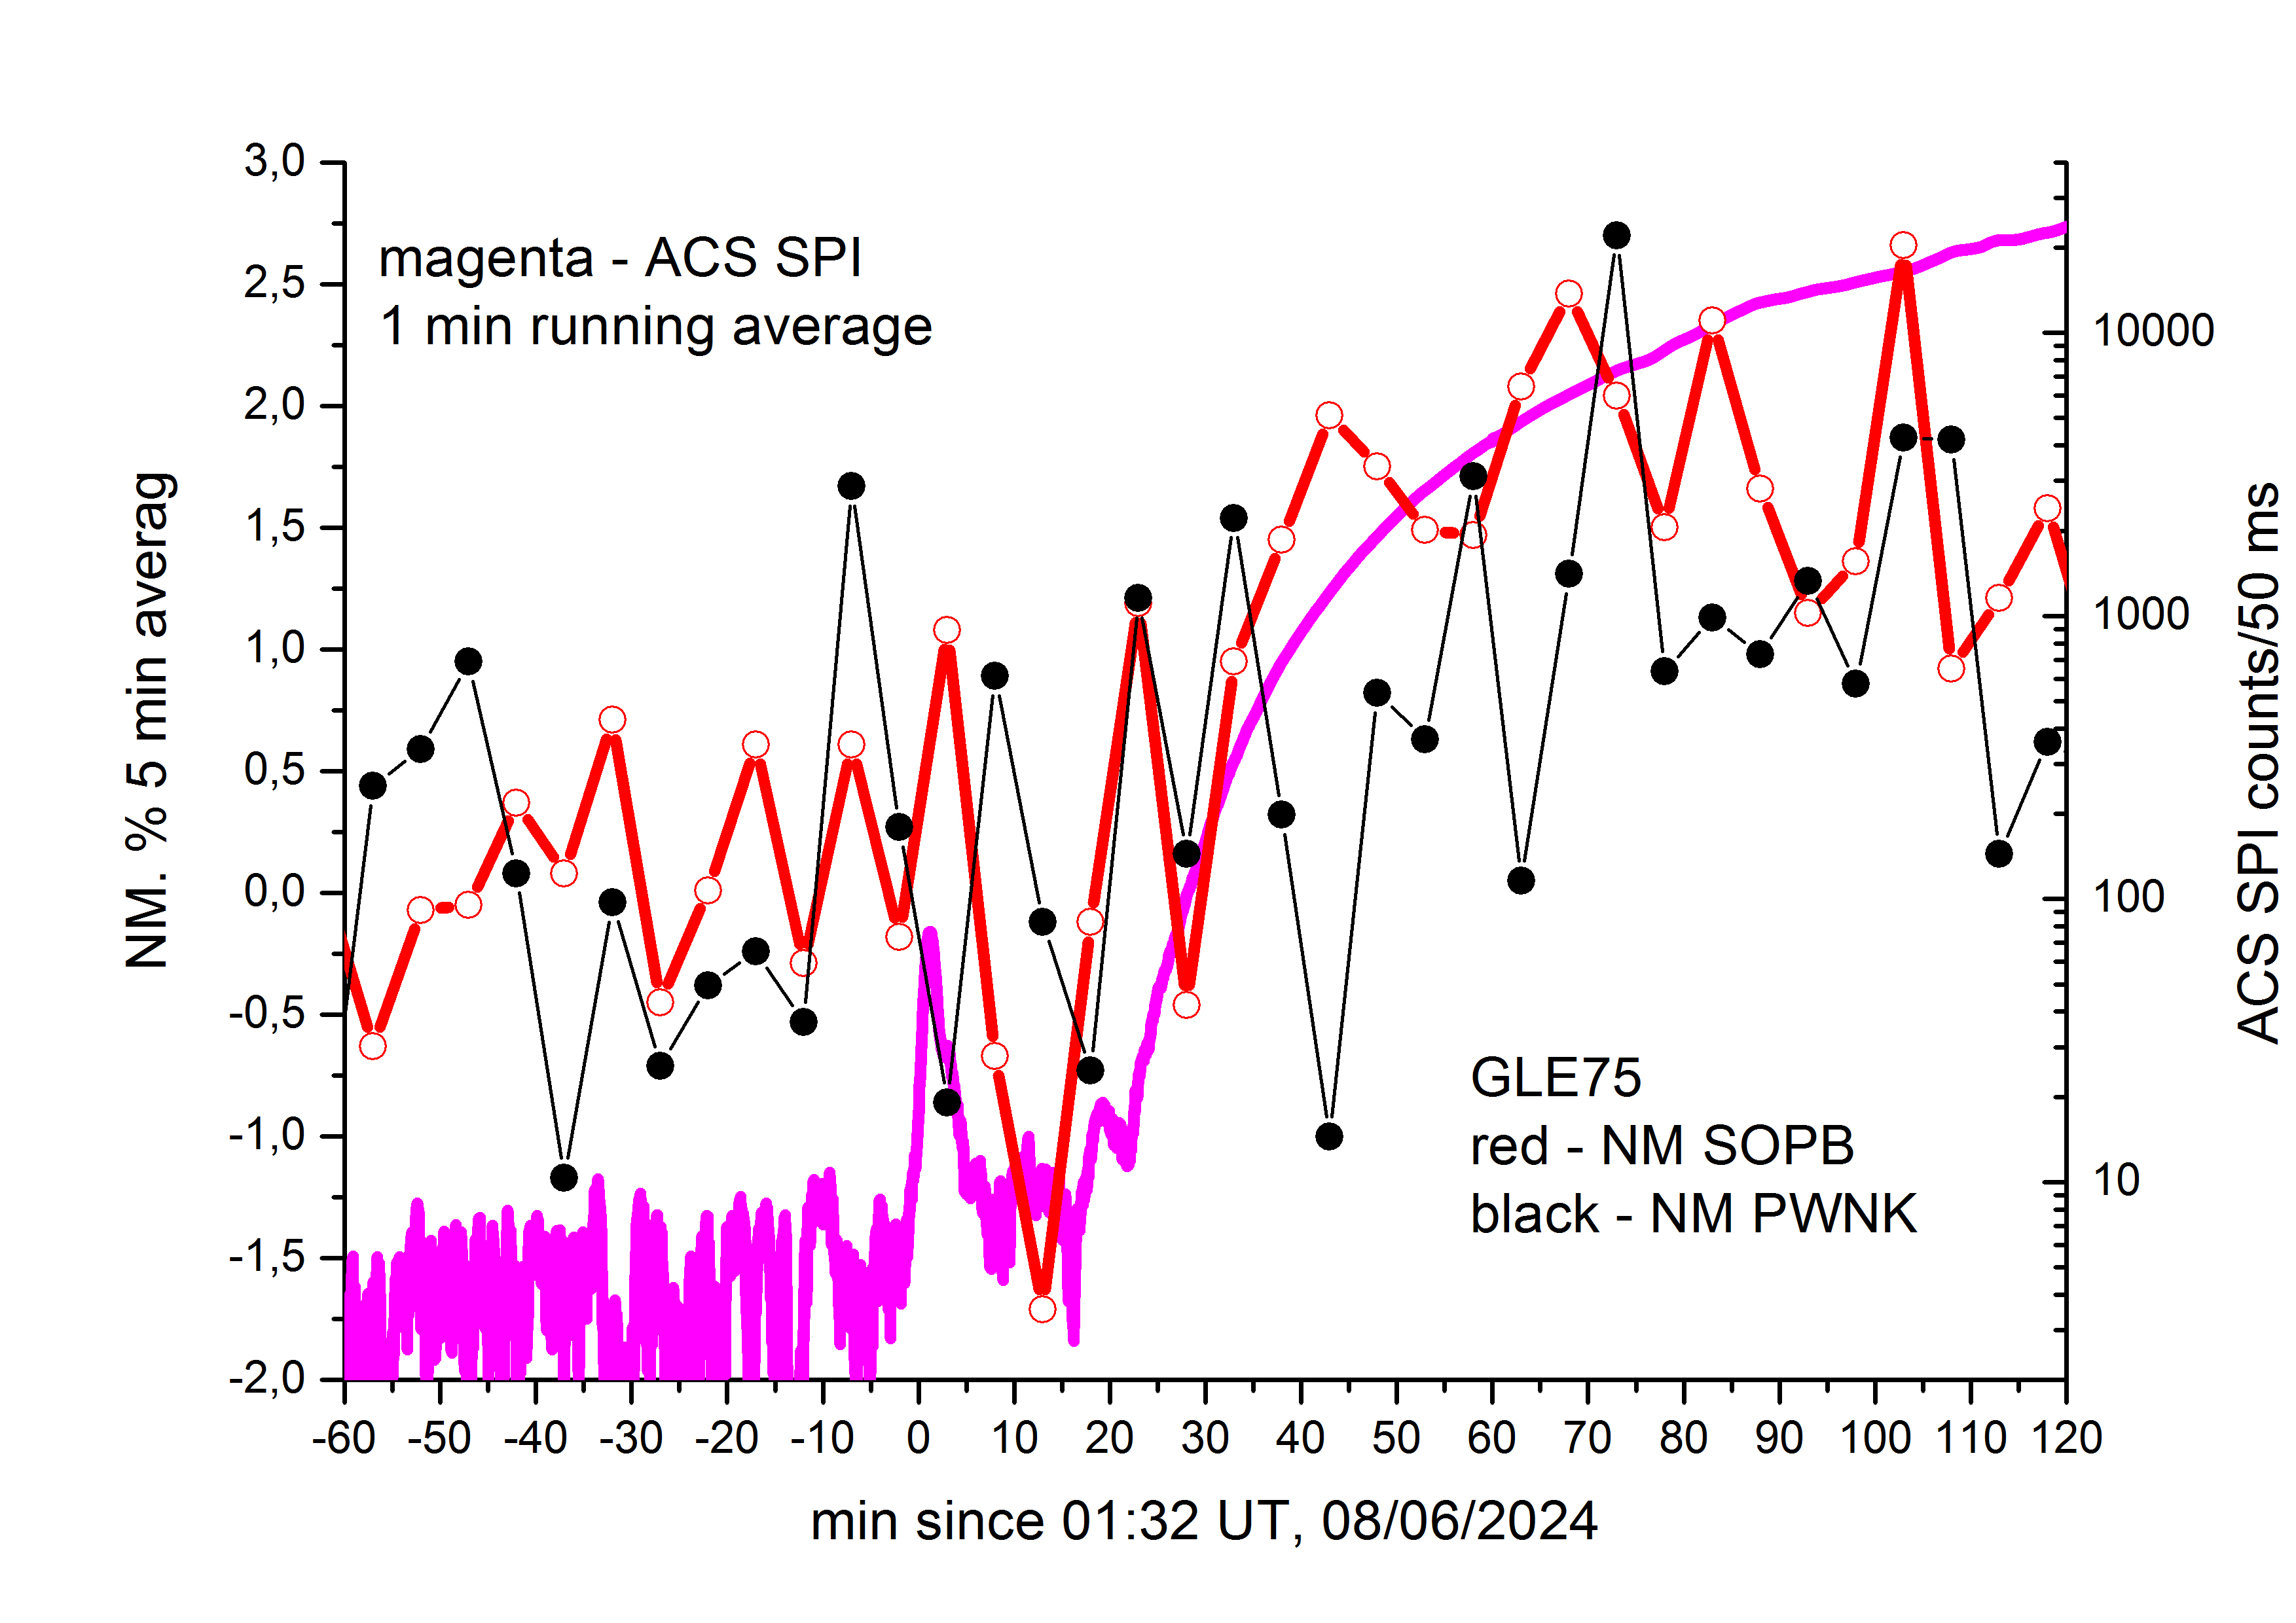
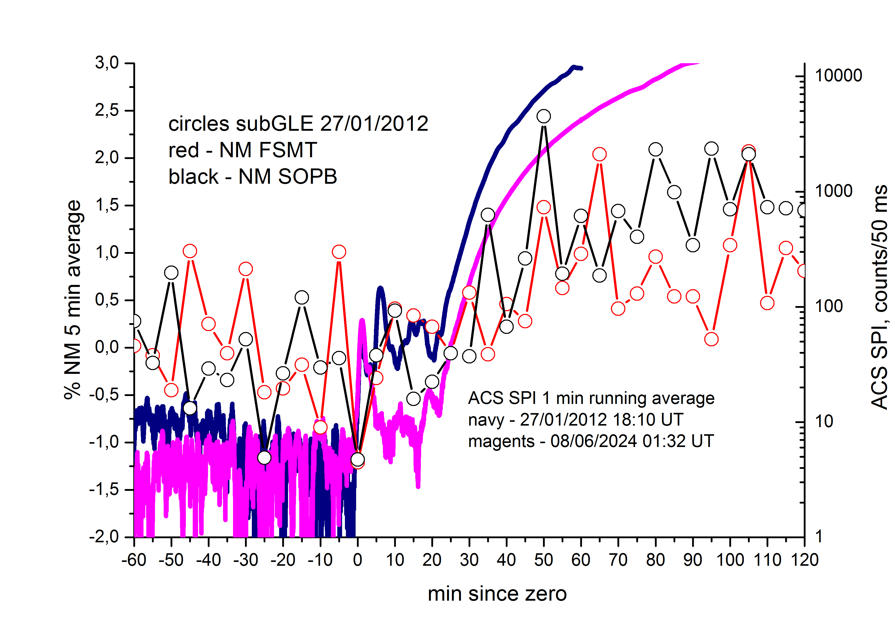
GLE75 08/06/2024
SubGLE 27/01/2012
date | NM onset, min | P, MV | β | T delay, min | τ, min | Ɛ, V/cm
08/06/2024 | +23 SOPO | 808 | 0.65 | 8.3 | 14.7 | 2.5 E-5
 | +28 PWNK | 996 | 0.73 | 6.5 | 21.5 | 2.2·E-5

Slide 11
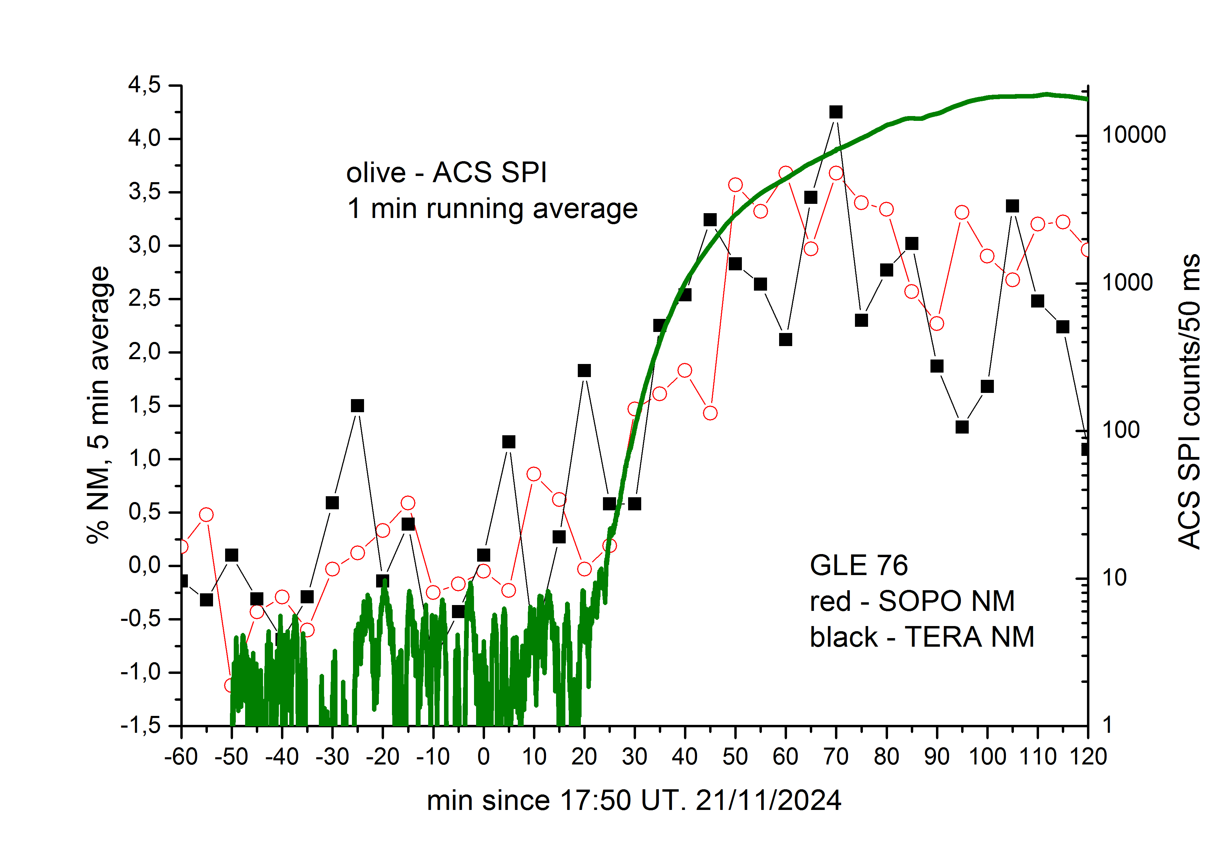
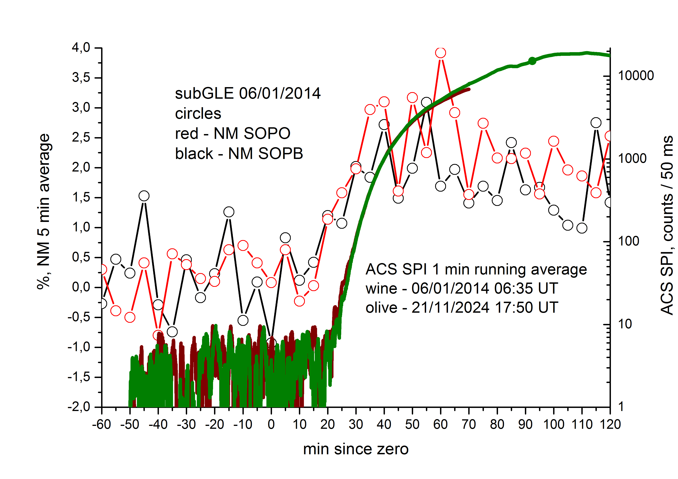
GLE76 21/11/2024
SubGLE 06/01/2014
date | NM onset, min | P, MV | β | T delay, min | τ, min | Ɛ, V/cm
21/11/2024 | +20 SOPO | 808 | 0.65 | 8.3 | 9.7 | 3.8 E-5
 | +25 TERA | 996 | 0.73 | 6.5 | 16.5 | 3.4·E-5
06/01/2014 | +20 SOPO | 808 | 0.65 | 8.3 | 9.7 | 3.8 E-5

Slide 12
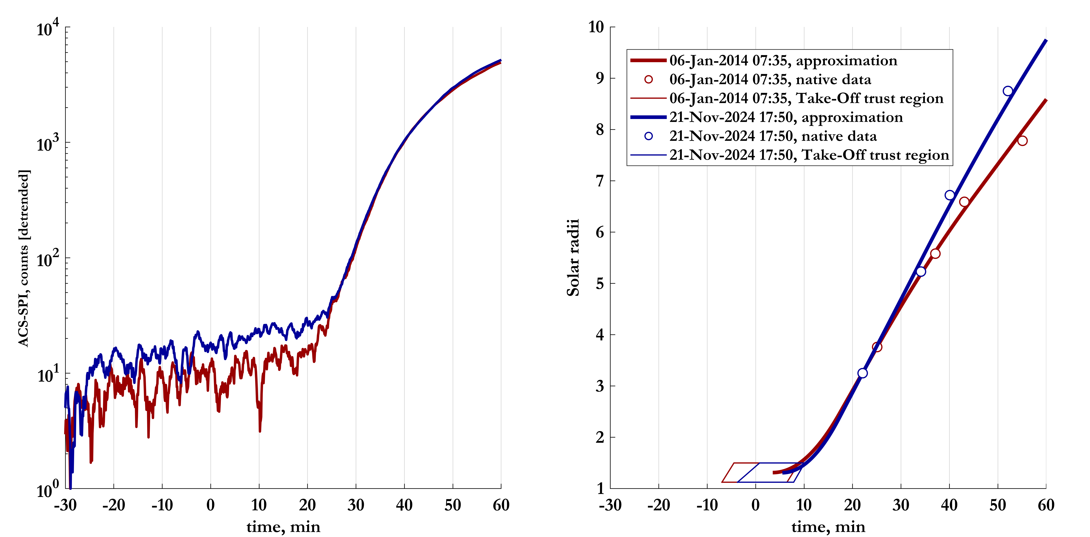
CHOICE OF ZERO TIME AND CME ACCELERATION MODEL
https://cdaw.gsfc.nasa.gov/CME_list/
2024/11/21 18:12:05 Halo 360 1436 980 1217
2014/01/06 08:00:05 Halo 360 1402 1360 1385

Slide 13
EFFECTIVE ELECTRIC FIELD
E_{p}, MeV | 50 | 100 | 300 | 500 | 1000
P_{p}, MV | 310 | 444 | 808 | 1090 | 1696
β=V/c | 0.31 | 0.43 | 0.65 | 0.76 | 0.87
Tdelay, min | 27 | 17 | 8.3 | 6.0 | 4.1
28/10/2021, 20 min | non | 5.7E-5 | 3.2E-5 | 3.8E-5 | 5.4E-5
16/07/2023, 7.5 min | non | non | non | 3.5E-5 | 2.5E-5
11/05/2024, 21 min | non | 4.3E-5 | 2.9E-5 | 3.5E-5 | 5.1E-5
08/06/2024, 21 min | non | 4.3E-5 | 2.9E-5 | 3.5E-5 | 5.1E-5
21/11/2024, 21 min | non | 4.3E-5 | 2.9E-5 | 3.5E-5 | 5.1E-5

Slide 14
CONCLUSIONS
The proton acceleration rate (effective electric field) can be estimated from a time difference between the onset of >100 keV electron emission and the SEP onset observed by ACS SPI as well as neutron monitors network in cases of GLEs.
The earlier onset of GLEs in comparison with ACS SPI proton enhancement corresponds to acceleration of observable by NMs amount of protons in the flare impulsive phase. In these cases the ACS SPI solar proton enhancement is visible later due to high solar HXR background.
The later onset of GLEs in comparison with ACS SPI proton enhancement correspond to acceleration of very small amount of protons above their atmospheric cutoff during the flare impulsive phase. The ACS SPI solar proton enhancement is visible earlier due to better sensitivity to protons of energies below the atmospheric cutoff.
The majority of solar protons responsible for the 73rd, 74th, 75th and 76th GLE events (the GLE events of the 25th cycle up to May 2025 have been accelerated in rather weak electric fields and as a result look like subGLE events of the 24th cycle.

Slide 15
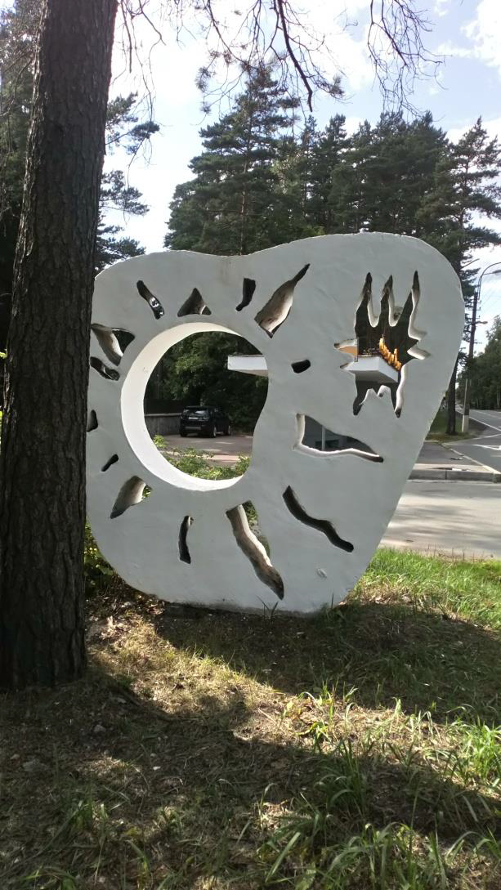
Thanks for your attention!
Struminsky Alexei,
Ozheredov Vadim, Sadovskii Andrei,
Grigorieva Irina
ISCRA, MEPHI June 24-26, 2025

