Slide 1
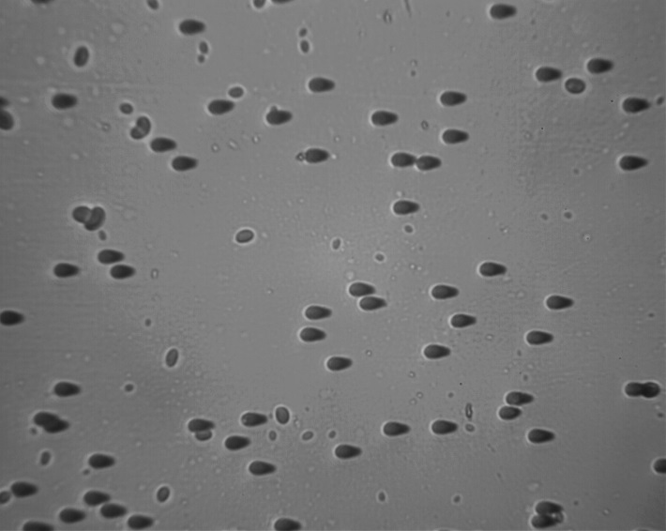

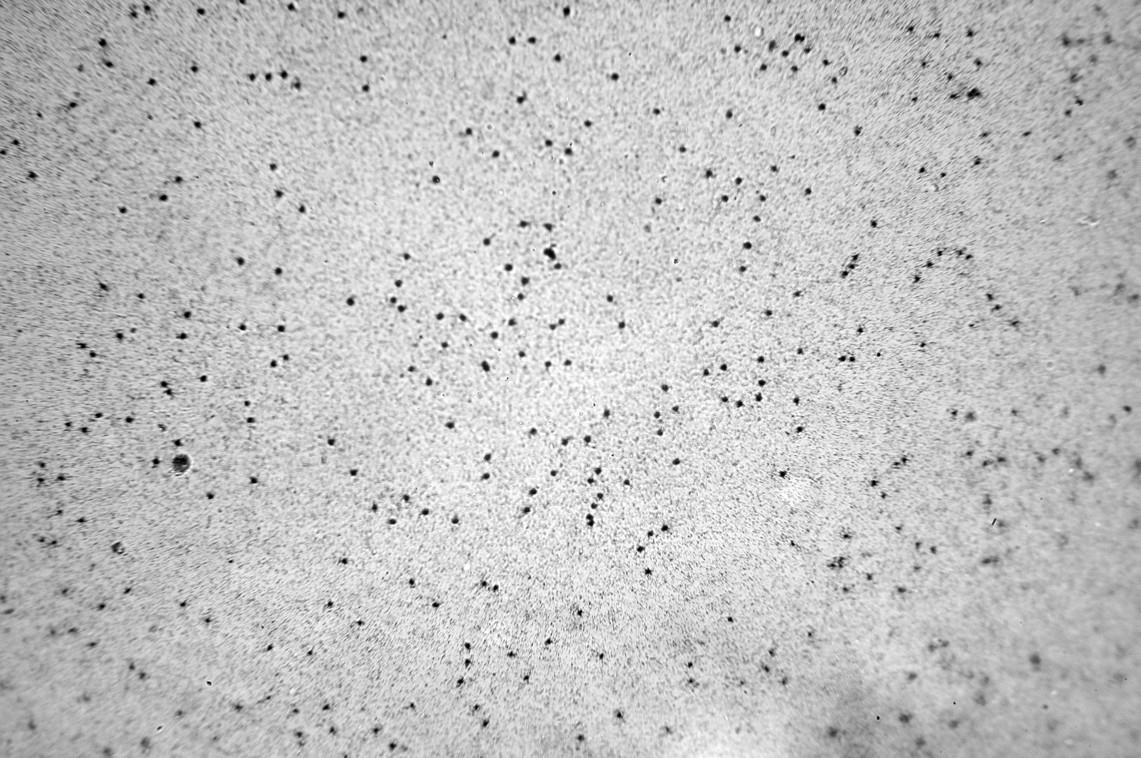
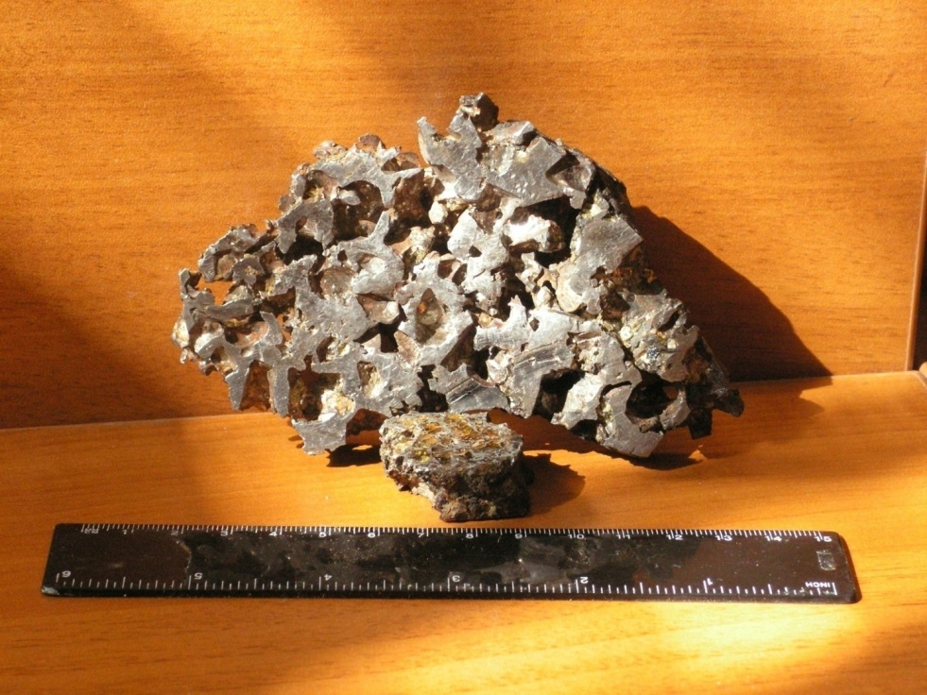
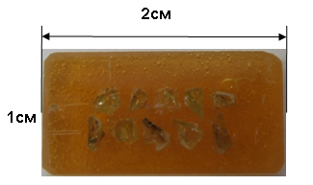
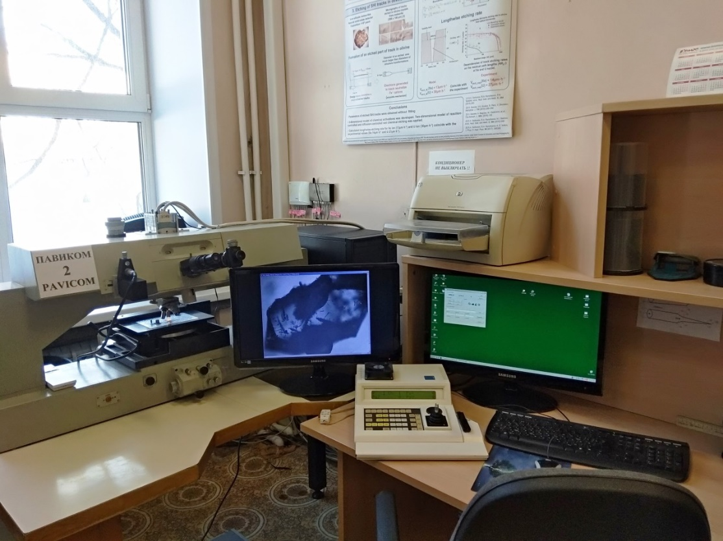
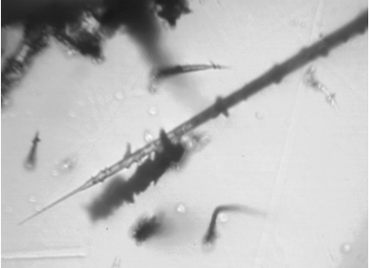
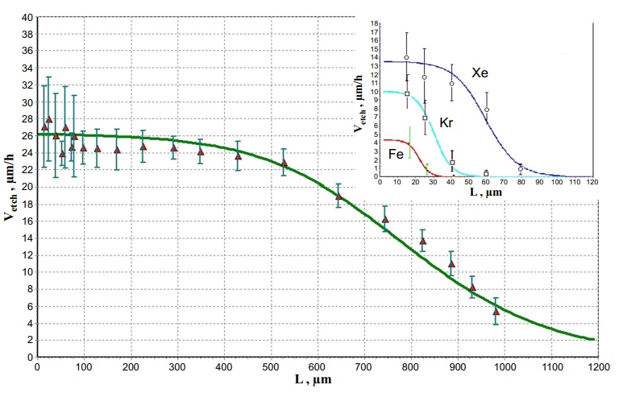
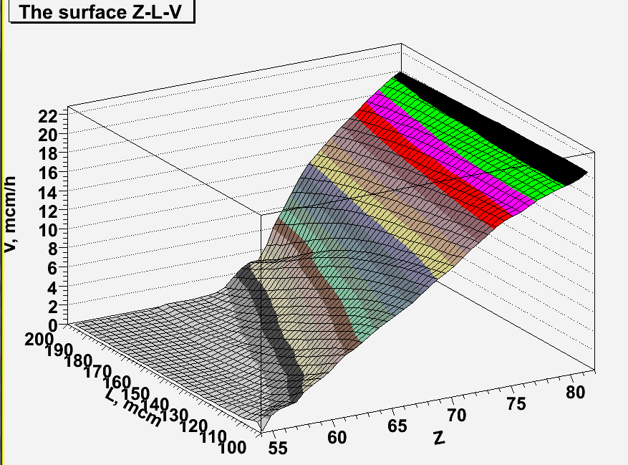
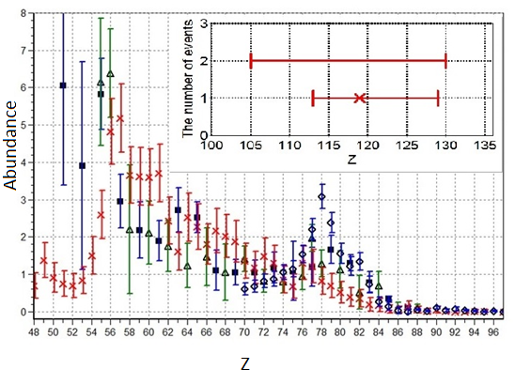
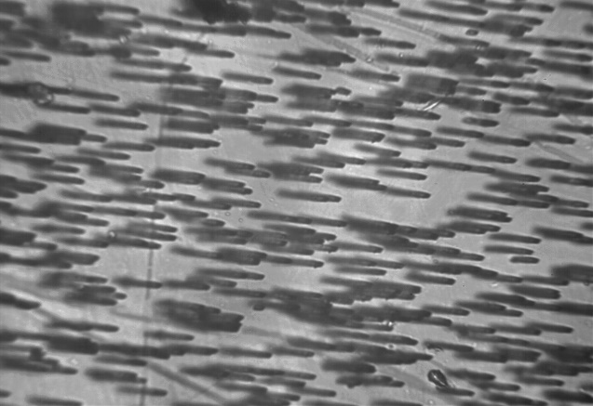
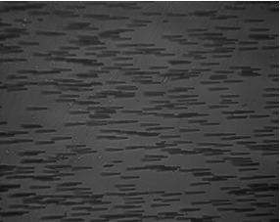
DEVELOPMENT OF THE METHOD FOR DETERMINING THE HEAVY ION CHARACTERISTICS USING SOLID-STATE DETECTORS (GLASS, MINERALS)
Starkova E.N., Polukhina N.G., Starkov N.I., Konovalova N.S.,
Okateva N.M., Chernyavskiy M.M., Shchedrina T.V.
Lebedev Physical Insitute
In the Laboratory elementary particles (LPI) during many years
solid-state detectors are used (glasses, minerals, plastics)
Glass Olivine Plastic
1. Determination of nuclear charge in olivine from meteorites
Meteorites Epoxy PAVICOM Nuclear track
The measured values are track length L and etching rate V. The connection Z(L,V) is necessary
Calibration five-parameter Surface Z(L,V) charge distribution experiments function of galactic nuclei
2. Determination of charge and energy of nuclei
This method is continuation of that used in olivine investigation : Track length, etching rate => Charge, energy Several samples were exposed with three nuclei and now they are in processing.
=> The model experiment was carried out (The SRIM calculations of L(Z,E)+our results about V(Z,E) )
Approximating function:
V=A(Z)+B(Z)*L+C(Z)*L*L
L, мм | V/100, мкм/ч | Z/100 |  | Энергия E, Мэв/1000
 |  | Реальный | Оценка | Реальная | Оценка
0,05421 | 0,2207 | 0,54 | 0,537375 | 0,09 | 0,08932
0,07664 | 0,266 | 0,54 | 0,536125 | 0,13 | 0,1286
0,03847 | 0,1522 | 0,46 | 0,45875 | 0,05 | 0,04972
0,05796 | 0,1923 | 0,46 | 0,45875 | 0,08 | 0,07884
0,05397 | 0,1416 | 0,36 | 0,360125 | 0,055 | 0,05437
0,06898 | 0,1596 | 0,36 | 0,3584375 | 0,07 | 0,06902
0,05223 | 0,09877 | 0,26 | 0,2656875 | 0,0375 | 0,03658
0,08268 | 0,1205 | 0,26 | 0,260125 | 0,055 | 0,05409
0,06476 | 0,07047 | 0,18 | 0,1816875 | 0,0275 | 0,02787
0,09656 | 0,08312 | 0,18 | 0,1804375 | 0,0375 | 0,03783
Ar Kr Xe
A(Z) B(Z)r C(Z)
3. Stability of nuclei tracks at high temperature in solid-detectors.
Such conditions arise in experiments on synthesis of superheavy elements.
Indian mica irradiated
by Bi of 670 MeV
The classification of the solid-state detector by stability to temperature
1 The tracks disappear (C48-3).
2 The tracks are kept but change their characteristics (KУ-2, KNFS-3, SELG).
3 The tracks are retained their characteristics (Indian mica).
Normal Annealing for hours
conditions at 500 degrees
The work was supported by a grant from the Russian Science Foundation 23-12-00054

