Slide 1
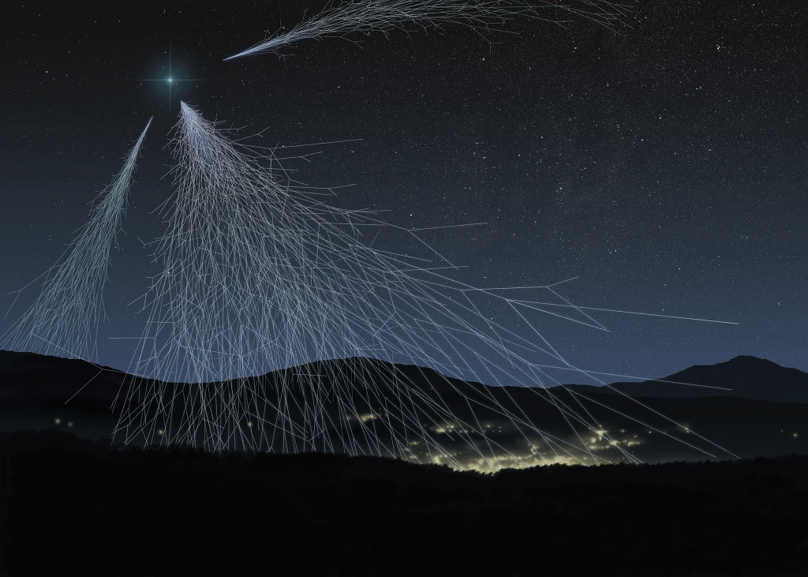

The 5ᵗ ͪ International Symposium on Cosmic Rays and Astrophysics
Investigations of extensive air showers
in the Experimental complex NEVOD
E.A. Yuzhakova, M.B. Amelchakov, A.G. Bogdanov, A. Chiavassa, S.S. Khokhlov, E.P. Khomchuk,
A.Yu. Konovalova, K.R. Nugaeva, I.A. Shulzhenko, S.Yu. Zhezhera
June 25, 2025

Slide 2
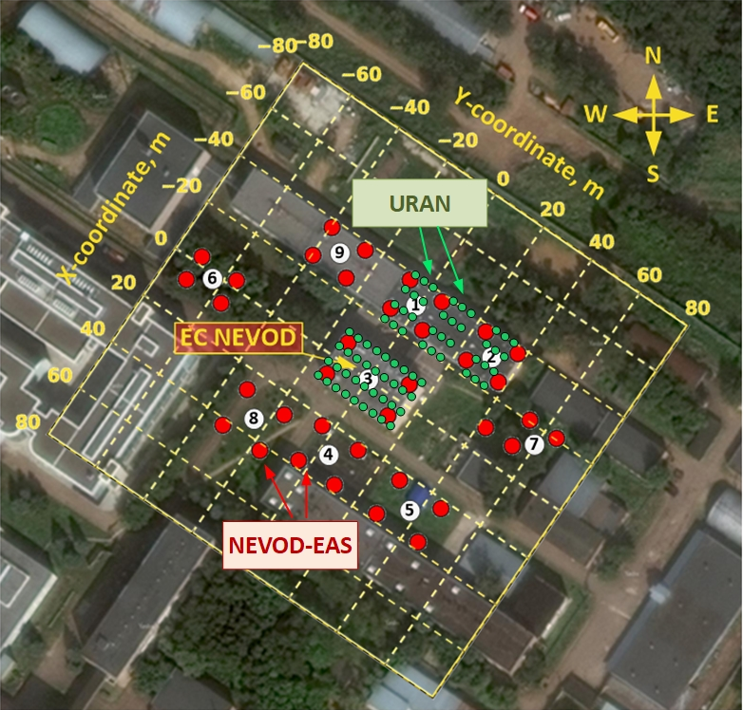
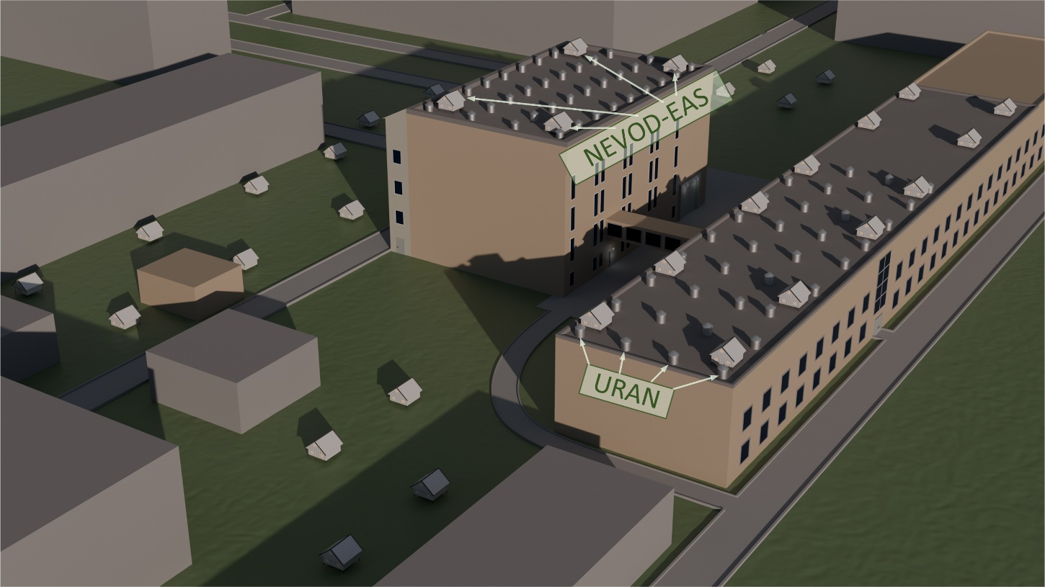
Arrays for EAS detection
NEVOD-EAS: 9 clusters, 36 detector stations, area of 10⁴ m²
URAN: 6 clusters, 72 en-detectors, area of 10³ m²
2

Slide 3
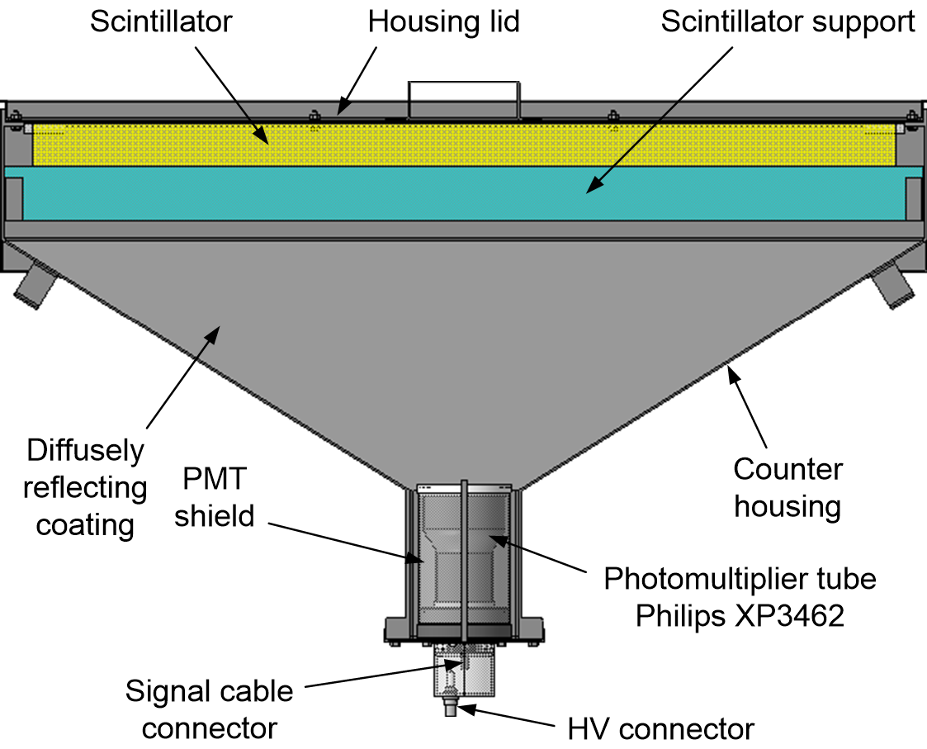
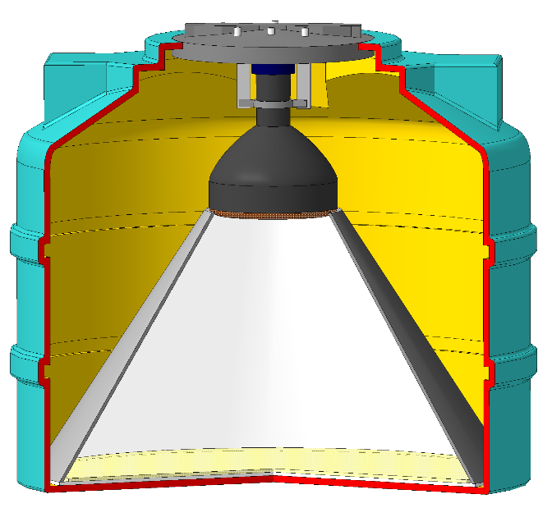
Detecting elements
NEVOD-EAS
URAN
Electron-photon component of showers
Hadronic + charged components
Scintillator ZnS(Ag) + B₂O₃
Plastic scintillator NE102A
¹⁰В + n → ⁷Li* + α + 2.31 MeV (94%)
⁷Li* → ⁷Li + γ + 482 keV
3

Slide 4
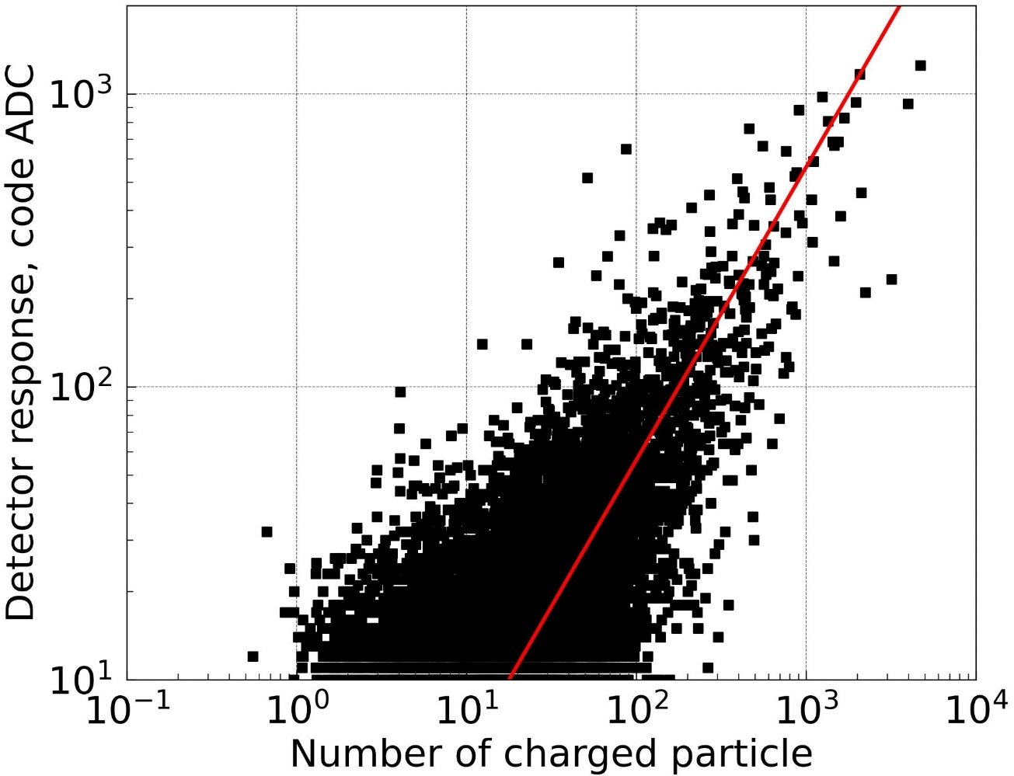
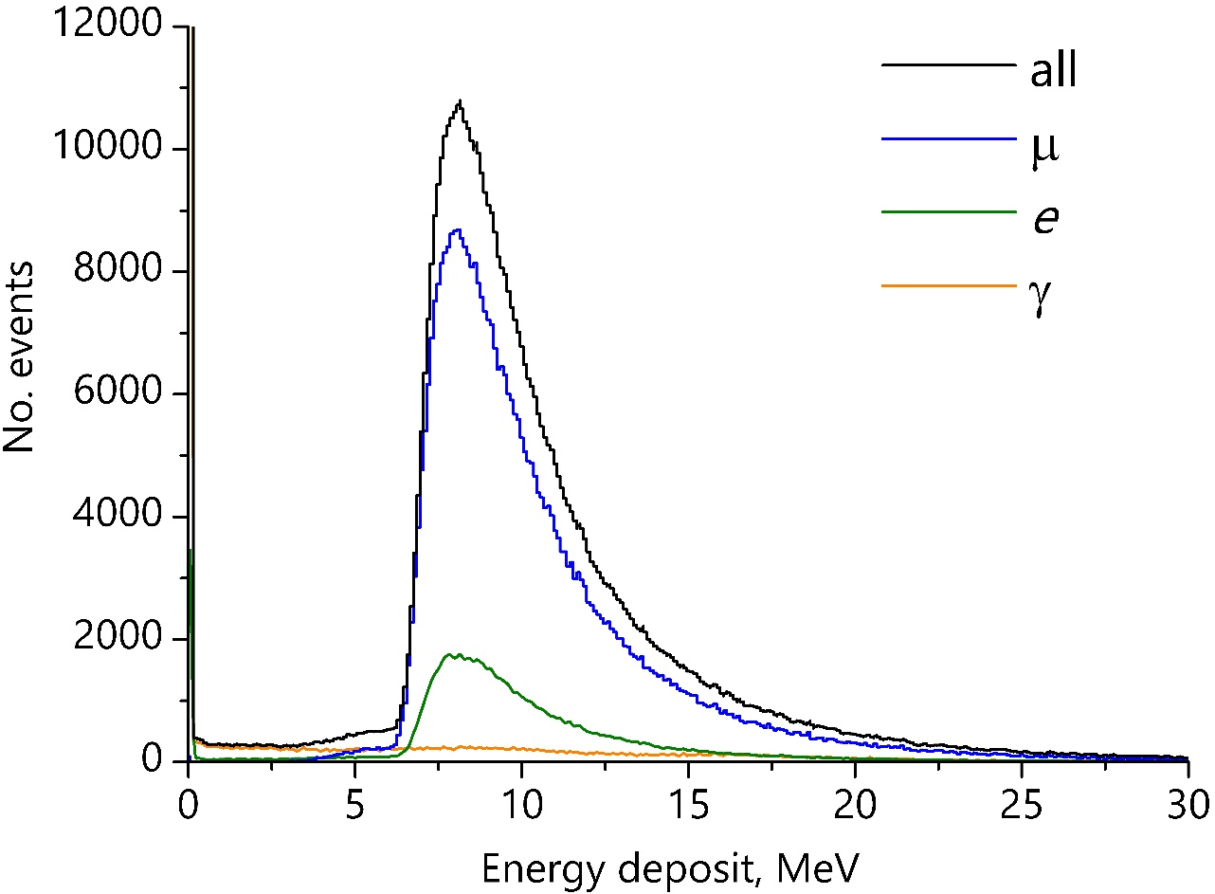
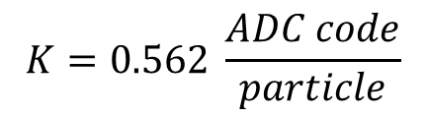
Calibration
NEVOD-EAS (CORSIKA + Geant4):
The muon peak in the experiment (13 pC) corresponds to E_{peak} = 8.15 MeV
URAN (joint events with the NEVOD-EAS):
Calibration dependence for each detector
$$K=0.562 \frac{ADC code}{particle}$$
Distribution by the energy deposit of single particles in the scintillator
# 16 – Svetlana Zhezhera
4

Slide 5
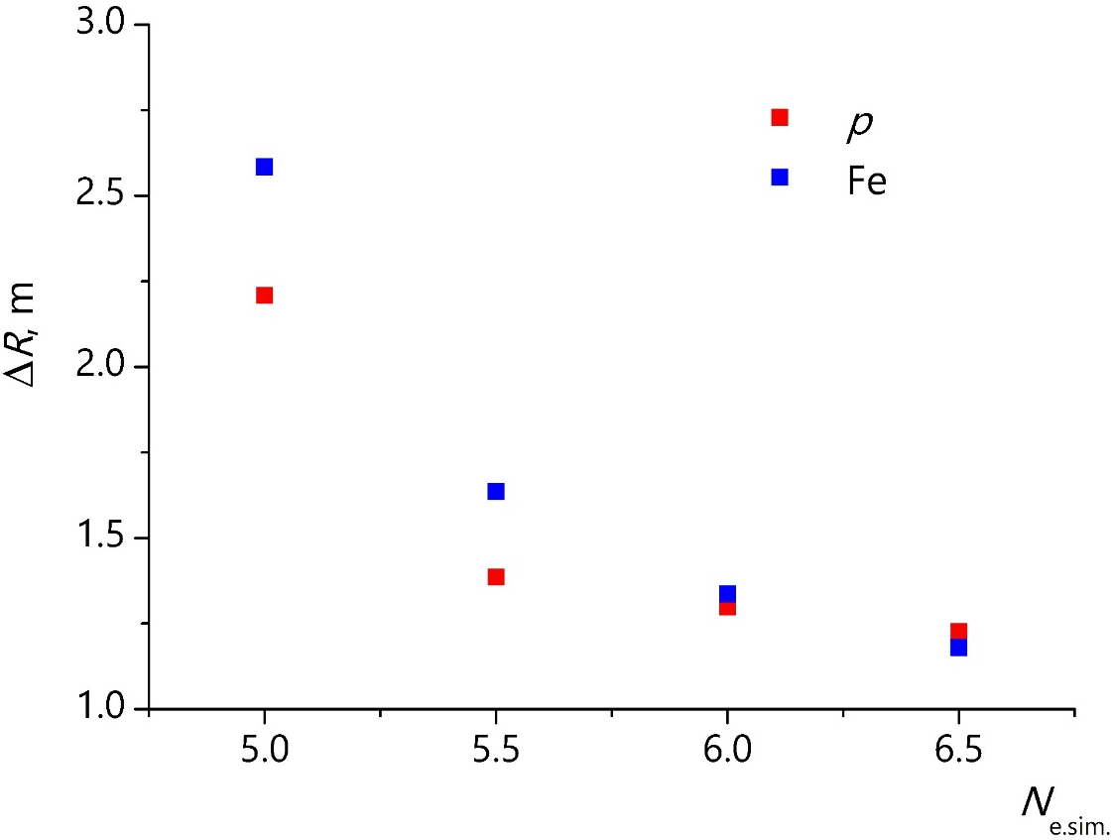
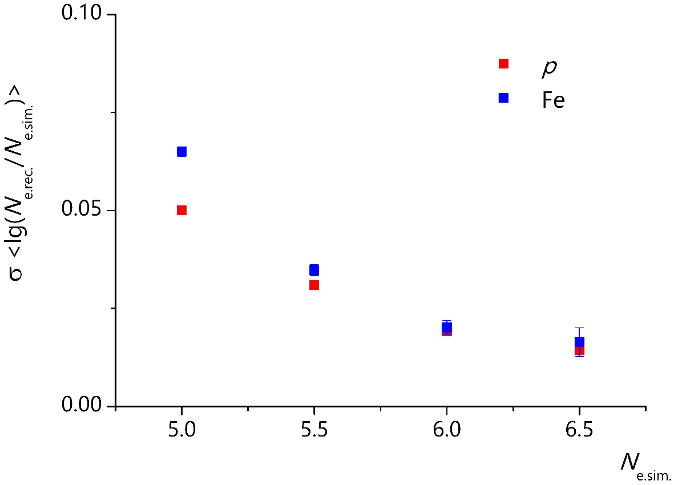
Simulation
CORSIKA (QGSJET-II-04 + FLUKA 2020.0.3); p, Fe : E =10¹⁴ – 10¹⁷ eV, (γ + 1) = 2.7 (3 million events).
Direction reconstruction accuracy: p ~ 2.6°, Fe ~ 2.2°
Axis reconstruction accuracy
Size reconstruction accuracy
∆R (p) ⁓ 2.2 m
∆R (Fe) ⁓ 2.6 m
∆N_{e} (p) ⁓ 0.05
∆N_{e} (Fe) ⁓ 0.06
For lgN_{e(sim.)} = 5±0.1:
For lgN_{e(sim.)} = 5±0.1 :
5

Slide 6
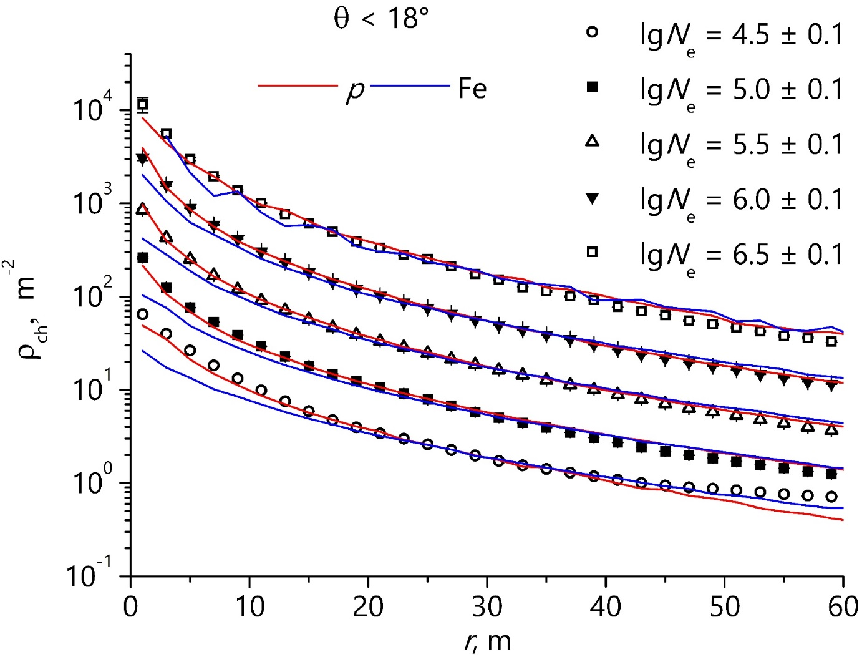
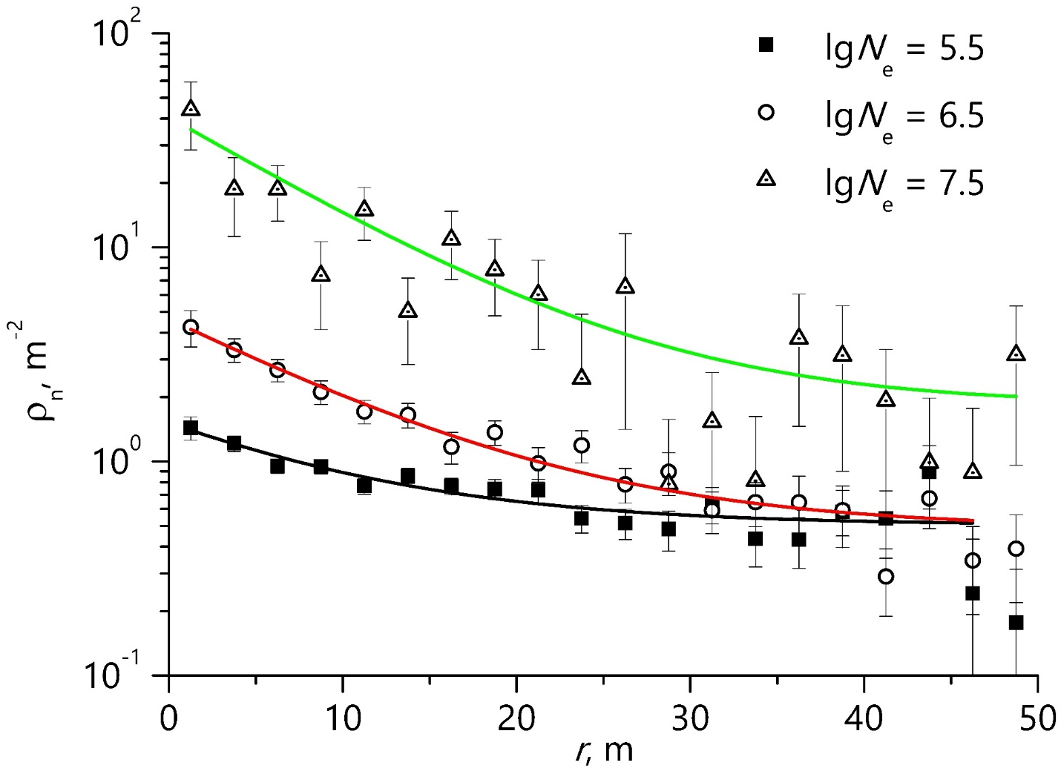
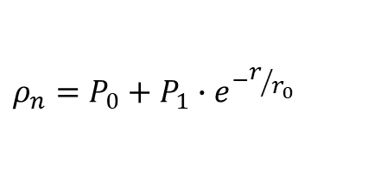
Average LDF
LDF of the electron-photon component
NEVOD-EAS
LDF of thermal neutrons
URAN
$$ρ_{n}=P_{0}+P_{1}∙e^{−r/{r_{0}}}$$
r₀ ⁓ 10.0 ± 0.4 m
6

Slide 7
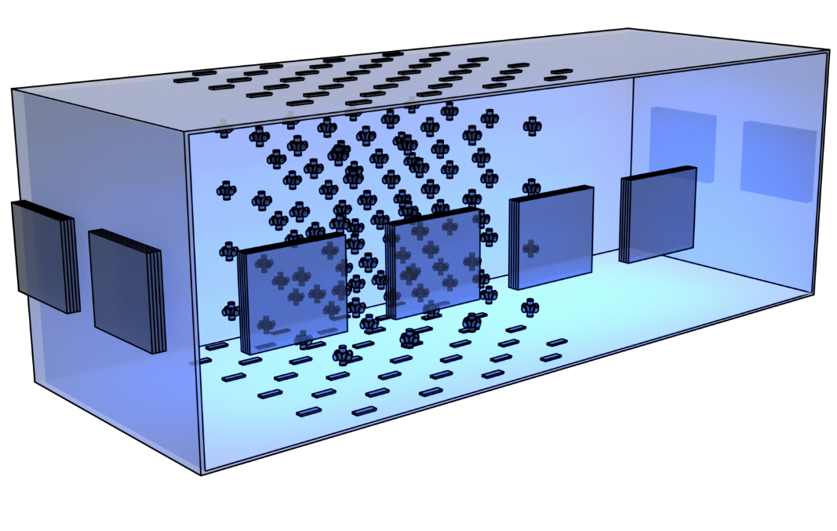
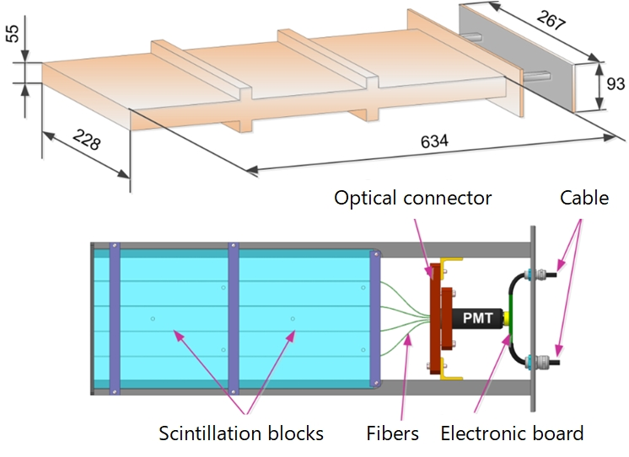
Calibration Telescopes System
Calibration Telescopes System
80 scintillation blocks:
40 × 20 × 2 cm³
Cherenkov water detector NEVOD
Coordinate detector DECOR
7

Slide 8
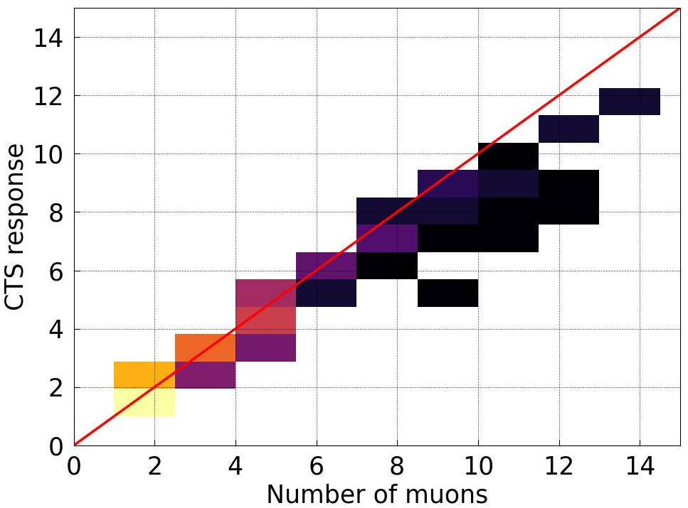
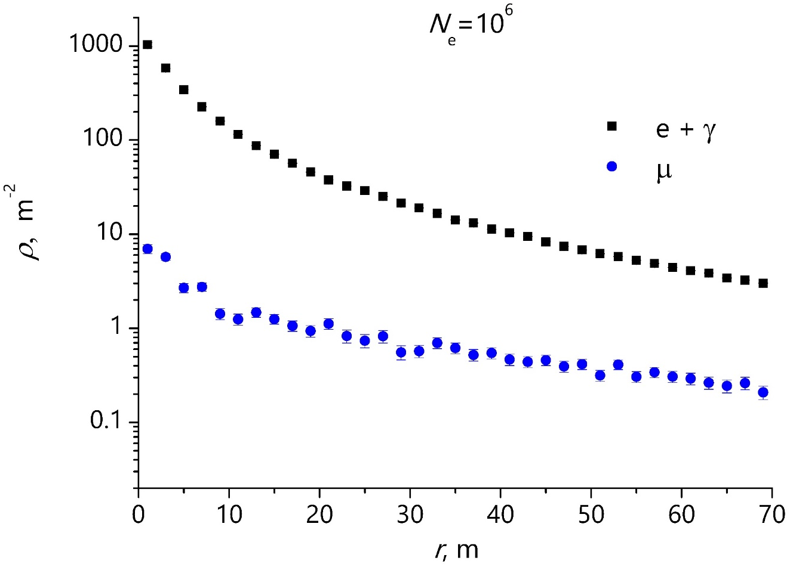
LDF of muons
Correlation of the number of muons passed through the detectors of the CTS bottom plane and the number of triggered detectors of the bottom plane
Muon LDF according to the CTS data
preliminary
8

Slide 9
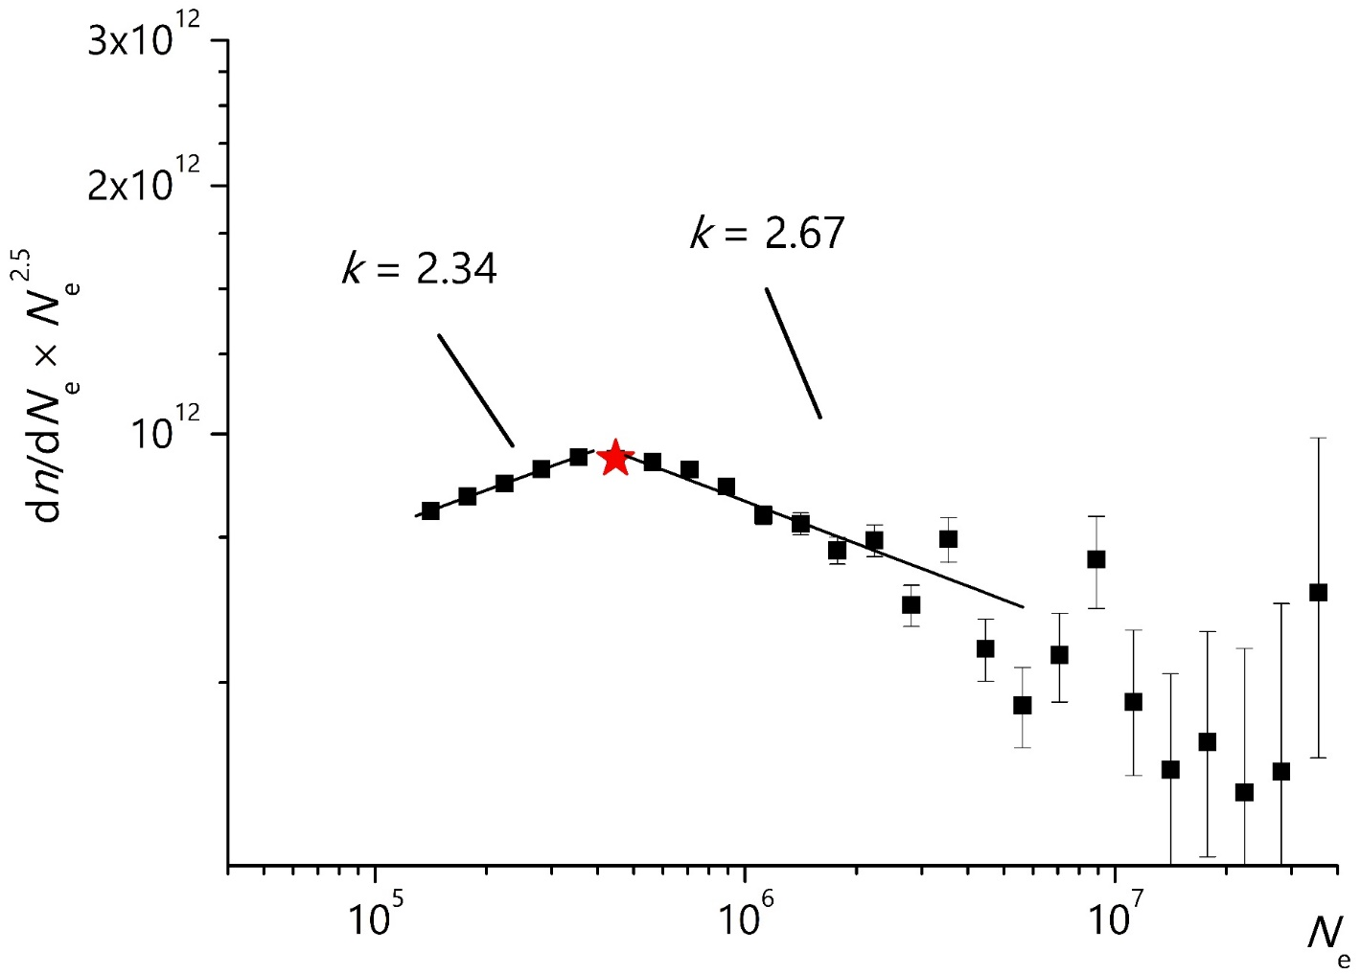
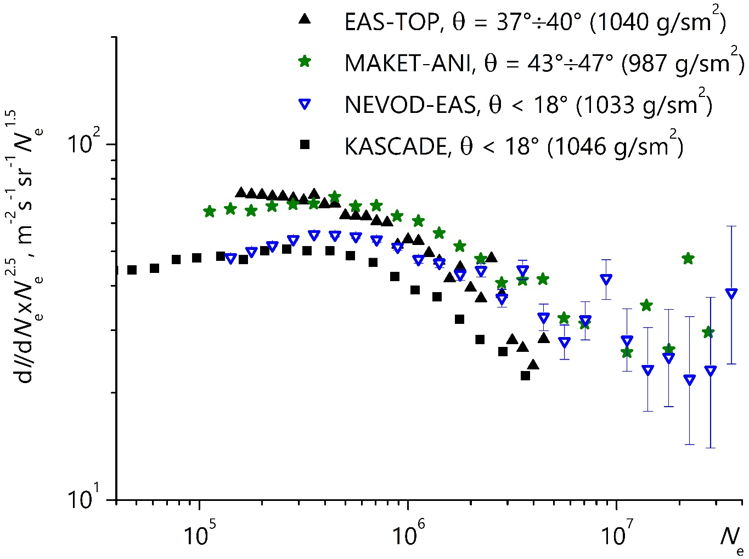
Shower size spectrum
NEVOD-EAS
lgN_{ek} = 5.65
∆k = 0.33
EAS-TOP
(M. Aglietta, 1999):
lgN_{ek} = 5.63 ± 0.07
∆k = 0.25 ± 0.07
MAKET-ANI
(A.Chilingarian, 2007):
lgN_{ek} = 5.84 ± 0.07
∆k = 0.48 ± 0.04
KASCADE
(K.-H. Kampert, 1998):
lgN_{ek} = 5.70 ± 0.07
9

Slide 10
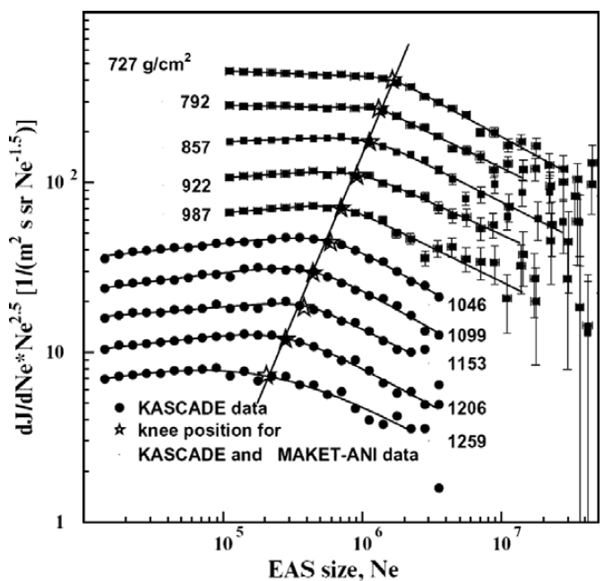
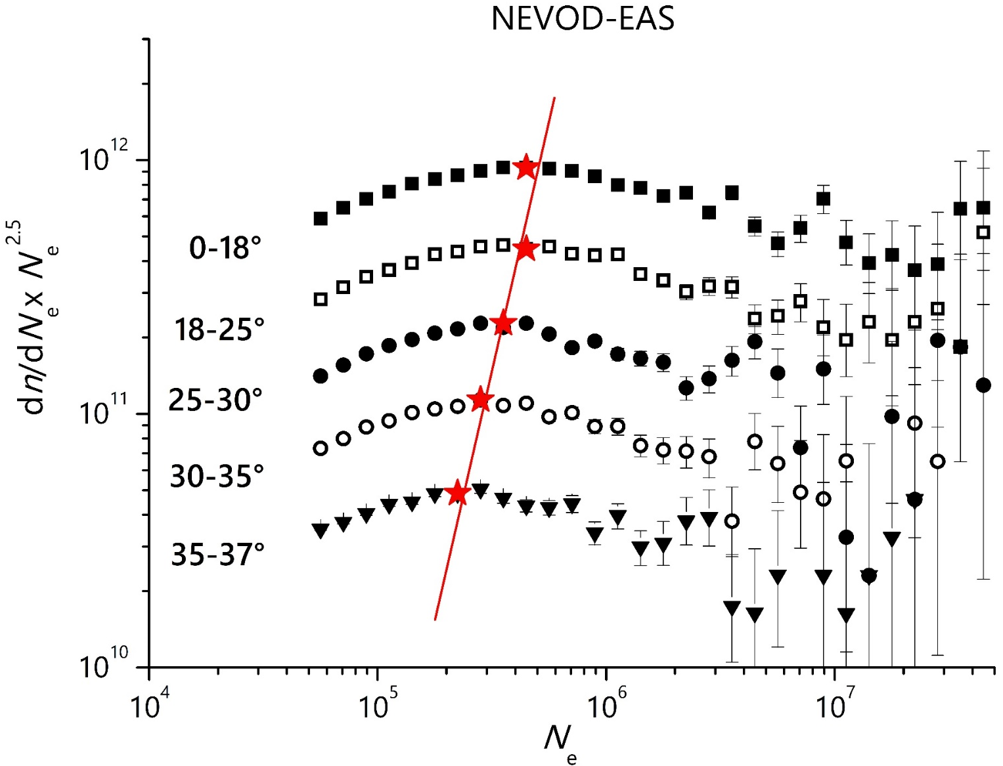
Shower size spectrum
The position of the knee is changing :
from N_{e} (35°÷37°) = 2.2×10⁵ to N_{e} (0°÷18°) = 4.5×10⁵.
A. Chilingarian et al. Astroparticle Physics 28 (2007) 58–71.
10

Slide 11
Preliminary energy spectrum according to
the NEVOD-EAS array data
Calculations are performed under the assumption of the proton composition of cosmic rays
The range of approximation:
Before the knee
E₀ = (0.89÷2.20)×10¹⁵ eV
After the knee
E₀ = (0.28÷1.80)×10¹⁶ eV
The knee position:
E₀ = 2.8×10¹⁵ eV, ∆γ =0.39
11

Slide 12
Conclusions
The NEVOD-EAS array allow reconstruction of the shower parameters with accuracy of 2.6° for the direction, 2.2 m for the axis and 0.05 for the size.
According to the NEVOD-EAS data, the knee in the energy spectrum is (preliminary) observed in the region of E₀= 2.8 × 10¹⁵ eV. The spectrum slope changes by 0.39.
The NEVOD-EAS array allows cross-calibration of other installations detecting different EAS components.
Our arrays allow analyzing three EAS components at once.
12

Slide 13
Thanks for your attention!

Slide 14
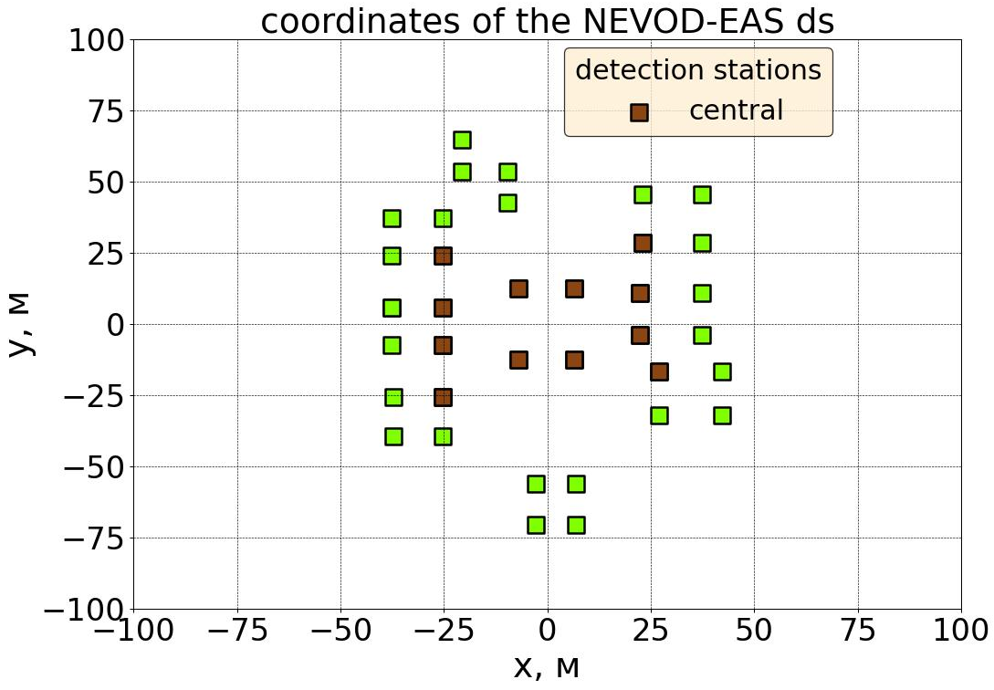
Selection conditions for the NEVOD-EAS array
Coordinates of the NEVOD-EAS detector stations
Maximum energy deposit in the central detector stations;
≥ 5 clusters triggered simultaneously;
Total energy deposit > 1 GeV;
Zenith angle < 18°.
Detector stations
central
peripheral
Y, m
X, m
5

Slide 15
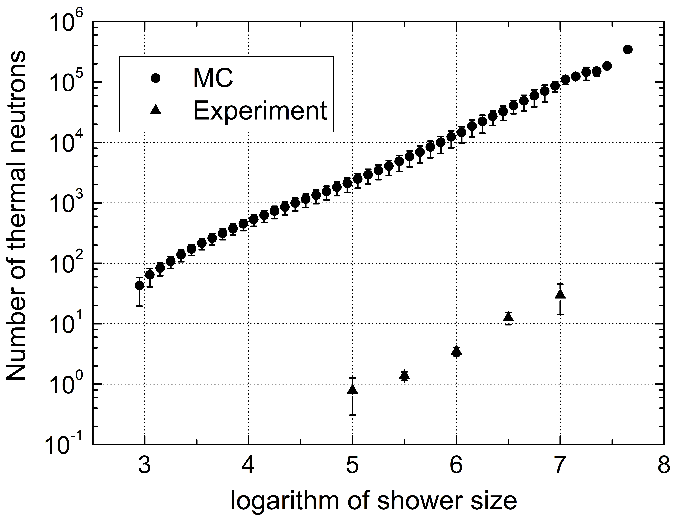
Thermal neutrons in EAS
Dependence of the number of hadrons on the shower size
α = 0.85 ± 0.02
α = 0.89 ± 0.09
11

